Slide 1

High Resolution γ-ray Spectroscopy in Exotic Nuclei: AGATA@GANIL
GRC - 2019

Slide 2
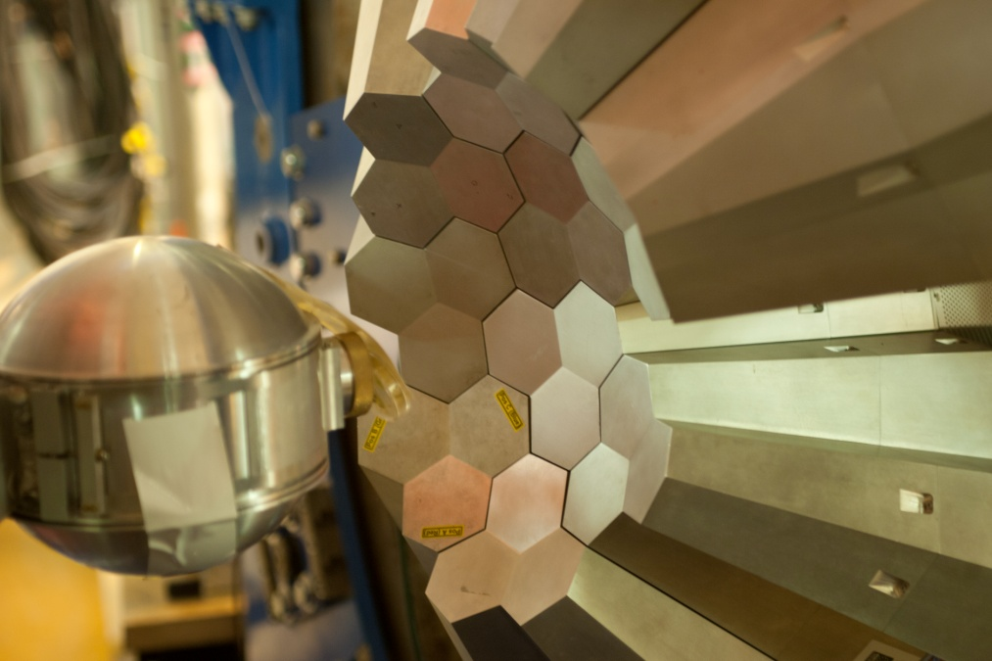
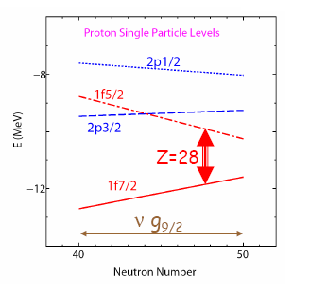
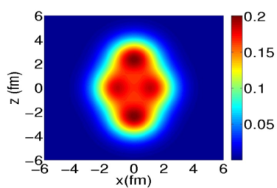
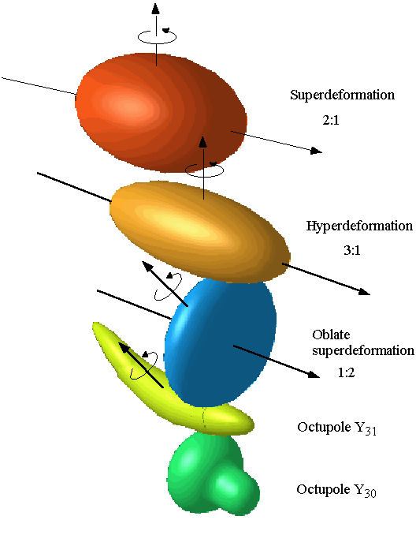
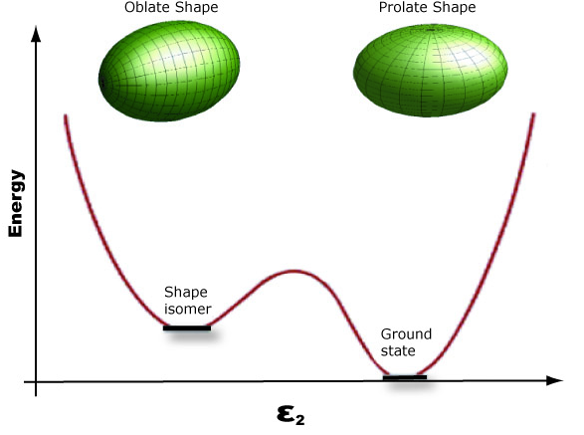
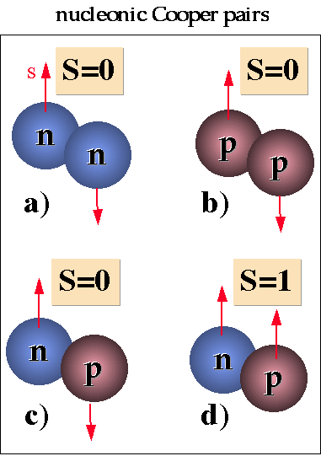
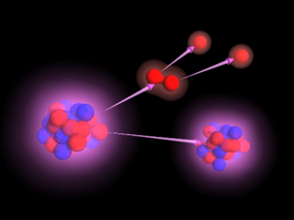

Shell evolution
far from stability
Isospin symmetry
breaking
Three-body forces
High-resolution gamma-ray spectroscopy is an optimum tool to study detailed nuclear structure properties and investigate how they emerge from fundamental interactions.
Nuclear shapes
and coexistence
clusterization
Measuring discrete γ-ray transitions from 20 keV to 20 MeV with 1‰ energy resolution and 30-40% P/T
p-n pairing
Super heavy elements
Nuclear Astrophysics
Coupling to the continuum

Slide 3

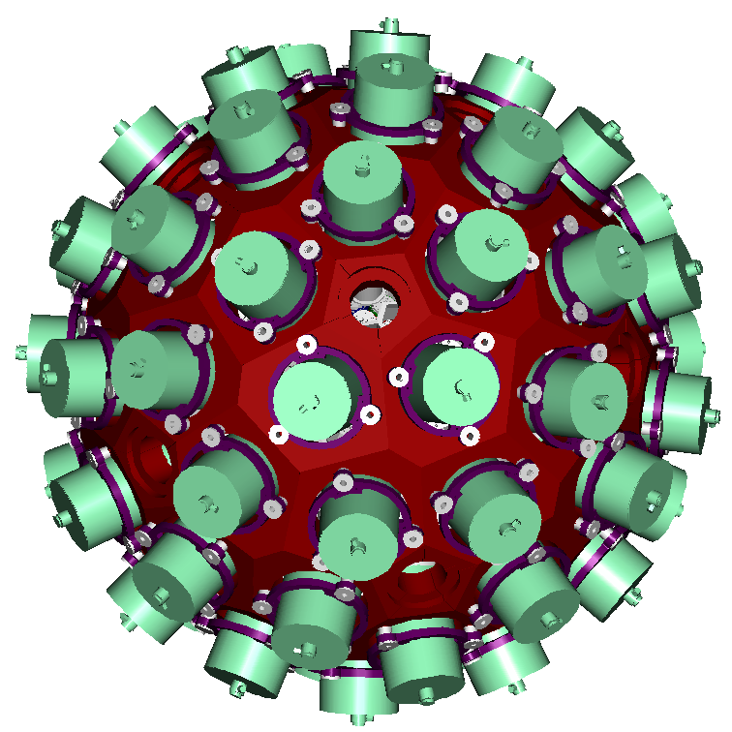
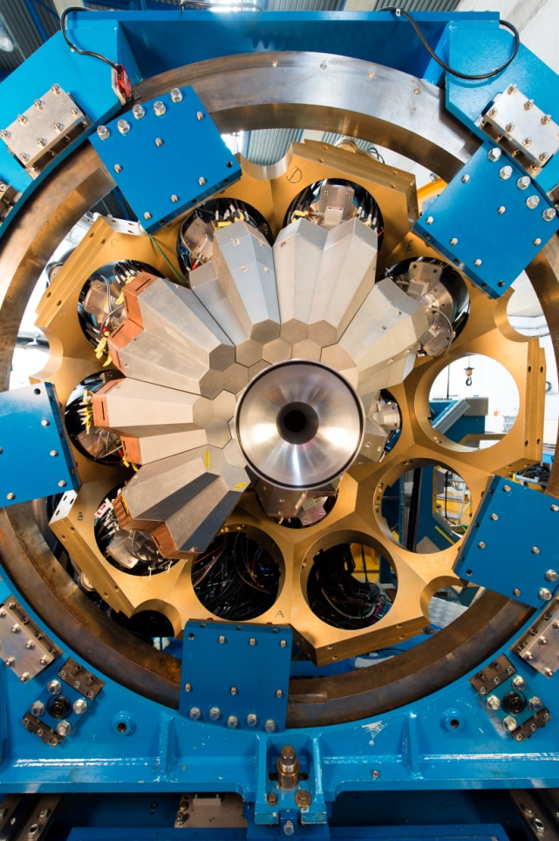
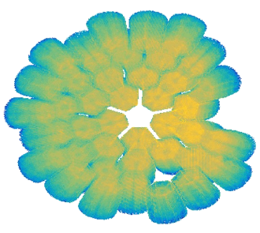













The AGATA project
180 (60 triple-clusters) 36-fold segmented crystals
Amount of germanium: 362 kg
Solid angle coverage: 82 %
Singles rate >50 kHz
Efficiency: 43% (M_{γ}=1) , 28% (M _{γ} =30)
Peak/Total: 58% (M _{γ} =1), 49% (M _{γ} =30)
Angular Resolution: ~1º
41 detectors on-line in 2019
The project timeline is to complete the 4π by 2030
Combination of:
segmented detector
pulse-shape analysis
tracking the γ rays
digital electronics
AGATA@GANIL
S. Akkoyun et al., Nucl. Instrum. Methods Phys. Res., Sect. A 668, 26 (2012).
E. Clément et al., Nucl. Instrum. Methods Phys. Res., Sect. A 855, 1 (2017).

Slide 4

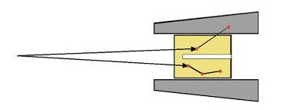
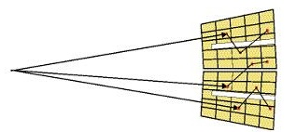
Tracking Arrays
Primarily design to maximize Efficiency and P/T of the high resolution γ-ray detector arrays
Maximizing the active solid
angle without loosing
signal/noise ratio
Improving the Energy resolution
on all experimental conditions,
even at high emission velocities
Maximizing the performance of the
detectors, even in conditions of
heavy duty with radiation damage
Compton Suppressed
Ω ~ 40%
ε_{ph}∼ 10%
solid angle taken by
the AC shields
large opening angle ➔
poor energy resolution
Tracking array
~ 80%
ε_{ph}∼ 40%
Large solid angle
Position sensitive mode using PSA
Large P/T using tracking for γ-ray reconstruction

Slide 5
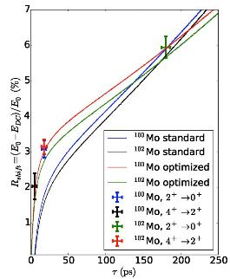
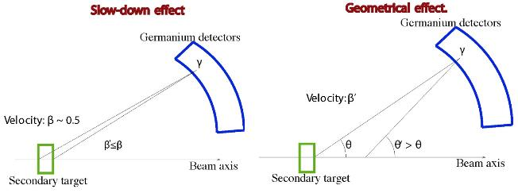
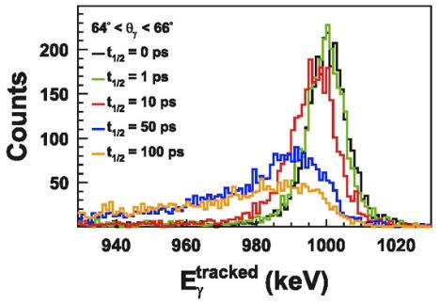
Tracking Arrays
Improved Doppler Correction capabilities
In-Flight Geometrical Line-Shape
Energy centroid shift %
v × T_{1/2}
MC simulations
β=0.5
D.Ralet et al. PRC 95 (2017) 034320
New “DSAM-like” technique based on the position sensitivity and the Doppler correction.
Possible to measure down to 1 to
10 ps lifetimes with relativistic RIBs.
C. Domingo-Pardo et al, NIMA 694 (2012) 297

Slide 6

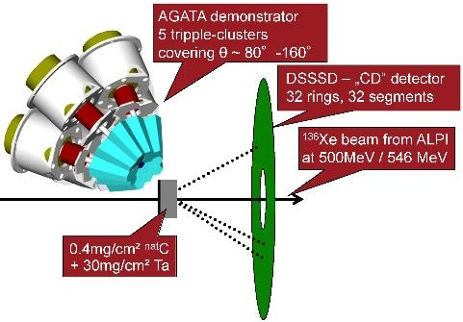
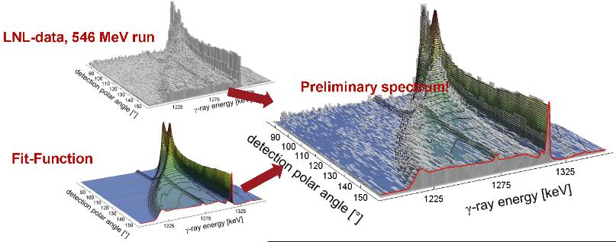
Continuous-Angle DSAM
Firstly used with the AGATA –Demonstrator at LNL
The continuous-angle DSAM represents an advancement of the ‘‘conventional’’ DSAM.
It extends the γ-ray lineshapes analysis as a function of γ -ray energy to a lineshape analysis as a function of both γ-ray energy and polar angle of the γ-ray detection.
Ch. Stahl et al, PRC 92 (2015) 044324
Ch. Stahl et al, CPC 214 (2017) 174
2D-data fitted with
2D fit-function
¹³⁶Xe
Coulex

Slide 7
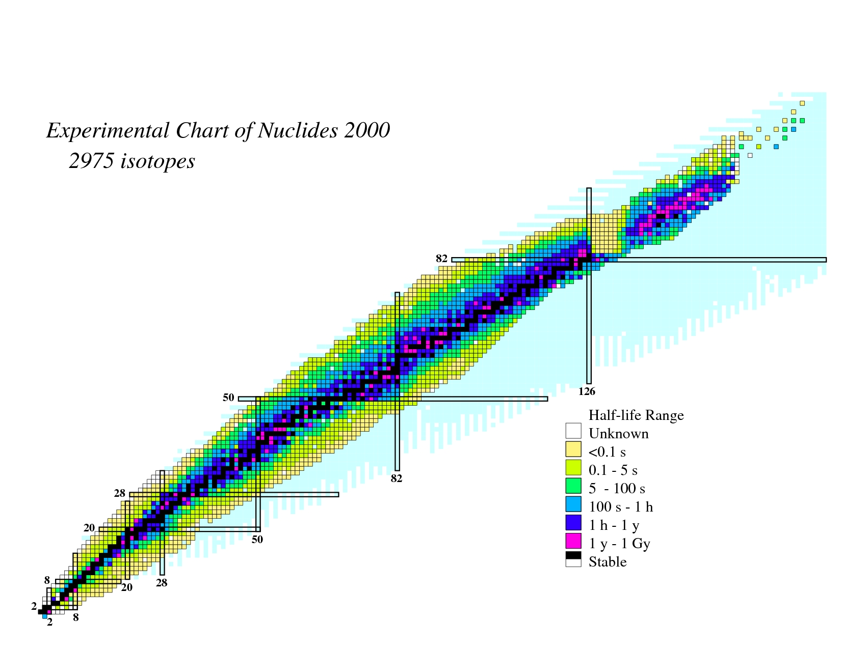
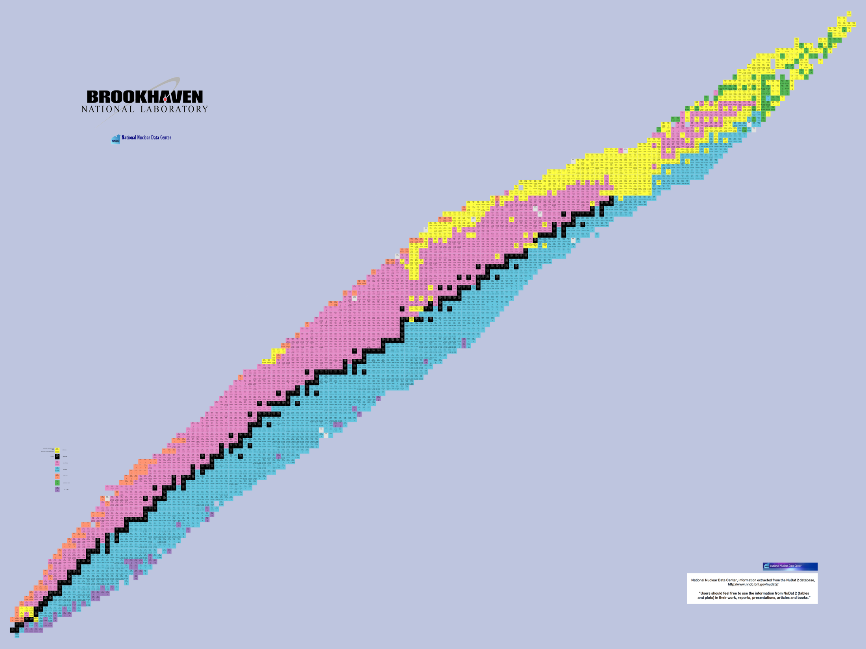
Experiments performed in 2015-2019 at GANIL with AGATA
ANSARI
24 experiments
32 weeks of beam on target
0.5 Po of data
Exotic nuclei populated by heavy-ions collisions at the Coulomb barrier
Search for Double Gamma decay in ¹³⁷Cs source
Reaction mechanism : Fission of Light Hg
Octupole – Quadrupole correlation in ¹¹²Xe
²⁰⁸Pb
Studies of excited states in ^{102,103}Sn
Octupole correlation in ²⁰⁷Pb
Evolution of collectivity around N=50: lifetime measurements ^{104,106}Sn
Exploration of alpha-cluster : the unique case of ²¹²Po (²⁰⁸Pb + α)
Evolution of collectivity around N=50: lifetime measurements ⁹⁴Ru
Shape transition in the neutron-rich W isotopes
Search for isoscalar pairing in the N=Z nucleus ⁸⁸Ru
Transition Quadrupole Moments in ^{166,168}Dy.
¹⁰⁰Sn
i_{13/2} single particle state in ¹³³Sn and high spin in ¹⁰⁸Zr
Isospin Symmetry Breaking in the A=63,71 mirror nuclei
¹³²Sn
Shape evolution in neutron rich fission fragments in the mass A~100 region *
Resonant states in ¹⁵F
Shell evolution around N=50: ⁸¹Ga spectroscopy
⁶⁸Ni
⁷⁸Ni
Evolution of collectivity around N=52: lifetime measurements in ^{83,84}Ge
Evolution of collectivity around N=40: lifetime measurements in ^{73,75}Ga
⁴⁸Ca
Evolution of collectivity around N=40: lifetime measurements in ⁶⁴Fe
Evolution of the shell structure in the region of neutron-rich Ti isotopes
Lifetime measurements of excited states in neutron-rich C and O isotopes
The lifetime of the 7.786 MeV state in ²³Mg as a probe for classical novae models

Slide 8
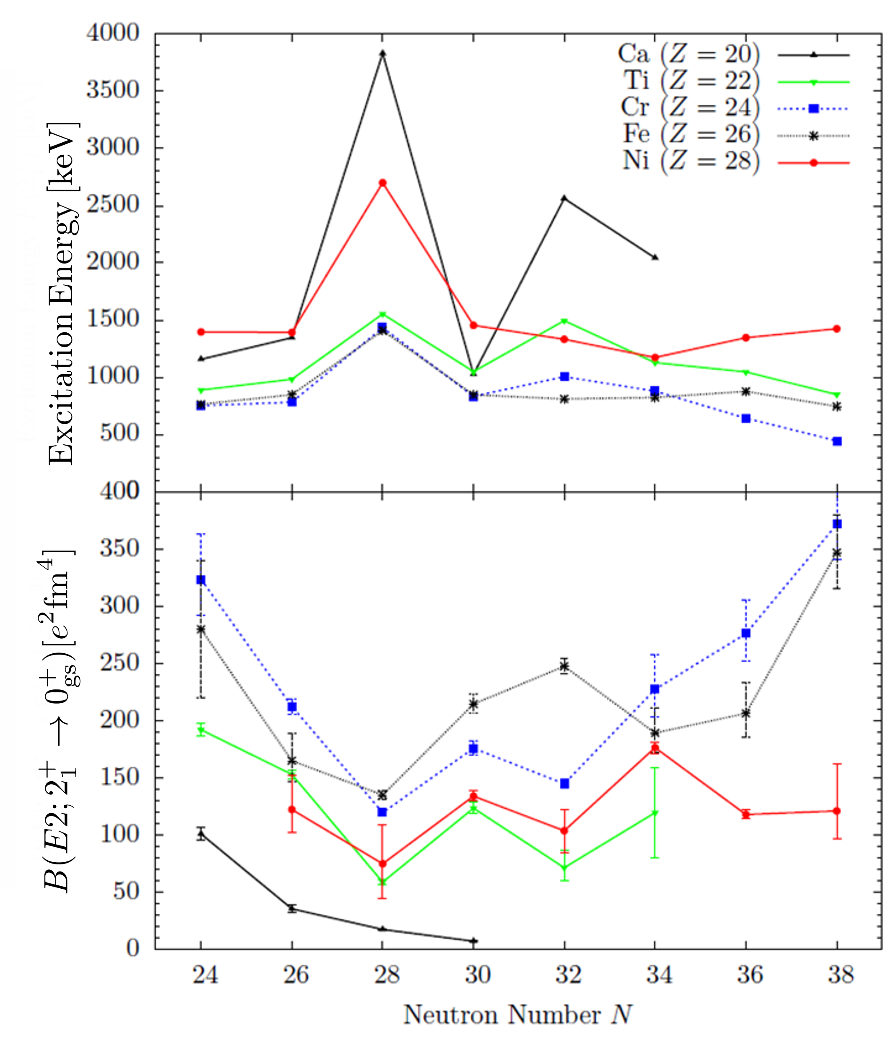
Subshell closure at N=32?
Phase transition from predominant collective structures in ⁵⁸Fe to a neutron subshell closure towards ⁵²Ca
Staggering of the B(E2) values in the Ti isotopes
Subshell closure at N=32 for higher spins in Ti
What are the consequences for the evolution in neighboring nuclei ?
How Shell Model calculations reproduce these systematics ?
New B(E2) measurement in 2⁺, 4⁺, 6⁺ states from their lifetime
K.-H. Speidel et al. Phys. Lett. B 633, 219 (2006).
A. Goldkuhle (IKP) et al, in preparation

Slide 9
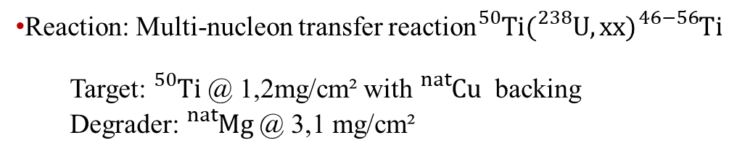
Reaction: Multi-nucleon transfer reaction${}_{}^{50}{Ti({}_{}^{238}{U, xx){}_{}^{46−56}{Ti}}}$
  Target: ${}_{}^{50}{Ti}$ @ 1,2mg/cm² with ${}_{}^{nat}{Cu}$ backing
  Degrader: ${}_{}^{nat}{Mg}$@ 3,1 mg/cm²
A. Goldkuhle (IKP) et al, in preparation

Slide 10
Experimental results
4 lifetime information in ⁵⁴Ti: 3 for the first time
3 lifetime information in ⁵²Ti: opposite behavior to previous measurement
5 preliminary lifetime information in ⁵³Ti determined for the first time
Interpretation
Shell model calculations reproduce the trend in ^{50,52,54}Ti
New result in ⁵²Ti: Opposite behavior to previous experimental results
A. Goldkuhle (IKP) et al, in preparation

Slide 11
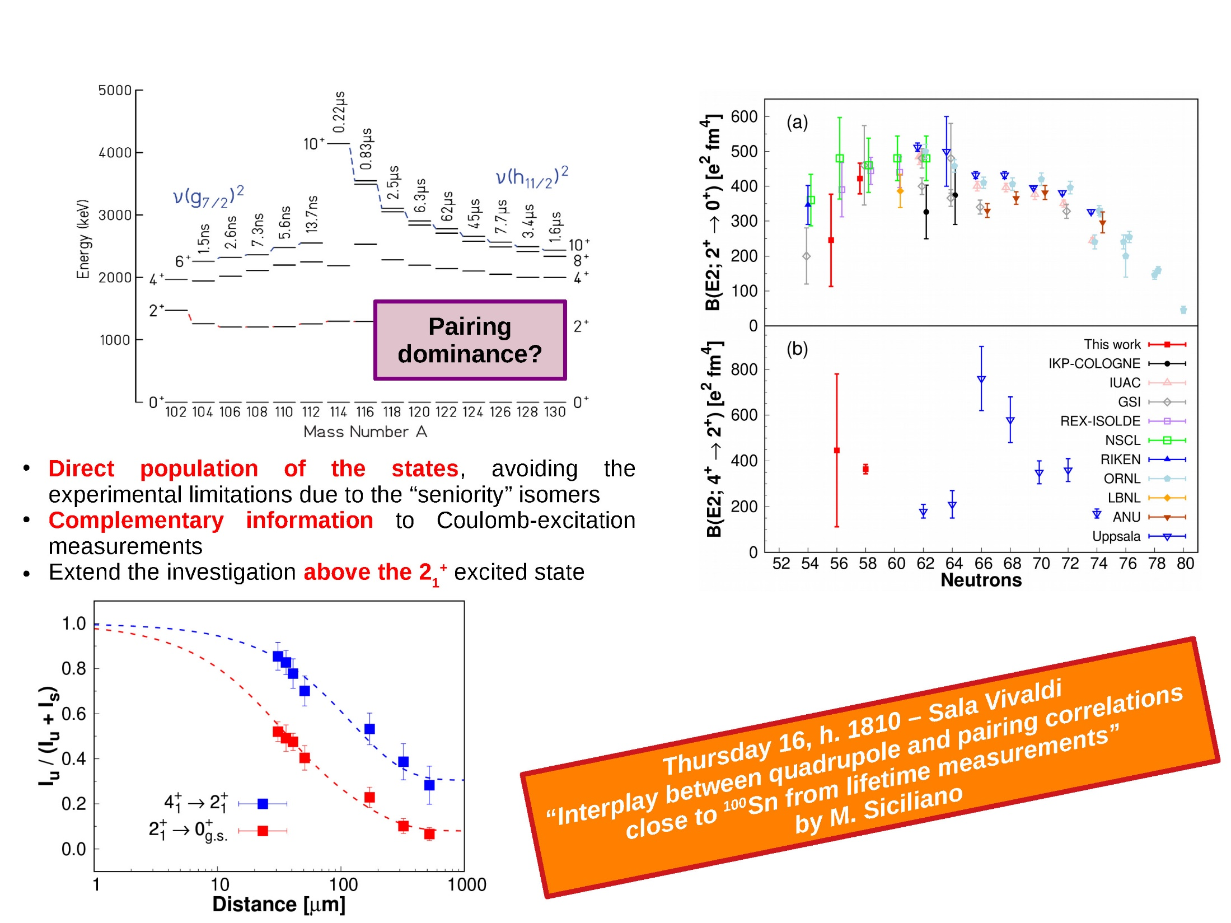
Lifetime Measurements in ^{106,108}Sn using MNT
M. Siciliano (LNL) et al, submitted to PRL
The first 4⁺→2⁺ transition strength in the neutron-deficient Sn.
The precise measurement for ¹⁰⁸Sn sheds light on the proton excitation into the g_{9/2} and h_{11/2} (from CN un-truncated), or g_{9/2} + pairing effect (Z)
The recent MCSMC points to g_{9/2} occupancy that vary with J and A, [T. Togashi et al PRL 121, 062501 (2018).], without comparison for the 4⁺ strength

Slide 12
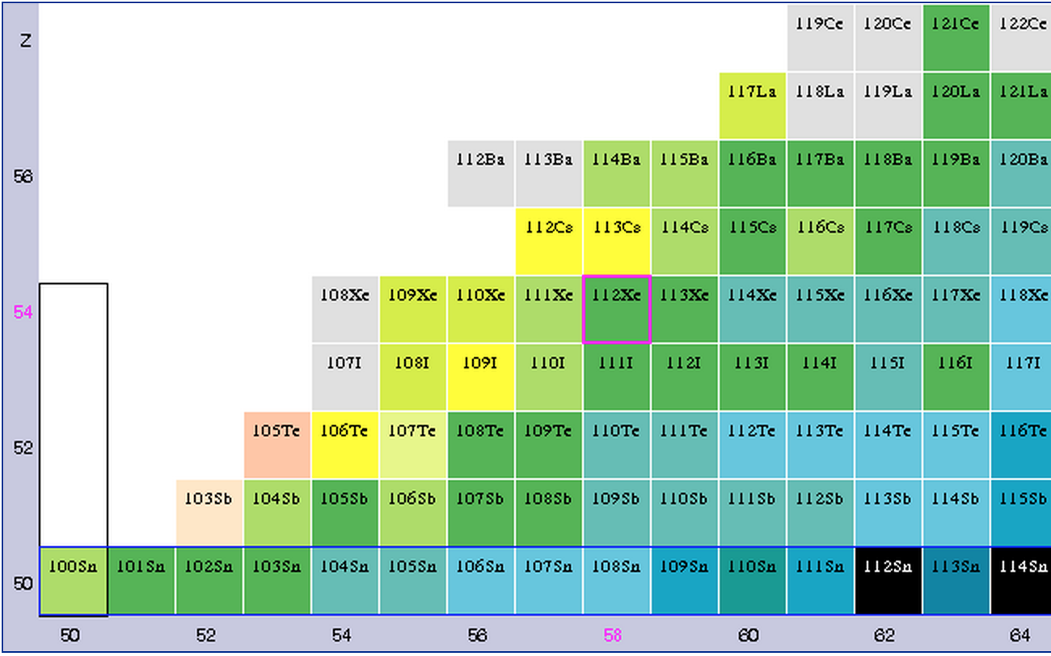
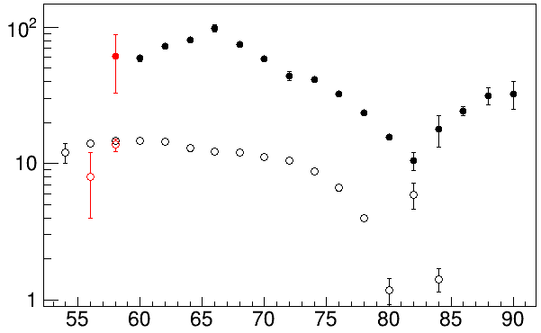
Shell evolution and collectivity using a ¹⁰⁰Sn core
d_{5/2,} g_{7/2,} h_{11/2}
M. Sandzelius et al Phys. Rev. Lett 99, 022501 (2007)
d_{5/2,} g_{7/2,} h_{11/2}
BE2(2⁺ → 0⁺) [Wu]
Maximum of 2⁺ and 4⁺ excitation energies at N=82
Maximum of collectivity at mid-shell
Collectivity approaching N=50 ?
^{106,108}Sn
Lifetime measurement in ¹¹²Xe

Slide 13
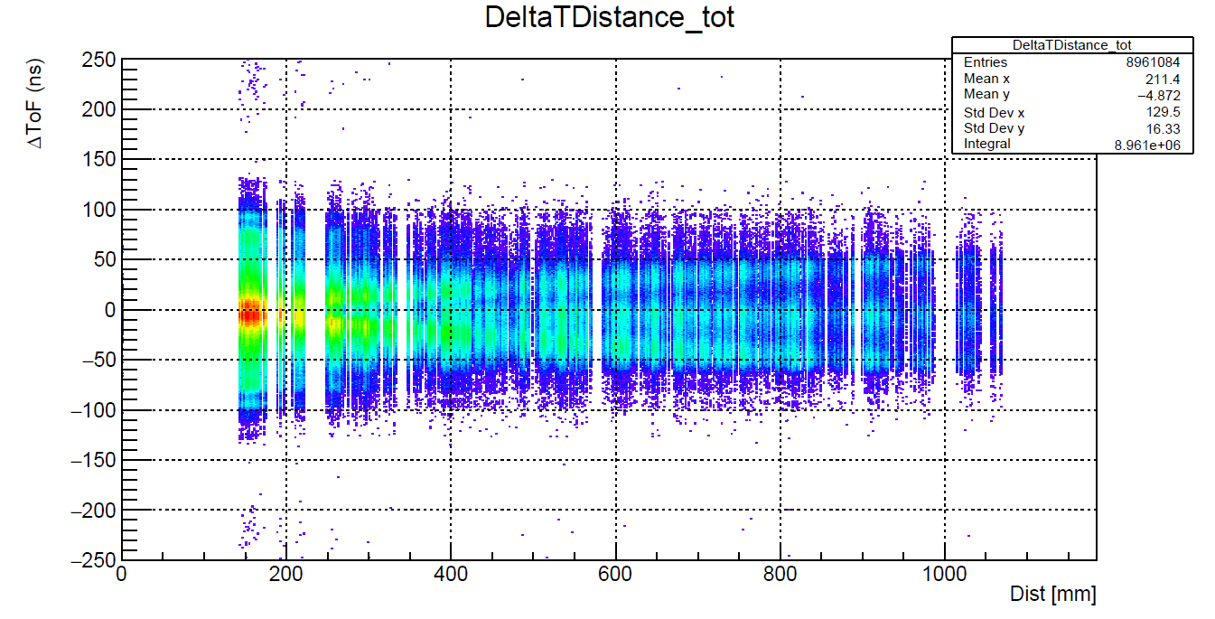
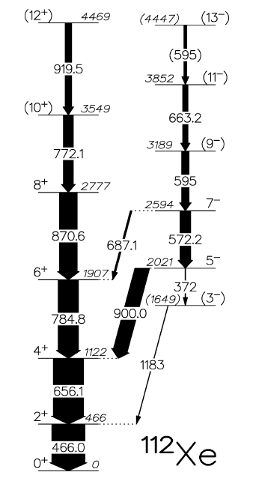
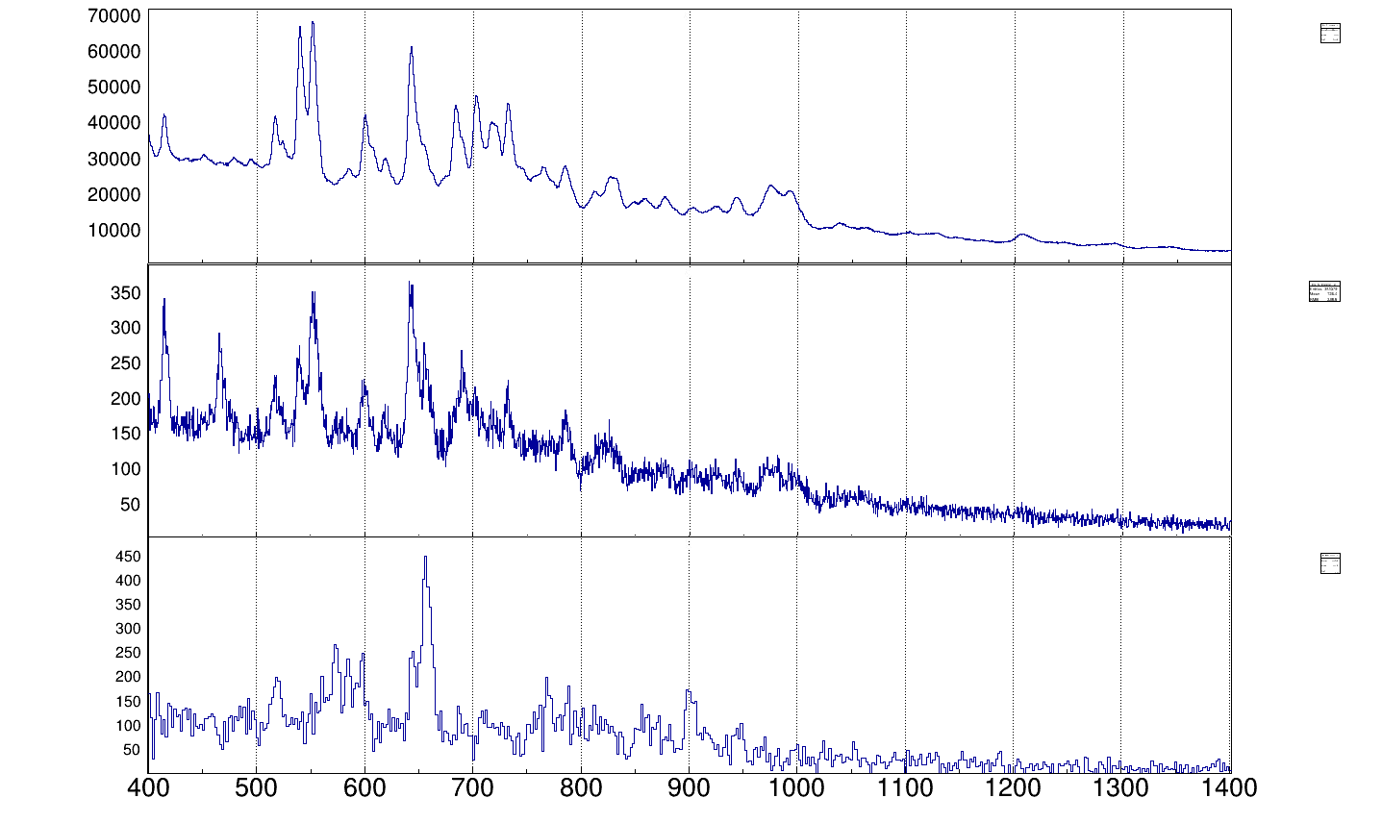
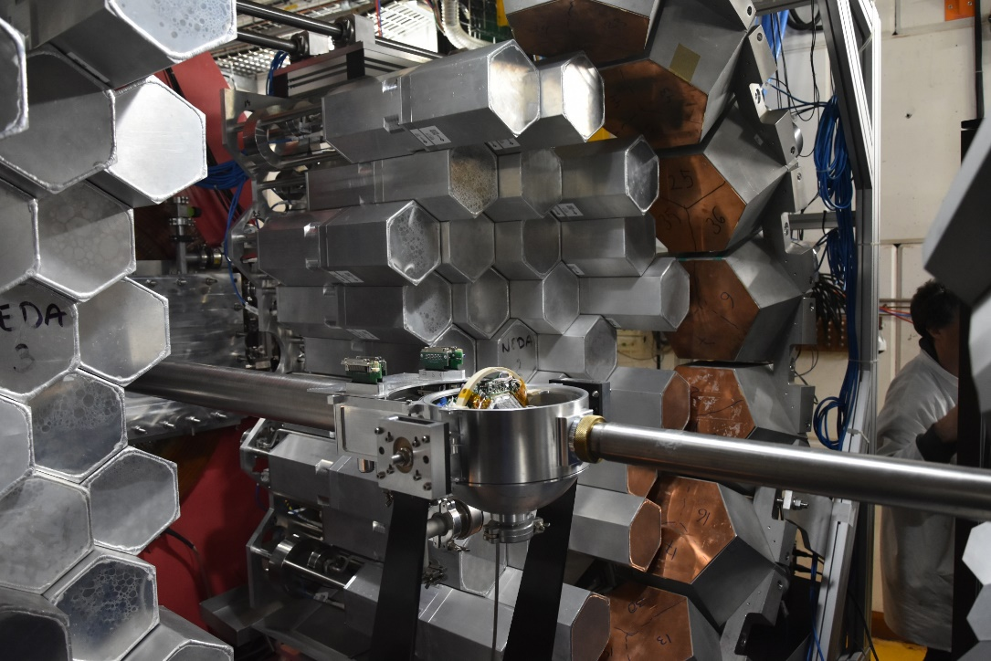
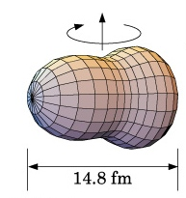
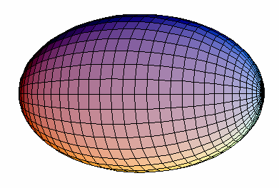
⁵⁸Ni(⁵⁸Ni, 2p2n)¹¹²Xe @ 250 MeV, ~4pnA.
Lifetime measurement using NEDA-AGATA-DIAMANT and the OUPS plunger in front of DIAMANT
9 plunger distances from 20 μm to 1.5 mm.
10 days experiments with ~30h per distances
Transitions for which a decay curve was observed on-line
1n2p
near-line
2⁺
2n2p
9⁻
4⁺
7⁻
6⁺
2n2p-2⁺ gated
e⁺e⁻
8⁺
5⁻
σ~100 μb
3⁻ ?
M. L. Jurado, D. Ralet, A. Goasduf, EC et al,
OUPS Plunger, J. Ljungvall et al, NIM A 679 (2012) 61-66. Degrader mode
J.F. Smith et al, Phys. Lett. B 523, 13 (2001)

Slide 14
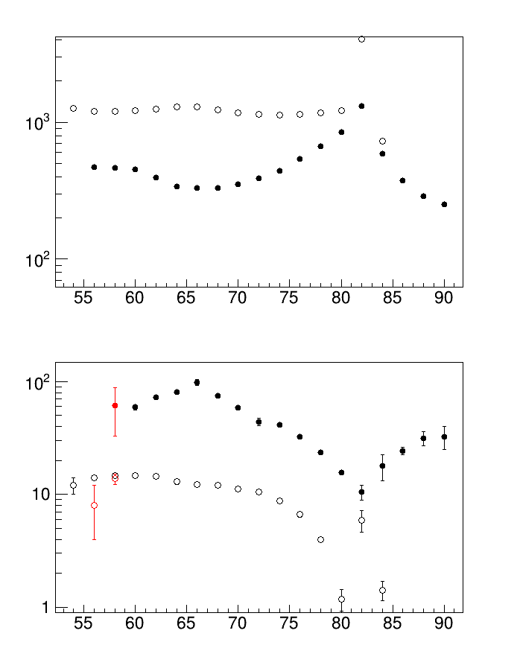
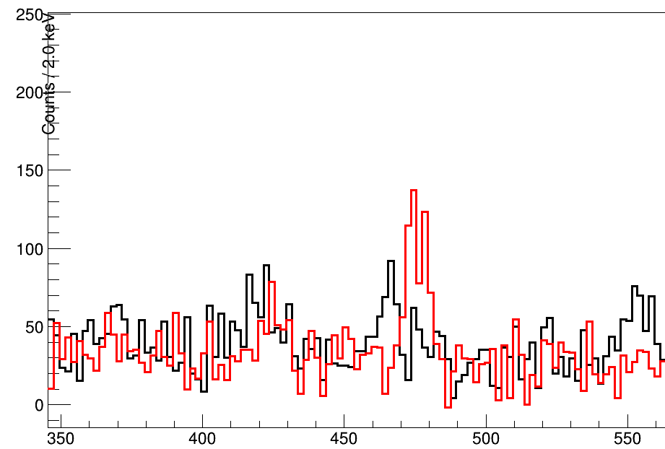
20 um /380 um
E(2⁺)
2⁺ transition gated by the fast 4⁺ decay component for 2 distances
Xe
Sn
Based on
Delion et al, Phys. Rev. C 82, 024307 (2010) and
Caurier et al PRC 82, 064304 (2010),
it supports more the role of the quadrupole interaction related to proton excitation from the Z=50 shell closure instead of the role of the T=0 pairing
BE2(2⁺ → 0⁺) [Wu]
¹¹²Xe from fusion
^{106,108}Sn from MNT
Neutron Number
M. L. Jurado (IFIC), et al, under analysis

Slide 15
Enhanced octupole correlation due to the interaction of ΔL=3, ΔJ=3, inverse parity : d_{5/2} and h_{11/2}
Online T_{1/2}
~7 ps
The Lifetime of the 5⁻ is determined
The E3 decay from the 5⁻ seems very weak and requires a careful analysis
~15 ps
~44 ps
B(E1 5⁻ → 4⁺ )* ~ 1.3 10⁻⁵ e²fm² (~0.9 10⁻⁵ wu)
*Assuming 100% E1 decay as soon as, on-line, the E2 and E3 are obviously very weak
Low B(E1). Similar to 3⁻ E1 decay in ¹¹⁴Xe. E1 probe for octupoles ?
Carrefull analysis to be done to discover the E2/E1/E3 branching ratio to get the B(E3)
The ¹¹⁴Xe case
(G. De Angelis et al., Physics Letters B 535 (2002) 93–102)
M. L. Jurado (IFIC), et al, under analysis

Slide 16
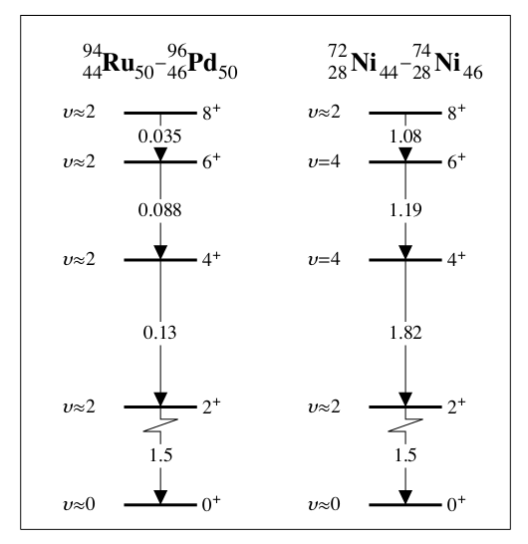
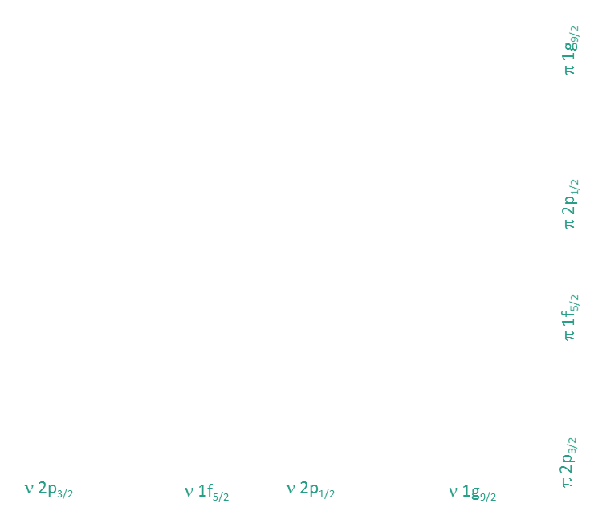
Investigation of the Seniority Conservation in the πg_{9/2} shell
¹⁰⁰Sn
g_{9/2} Shell: seniority might be not conserved
⁹⁹In
Valence Mirror Symmetry Partners
⁹⁸Cd
⁹⁷Ag
⁹⁶Pd
Shell Model orbitals for valence along N=50 are the same as for valence along Z=28
Same nuclear structures for Valence Mirror Symmetry Partners (?)
Indeed similar 2⁺ and 4⁺ excitation energy towards ¹⁰⁰Sn and ⁷⁸Ni
Effective two-body interaction is very different along g_{9/2} near ¹⁰⁰Sn and around ⁷⁸Ni
Suggested in ⁹⁴Ru and ⁹⁶Pd 4⁺ have 𝝊=2 character and ^{72,74}Ni have 𝝊=4 character
Seniority conservation breaking occurs via the mixing of 𝝊=2 and 𝝊=4 and might be possible for j=9/2
⁹⁵Rh
⁹⁴Ru
⁹³Tc
⁹²Mo
⁹¹Nb
⁹⁰Zr
⁸⁹Y
⁸⁸Sr
⁸⁷Rb
⁸⁶Kr
⁸⁵Br
⁸⁴Se
⁸³As
⁸²Ge
Journal of Physics 2011, P. Van Isacker.
⁸¹Ga
⁸⁰Zn
Z=28
⁷⁹Cu
⁵⁶Ni
⁵⁷Ni
⁵⁸Ni
⁵⁹Ni
⁶⁰Ni
⁶¹Ni
⁶²Ni
⁶³Ni
⁶⁴Ni
⁶⁵Ni
⁶⁶Ni
⁶⁷Ni
⁶⁸Ni
⁶⁹Ni
⁷⁰Ni
⁷¹Ni
⁷²Ni
⁷³Ni
⁷⁴Ni
⁷⁵Ni
⁷⁶Ni
⁷⁷Ni
⁷⁸Ni
A.F. Lisetskiy et al., Eur. Phys. J. A 25, s01, 95 (2005)
A.F. Lisetskiy et al,. Phys. Rev.C 70, 044314 (2004).
P. Van Isacker Int. Jour. of Mod. Phys. E, Vol . 20, 191 (2011)
P. Van Isacker et al., Phys. Rev. Lett. 100, 052501 (2008)
Notes:
E2 decay between yrast states of the (9/2) 4 system as expected in the N = 50 isotones
(left) and the Z = 28 nickel isotopes (right). The numbers between the levels denote calculated
+B(E2) values expressed in units of B(E2; 2 +1 → 0 1 ) of the two-particle system, assuming a
seniority-conserving interaction. All levels have v ≈ 2, except the J π = 4 + and 6 + states in
72,74 Ni which have exact v = 4.

Slide 17
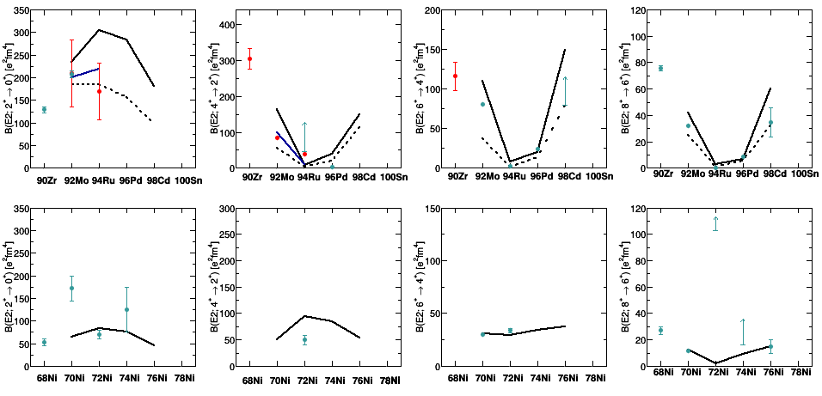
Investigation of the Seniority Conservation in the πg_{9/2} shell
R.Perez-Vidal, A.Gadea, C.Domingo-Pardo (IFIC) et al, in preparation
2⁺→0⁺
4⁺→2⁺
6⁺→4⁺
8⁺→6⁺
𝝊=0,2
[1]
[3]
[2]
[4]
[3]
[1]
[3]
[4]
[1][3]
𝝊=2
𝝊=2
[1]
[3]
[1][3]
𝝊=2
N=50
[1]
[3]
[2]
[4]
[3][5]
Valence Mirror Symmetry Partners
[1]
[6][7]
𝝊=0,2
[1]
[7]
𝝊=4?
[1]
[8][9]
𝝊=4?
𝝊=2
[1]
[5][10][11]
Z=28
[6] T. Marchi et al PRL 2014
[7] K. Kolos et al PRL 2016
[8] C.J. Chiara et al PRC 2015
[9] A.I. Morales et al. PRL 2018
[10] M. Sawicka et al PRC 2003
[11] A.I. Morales et al. PRC 2016
Seniority is well preserved in the N=50 isotones along the (πg_{9/2})^{n} excitations
[1] A.F. Lisetskiy et al. PRC 2004
[2] A. Gargano Private communication
[3]H. Mach et al. PRC 2017
[4]R.M. Pérez-Vidal et al. This work
[5]NNDC

Slide 18
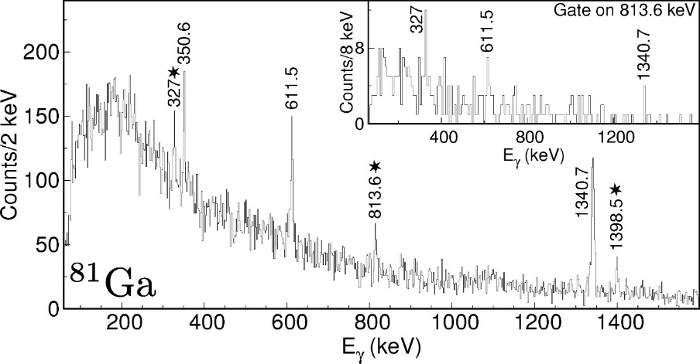
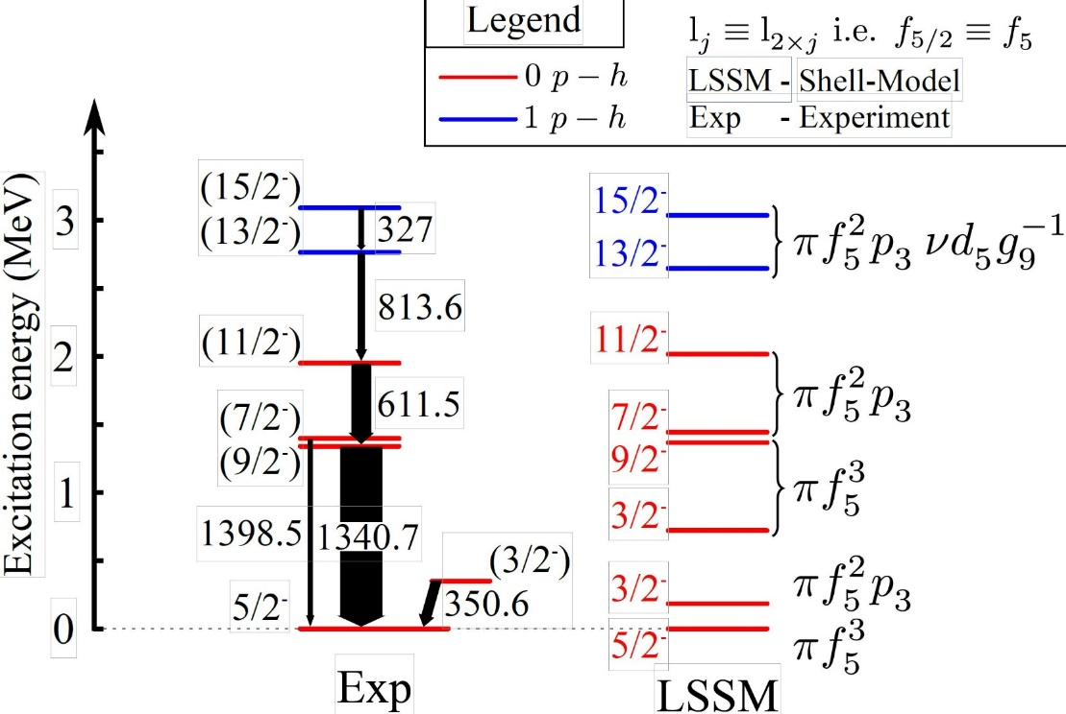
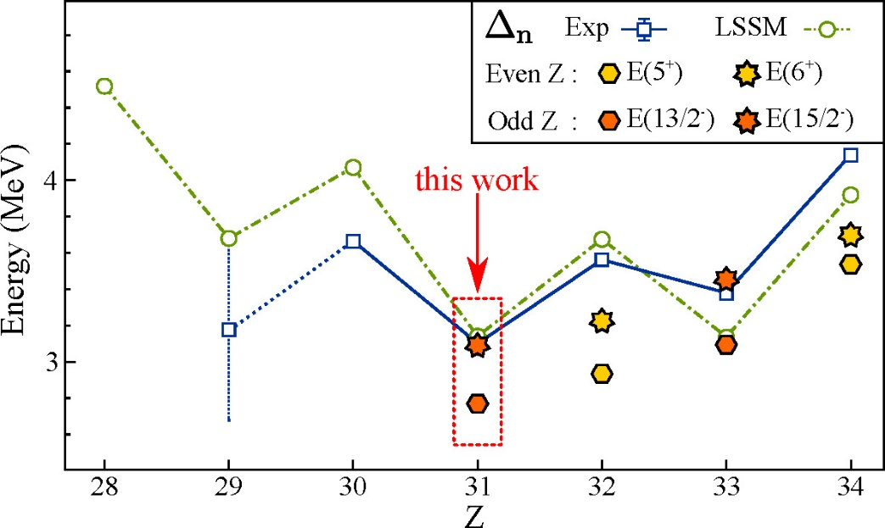
⁸¹Ga – Three valence protons coupled to
N = 50 neutron-core excitations
The quenching of the N=50 gap towards 78Ni can be investigated looking at the Spectroscopy of excited states involving particle-hole excitations across the N=50 gap
PFSDG-U interaction
F. Nowacki
PRL117, 272501
n Shell Gap
J. Dudouet et al.
Phys. Rev. C 100, 011301(R) – Published 12 July 2019
Notes:
Exp from binding energies

Slide 19
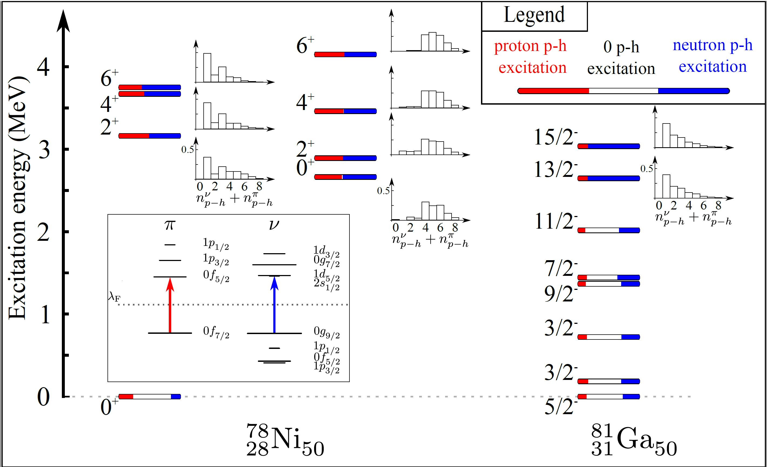
⁸¹Ga – Three valence protons coupled to
N = 50 neutron-core excitations
PFSDG-U interaction F. Nowacki PRL117, 272501
J. Dudouet et al. Phys. Rev. C 100, 011301(R) – Published 12 July 2019

Slide 20
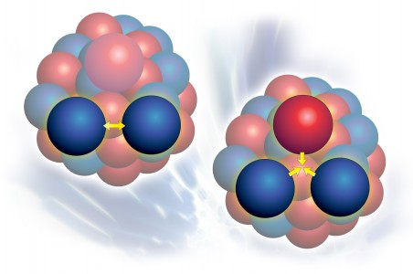
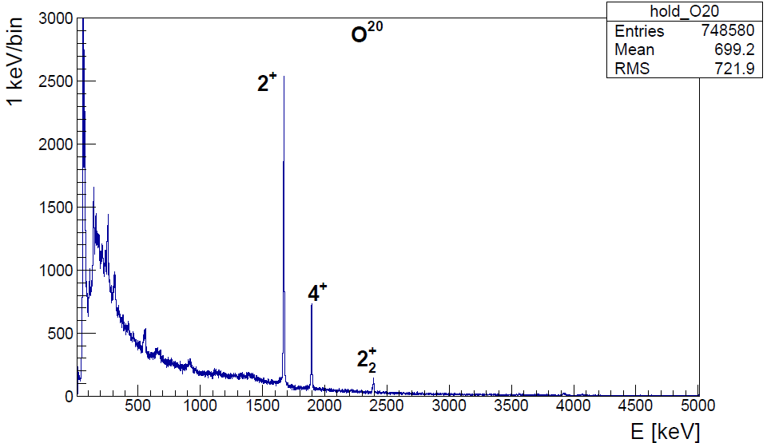
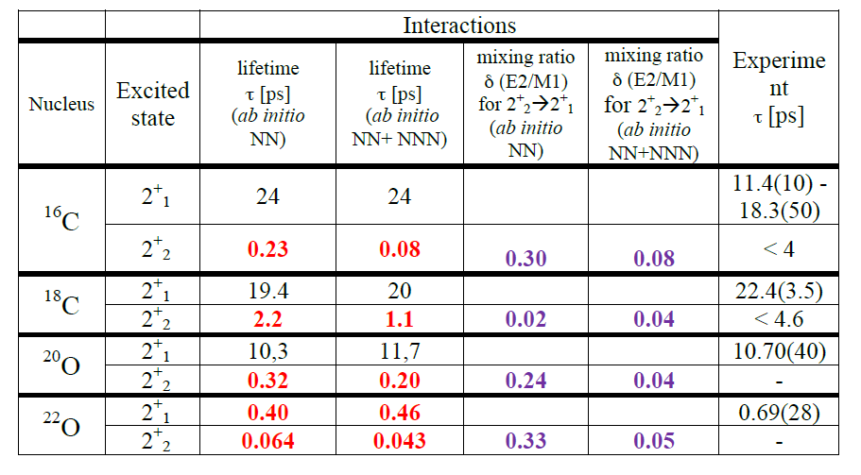
Lifetime in n-rich O and C
M. Ciemala , S. Leoni, B. Fornal, et al.,
Lifetime measurement in the non-yrast excited states of neutron rich C and O isotopes. Branching ratio and E2/M1 using the PARIS LaBr3 array
The 2⁺₂ state corresponds to a neutron (d_{5/2})³(s_{1/2})¹ configuration
C. R. Hoffmanu et al .PRC 85, 054318 (2012)
T. Otsuka PRL 105, 032501 (2010)
¹⁹⁸Pt/Tl(¹⁸O, ^{16,18}C, ²⁰O)
n(d_{5/2})⁴
n(d_{5/2})³ (s_{1/2})¹

Slide 21
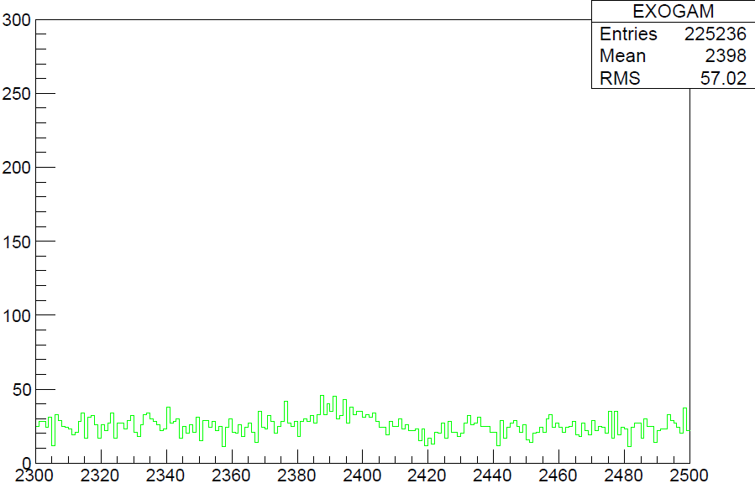
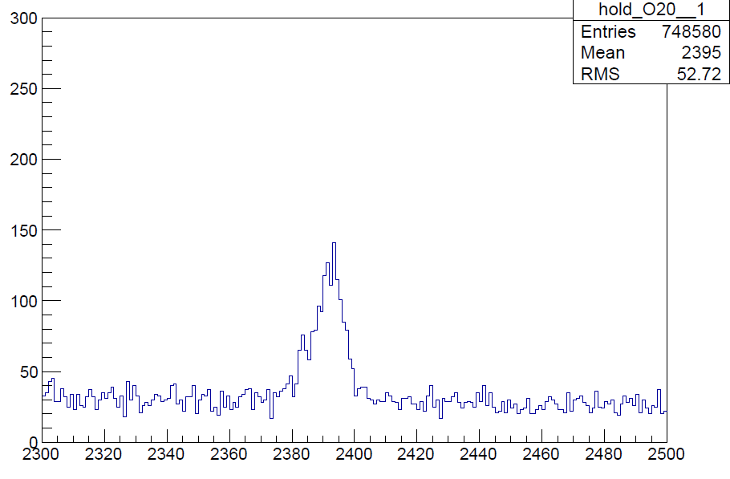
M. Ciemala (ifj-PAN)et al , to be submitted to PRL
EXOGAM-VAMOS (simulated)
The MBPT predicts that the lifetime is dominated by the B(M1) dipole strength
2⁺₂→2⁺₁

Slide 22
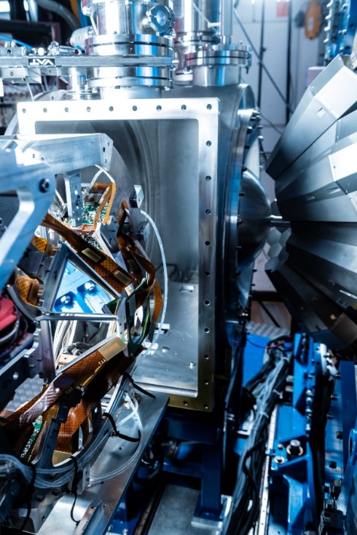
MUGAST campaign 2019-2020
Nucleons transfer spectroscopy using the SPIRAL1 ISOL beams
Nuclear Astrophysics: spectroscopic factors of relevant resonances for nucleosynthesis studies in radiative capture reactions: (⁶Li,d), (³He,d), (d,p)
Shell evolution:
spectroscopic factors, s.p. energies (d,p), (t,p), (³He,n)
n-p pairing, clusterization
3 successful SPIRAL1 exp in 2019 :
“Resonant state in ¹⁵F” F. De Oliveira’s et al
« Proton state in 48K by the 46Ar(3He,d) reaction
« The ¹⁵0 + a astrophysical reaction in surrogate method by 15O (7Li,t) reaction

Slide 23
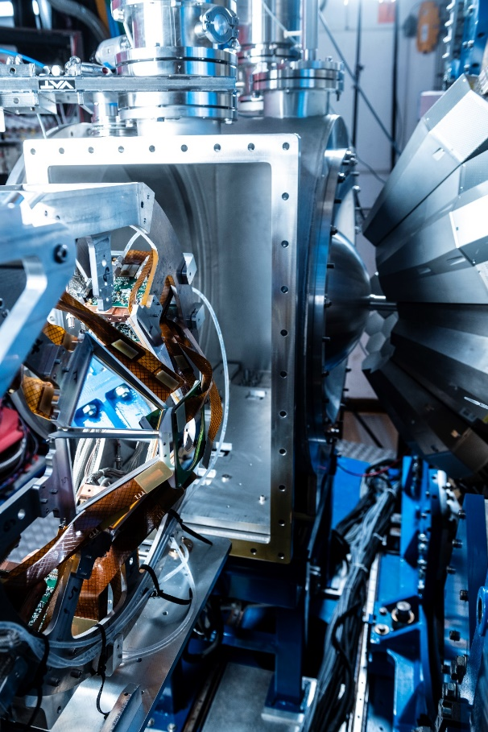
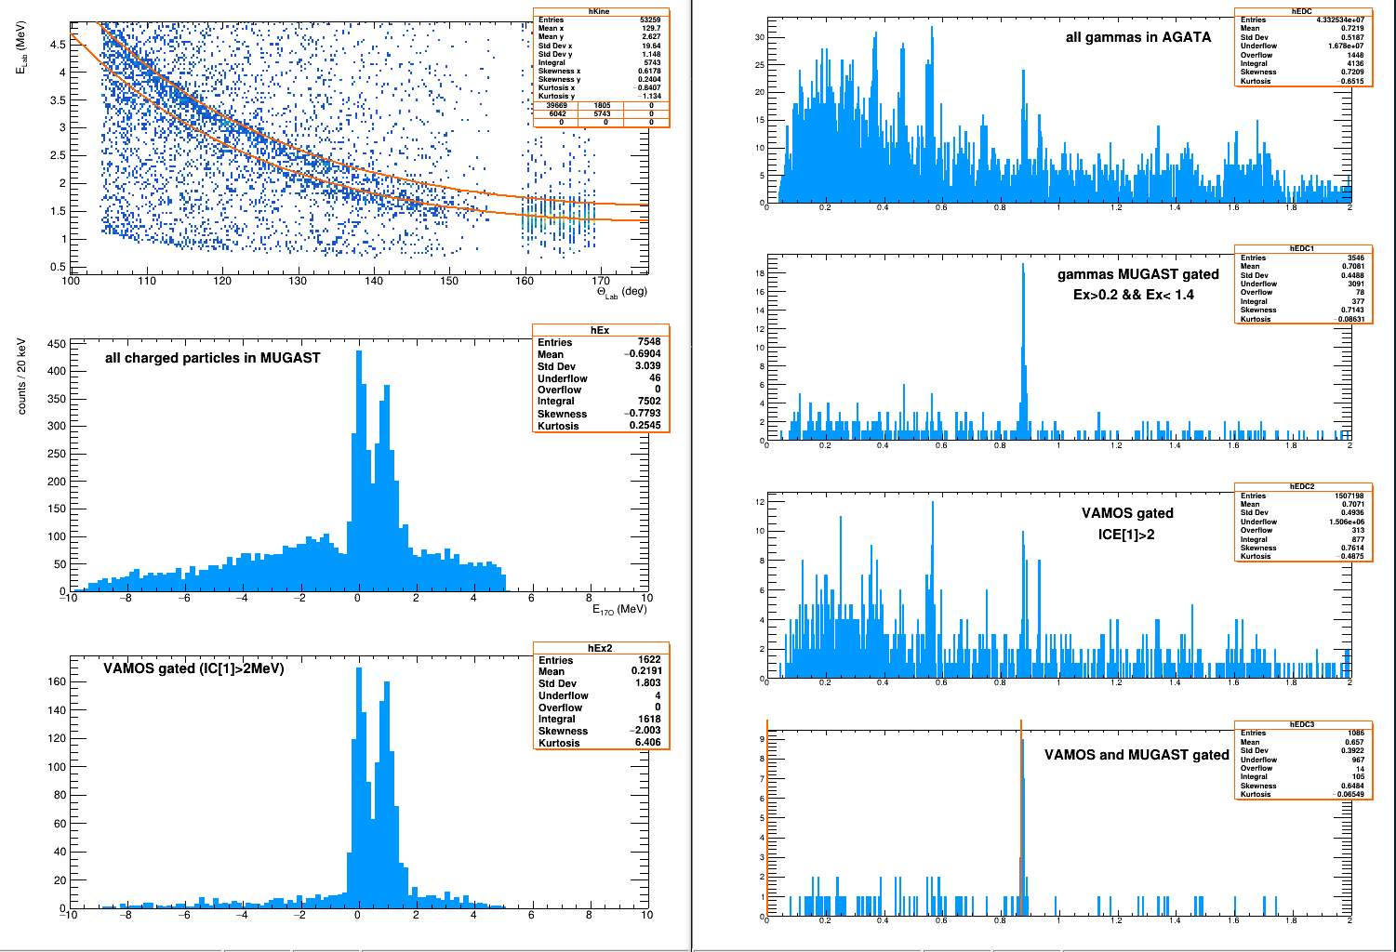
MUGAST campaign 2019-2020
¹⁶O(d,p)¹⁷O commissionning
867 keV:: 152Eu= 7.7(2)%. 870 keV ¹⁷O = 7.8%. Geant4 = ~8%

Slide 24
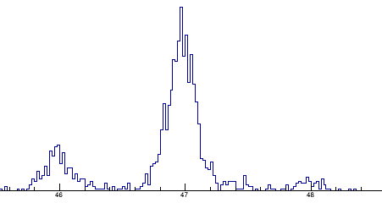
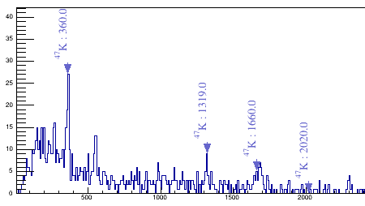
MUGAST campaign 2019-2020
⁴⁶Ar(³He,d)⁴⁷K → Probing proton states at N=28
⁴⁷K in VAMOS++
46
47
48
K masses isotopes in coincidence with particle at backward angle
s_{1/2} state
d_{5/2} state
AGATA

Slide 25
Conclusions
The AGATA array is operated since 2014 at GANIL and will be transferred in summer 2021 to LNL – Legnaro
AGATA at GANIL is used to performed high resolution γ-ray spectroscopy in exotic nuclei produced in heavy-ions collision at the Coulomb barrier
Unpublished results in ^{52,54}Ti, ^{106,108}Sn, ¹¹²Xe, ²⁰O have been presented with a specific focus on lifetime measurements
The new lifetime measurements result for states with J>2₁⁺ are :
    New values for ⁵²Ti presenting now bell shape compatible with SM
    New B(E2) up to the 6⁺ state in ⁵⁴Ti at the N=32 shell closure
    High precision measurements in ¹⁰⁸Sn underline the role of proton excitation above Z=50
    New reduced transition probabilities in ¹¹²Xe
    New indication that the 3-body term of the nuclear interaction plays a major role in the structure of n-rich Oxygen isotopes
Successful SPIRAL1-MUGAST experiment performed in 2019

Slide 27
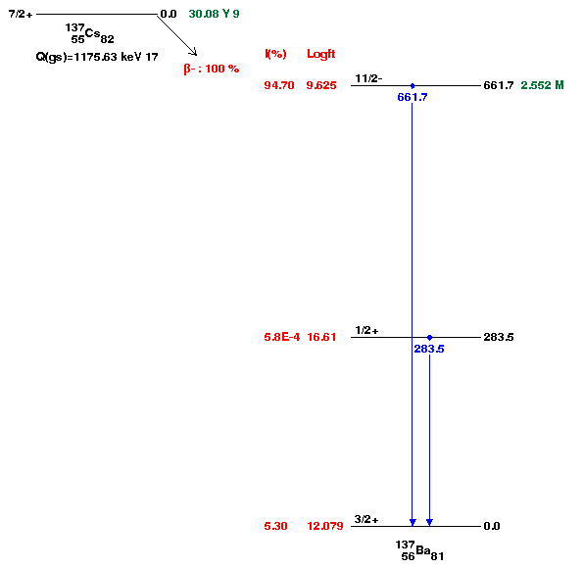


Double Gamma decay
D. Brugnara, A. Goasduff, JJ Vailente-Dobon et al.
Can decay as a cascade of two gamma (P ∞ 2 10⁻⁶ ) with a dominant M2-E2 and a minor E3-M1 contribution
The main point is to discriminate the real double gamma event candidates on top of the “background” of the Compton scattering.
“Tracking” should be able to reconstruct the Compton scattering and leave only candidate for the double events … Proof of principle ?
C. Walz et al., Nature volume 526, pages 406–409 (2015)
30-31 May 2018 : 49h of Continues Data
Compton not reconstructed
After Tracking – OFT Std
Prompt Track1+Track2 =
661 ± 1.5 keV, nbTrack=2
Compton Angle (Track1,Track2)
Vs Diff (ETrack1, ETrack2)
Remain to be understood in details
< 0.007% of events
¹³⁷Cs

Slide 28



Evidence of octupole-phonon at high spin in ²⁰⁷Pb : Study of the octupole phonon in the ²⁰⁸Pb region.
Case of the ²⁰⁷Pb : 1 neutron hole in ²⁰⁸Pb
The first excited states of ²⁰⁷Pb are part of the νp⁻¹ _{1/2} X 3⁻ multiplet with slightly reduced B(E3) with respect to ²⁰⁸Pb due to the p_{1/2} blocking effect
The ν(i_{13/2})⁻¹ state band structure : strong coupling effect of the i_{13/2} and f_{7/2} : enhanced B(E3) with respect to ²⁰⁸Pb
D. Ralet, E. Clément et al, submitted to PLB
D. Ralet et al., Phys.Scr. 92, 054004 (2017)

Slide 29
⁵²Ti summed spectrum

Slide 30
⁵²Ti
Flight comp.
Degrader comp.
Feeding correction

Slide 31
⁵⁴Ti
Differential decay curve method (DDCM)
Flight comp.
Feeding correction
Degrader comp.
A. Goldkuhle (IKP) et al, in preparation

Slide 32


⁵⁴Ti
 | Lifetime [ps] |  | B(E2) [e²${fm}^{4}\text{]}$
$$I_{1}^{+}→{(I−2)}_{1}^{+}$$ | Present | Previous [1] | Present | Previous [1]
$$2_{1}^{+}→0_{g.s.}^{+}$$ | 1.4(7) | 1.53(27) | $${80}_{−27}^{+82}$$ | $${72}_{−11}^{+15}$$
$$4_{1}^{+}→2_{1}^{+}$$ | 5.9(9) | - | $${139}_{−18}^{+25}$$ | -
$$6_{1}^{+}→4_{1}^{+}$$ | $$≥380$$ | - | $$≤132$$ | -
$$8_{1}^{+}→6_{1}^{+}$$ | $$≤1.4$$ | - | $≥$ 5.7 | -
⁵²Ti
[1] D.-C. Dinca et al., Phys. Rev. C 71, 041302 (2005).
 | Lifetime [ps] |  | B(E2) [e²${fm}^{4}$]
$$I_{1}^{+}→{(I−2)}_{1}^{+}$$ | Present | Previous [2] | Present | Previous [2]
$$2_{1}^{+}→0_{g.s.}^{+}$$ | 10.1(4) | 5.19(20) | $${63}_{−6}^{+8}$$ | $${124}_{−5}^{+5}$$
$$4_{1}^{+}→2_{1}^{+}$$ | 2.3(1) | 4.76(58) | $${111}_{−9}^{+8}$$ | $${53}_{−6}^{+7}$$
$$6_{1}^{+}→4_{1}^{+}$$ | 45(1) | 36.07(577) | $${100}_{−8}^{+9}$$ | $${125}_{−17}^{+24}$$
[2] K.-H. Speidel et al. Phys. Lett. B 633, 219 (2006).
A. Goldkuhle (IKP) et al, in preparation

Slide 33
Collective octupole motion in such nuclei is strongly influenced by quadrupole softness
νh_{11/2} occupancy
[M. P. Metlay Phys. Rev. C 52, 1801 (1995)]

Slide 34
G. de Angelis et al., Phys. Lett. B 535 (2002) 93
J.F. Smith et al., Phys. Lett. B 523 (2001) 13.
¹¹⁴Xe : B(E3:3⁻ → 0⁺) = 77(27) W.u

Slide 35
Non –yrast states in ²⁰O
S_{cal} (d_{5/2}, s_{1/2},d_{3/2})
n(d_{5/2})³ (s_{1/2})¹
Neutron transfer reaction by C. R. Hoffman et al .PRC 85, 054318 (2012)
has shown that :
(0.2,0.7,0.0)
Yrast 2⁺ and 4⁺ states are dominated by the natural n(d_{5/2})⁴ configuration
The 2⁺₂ and 3⁺ states are dominated by the n(d_{5/2})³(s_{1/2})¹configuration
n(d_{5/2})³ (s_{1/2})¹
(1.0,0.,0.)
(0.8,0.3,0.2)
n(d_{5/2})⁴
(1.8,0,0)
Exp
Theoretical S factors from SM calculations are in good agreement with the measured ones

Slide 36
Non –yrast states in ²⁰O
τ=27 fs
Abinitio
G. Hagen et al., PRL 108, 242501 (2012)
The 2⁺₁ lifetime is not sensitive to the d_{3/2} position
The 2⁺₂ and 3⁺ states lifetimes are sensitive to the d_{3/2} contribution
Placed phenomenological in SM calculations
the 3-body interaction create repulsion in the ab-initio model
A reduced splitting of the s_{1/2}d_{3/2,5/2} increases the lifetime
As an increased repulsion between the orbits reduces the lifetime
n(d_{5/2})³ (s_{1/2})¹
τ=180 fs
τ_{NN} = 320 fs
d_{3/2} lowered by 2 MeV
τ=240 fs
τ_{NNN} = 200 fs
n(d_{5/2})⁴
n(d_{5/2})⁴
τ=12 ps
τ=10.4(4) ps
τ_{NN} = 10.5 ps
d_{3/2} lowered by 2 MeV
τ=11 ps
τ_{NNN} = 11.7 ps
n(d_{5/2})⁴
USDB
Exp
SM :M. Rejmund, Private
communication USDB, A. Brown et al PRC, 74(3), 034315 (2006).
The lifetime of the 2⁺₂ state is a sensitive probe for the s_{1/2}d_{3/2,5/2} decomposition in neutron-rich O

Slide 37


Proposed experiment
Populating the relevant neutron states by the selective ¹⁹O(d,p)²⁰O reaction
¹⁹O beam from SPIRAL1 at 6.6 MeV/ and at 7. 10⁴ pps
DSAM dedicated target CD2 (0.3mg/cm²) + Au (20mg/cm²)
²⁰O to be identified in VAMOS and γ-ray in AGATA placed at backward angles
The entry point is constrained by the proton spectroscopy in MUGAST
Lifetime measurement of the 2⁺₂ and 3⁺ state, feeding free, by DSAM
Cross section from C. R. Hoffman et al .PRC 85, 054318 (2012)
400 (1000) counts respectively in the 2⁺₂ (3⁺) decay to the 2⁺₁ state in 30 UT
Make the best use of the present setup
Response function studied using the GEANT4 AGATA package
Risk is the quality of the target preparation and its thickness measurement
We do not probe directly the 3-body term (because it is impossible)
We do not directly measure the relative position of the s_{1/2} – d_{3/2,5/2}
But we measure an accurate and relevant quantity (T_{1/2}) which is sensitive to their relative spacing independently if it is the consequence of the 3-body term or a phenomenological approach
Within an ab-initio framework it can be related to the 3-body contribution
Within the SM approach, it can be related to the position of the single particle orbit

Slide 38


Shell evolution around ¹⁰⁰Sn
Due to the optimum Q-value condition with stable beams mostly p-stripping and n-pick-up occur in MNT processes →populates n-rich nuclei.
protons
N=Z
With p-rich beam and target possible to populate p-rich ejectiles with
= few to ~1mb
in +2p pick-up reactions
R.Broda et al., PRC 49, R575
neutrons

Slide 39







Large arrays for γ-ray spectroscopy in Europe by European collaborations
ESSA30
Eurogam
30 Detec. at Daresbury - 1987
40-50 Detec.
90’
Euroball 100. Detec.
90’-2000
Strong collaboration with industry
→ Composite detector to increase the photopeak efficiency
20-40 Detec.
2000-
Segmentation of detectors
Improve granularity (reduce Doppler broadening)
+ Digital electronic

Slide 40





The GANIL Campaign [2015-2021]
Lifetime measurements
2015-2017: 93% of performed experiments are lifetime measurements from fs to μs
E. Clément et al., NIMA 855, 1-12 (2017)
Y. H. Kim et al., Eur.Phys.J. A 53, 162 (2017)
FATIMA-PARIS detectors coupled to AGATA

Slide 41


Shell evolution below ⁶⁸Ni
Interplay of the monopole terms of the interaction with multipole terms, like pairing and quadrupole, which determines the different phenomena we observe
Collecting spectroscopic data like transition probability constraining the theoretical description of the Island of inversion from N=28 to N=40 :
What is the influence of the νg9/2 and νd5/2 orbits ?
What is the influence of the proton excitations across Z=28 ?
How collectivity change when decreasing the number of proton in the f7/2 orbital
Lifetimes of the 4⁺ states in ^{62;64}Fe and the 11/2⁻ in ^{61;63}Co and ⁵⁹Mn
M. Klintefjord et al., PRC 95, 024312 (2017)

Slide 42

¹¹²Ba should corresponds to the best octupole N=Z=56 for p and n
d_{5/2,} g_{7/2,} h_{11/2}
d_{5/2,} g_{7/2,} h_{11/2}
Enhanced octupole due to the interaction of ΔL=3, ΔJ=3, inverse parity : d_{5/2} and h_{11/2}
3⁻ states dominate by d_{5/2} × h_{11/2} orbital configuration
Removing neutron from the h_{11/2} orbital gradually decreases the 3⁻ excitation energy and enhances the B(E3) value

Slide 43
 | ¹¹⁴Xe | ¹¹²Xe | ¹¹⁸Ba
E (3-)_{theo} (MeV) / Exp | 1.84 /1.62 | 1.99/1.65 | 2.11
B(E3: 3- → 0+)_{theo} W.u. | 17 | 25 | 18.7
B(E3: 3- → 0+)_{exp} W.u. | 77(27) | - | -
Factor 4.5
The h_{11/2}-d_{5/2} octupole in ¹⁴⁶Gd for protons is 37 W.u. reproduced by the same GCM HFB calculations
L.M. Robledo private communication
Quadrupole-octupole coupling is a key contribution
→ Reproduces the Ra-Rn octupole transition strength
L.M. Robledo and P.A. Butler, PRC 88 051302 (R) (2013)
Q2-Q3 does not change the B(E3)
The large B(E3) might be due to the presence of an isoscalar the proton-neutron
π(ν) d_{5/2} - ν (π) h_{11/2} term
Should increase toward N=Z
¹¹²Xe : B(E3) = ?

Slide 44
Shell evolution around proton shell closure
Interplay of the monopole terms of the interaction with multipole terms, like pairing and quadrupole, which determines the different phenomena we observe
Characterizing the islands of inversion, formed near the magic numbers.
Collectivity development with valence particle
These are new regions of deformation with configurations involving intruder orbitals from the above main shell.
While a signature of collective properties is given by the energy of the first excited states, their lifetimes allow a better understanding of their properties by comparison with LSSM calculations

Slide 45



GANIL Facilities
The cyclotrons will continue to deliver stable, high intensity beams from ¹²C to ²³⁸U 4-3 months/year
SPIRAL1 has delivered post-accelerated RIB after an important upgrade
The start of the full LINAC accelerator commissioning with RF on July
First experiment using the neutron beam around summer 2020
The S3 spectrometer assembly has started in the cave. First Cryo-modules delivered, final cooling expected for 2021
The DESIR hall construction contract signed

Slide 46




The GANIL Campaign [2015-2021]
2015-2017 run VAMOS campaign
Courtesy J. Dudouet
Nucleons transfer
Fusion-fission
Transfer-fission
« States above the 2⁺ are well populated »
E. Clément et al., NIMA 855, 1-12 (2017)
Y. H. Kim et al., Eur.Phys.J. A 53, 162 (2017)

Slide 47


The GANIL Campaign [2015-2021]
2018 run NEDA campaign
DIAMANT and NEDA in full digital system making use of the NUMEXO2 boards and coupled to AGATA with the AGATA GTS system
×20 increase in (nγ²) event rate readout compared to the NWALL-DIAMANT-EXOGAM system in VME-VXI.
T. Huyuk et al, Eur. Phys. J. A (2016) 52: 55 Page 5
PSA
E. Clément et al., NIMA 855, 1-12 (2017)
J. J. Valiente-Dobon et al, NIMA 927, 81-86 (2019)
p
α
Energy
Time of flight
γ
n
54 self produced NEDA detectors at forward angles and 14 NWALL detectors + plunger
~9% γ-efficiency at 1.4 MeV after tracking
>20% efficiency for 1 neutron
>35% efficiency for 1 proton
PSA – Neural network

Slide 48

Tracking Arrays
Improved Doppler Correction capabilities
Lifetime measurements are revisited
Separation of both peaks for a larger solid angle even for small Δv → Combined with spectrometer and low recoil energy
Use of thinner degrader for shorter lifetime
d
Velocity
2⁺
T_{1/2}
0⁺

