Slide 1

The
AGATA Campaign @GANIL
Nuclear Structure 2018

Slide 2
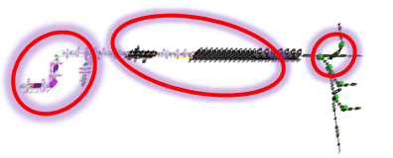
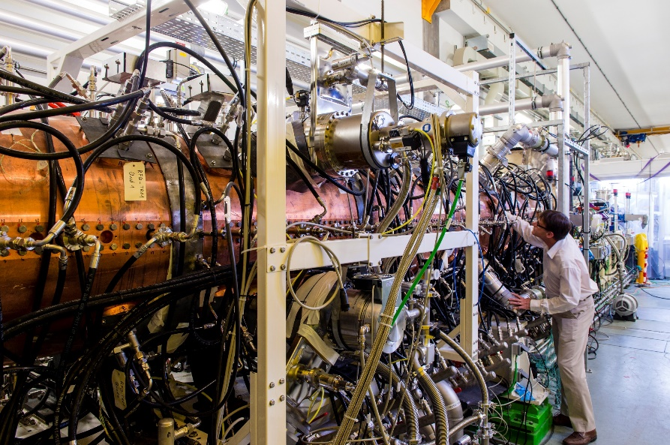
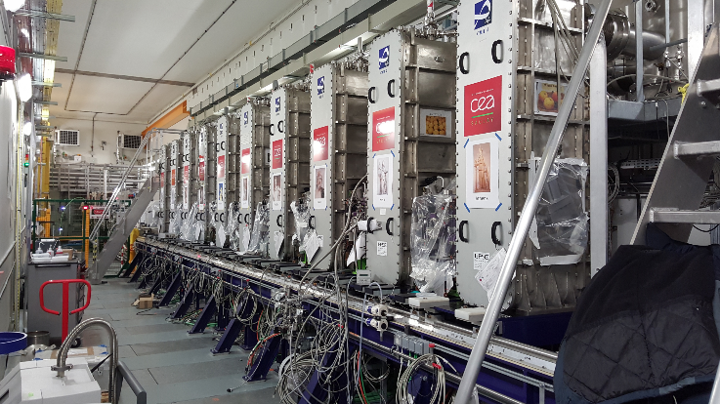
GANIL Facilities
The cyclotrons will continue to deliver stable, high intensity beams from ¹²C to ²³⁸U 4-3 months/year
SPIRAL1 has delivered post-accelerated RIB after an important upgrade this year
→ Next are the AGATA-MUGAST and ACTAR campaigns
→ FAZIA/INDRA setup is tested and ready for campaign
The SPIRAL2 accelerator is assembled
First experiment using the neutron beam around summer 2020
The S3 spectrometer assembly has started in the cave – last cryo-module cooling expected for 2021
The DESIR hall construction contract will be signed by end of the year.

Slide 3

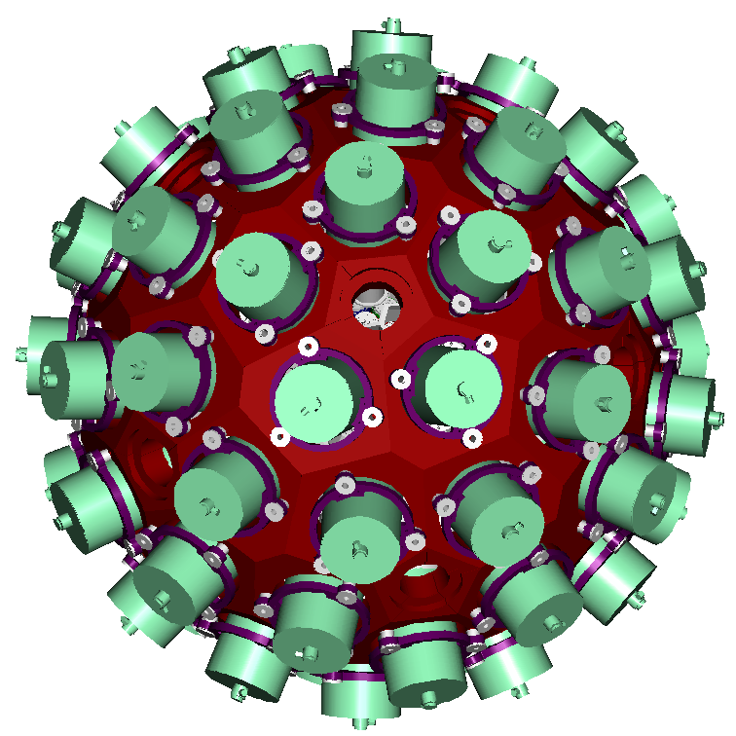
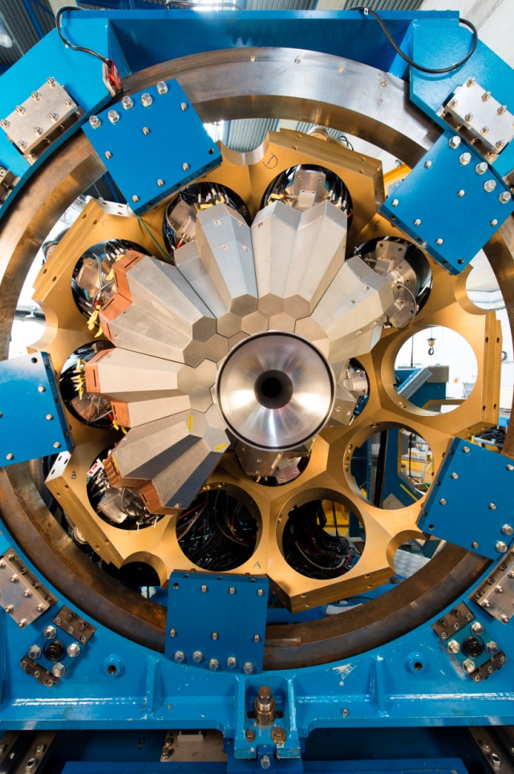













The AGATA project
180 (60 triple-clusters) 36-fold segmented crystals
Amount of germanium: 362 kg
Solid angle coverage: 82 %
Singles rate >50 kHz
Efficiency: 43% (M_{γ}=1) , 28% (M _{γ} =30)
Peak/Total: 58% (M _{γ} =1), 49% (M _{γ} =30)
Angular Resolution: ~1º
Combination of:
segmented detector
pulse-shape analysis
tracking the γ rays
digital electronics
S. Akkoyun, et al, NIMA 669, 26-58 (2012)
AGATA@GANIL

Slide 4
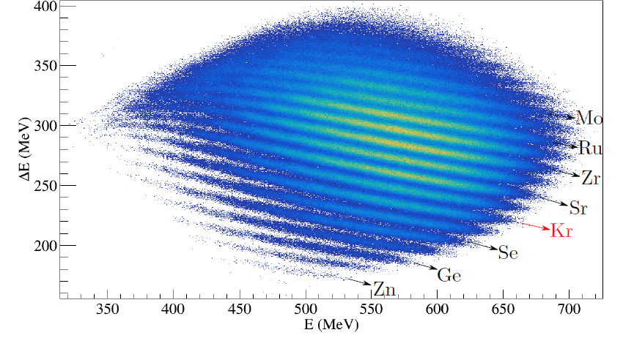
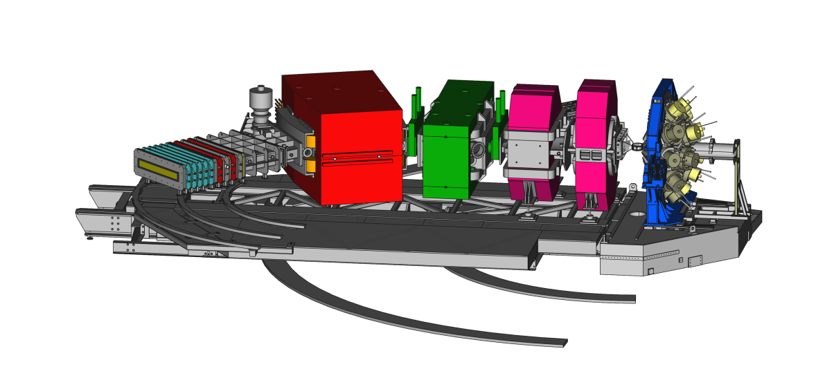
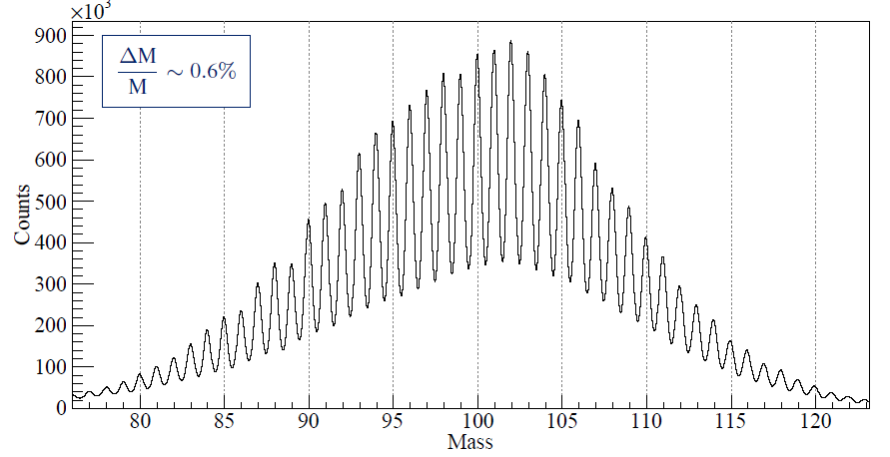
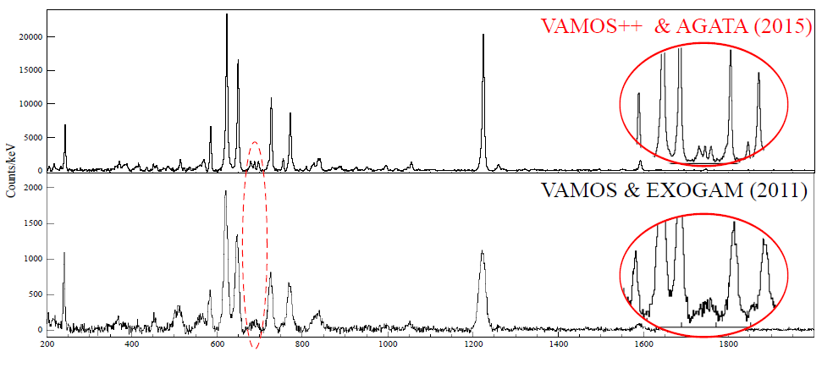
The GANIL Campaign [2015-2020]
Courtesy J. Dudouet
2017-2018 : 35 detectors on-line : core efficiency measured at 3.4(1)% in nominal position at 1.408 MeV (GEANT4 = 3.6%)
853 UT have been already approved
628 UT have been performed over 22 experiments
Nucleons transfer
Fusion-fission
Transfer-fission
E. Clément et al., NIMA 855, 1-12 (2017)
Y. H. Kim et al., Eur.Phys.J. A 53, 162 (2017)

Slide 5
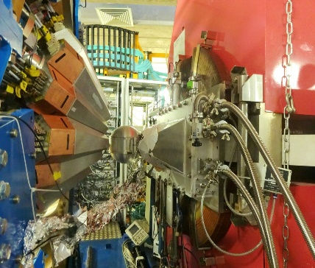
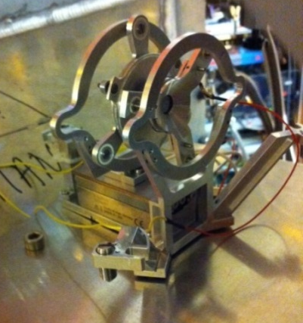
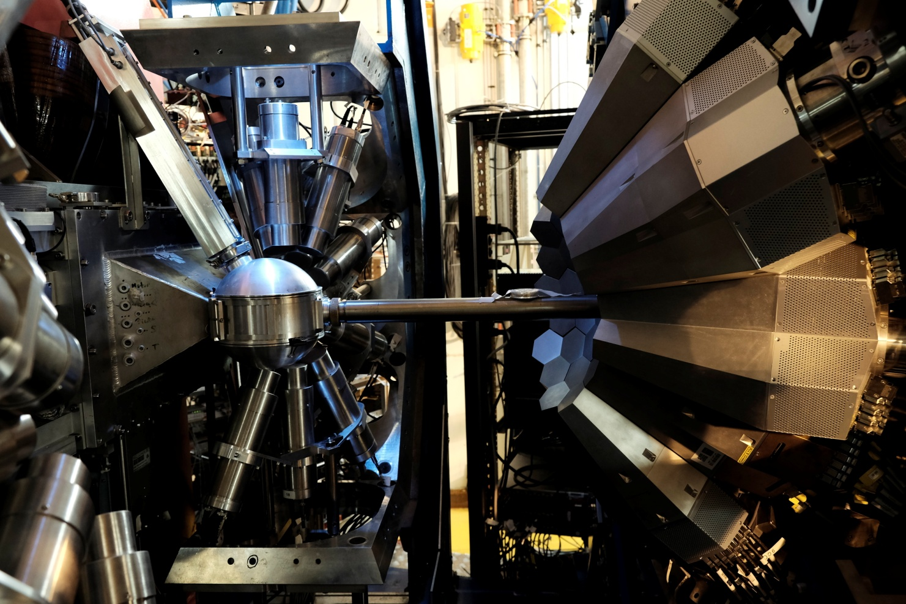
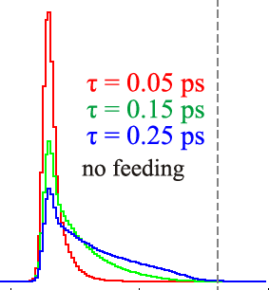
The GANIL Campaign [2015-2020]
2017-2018 : 35 detectors on-line : core efficiency measured at 3.4(1)% in nominal position at 1.408 MeV (GEANT4 = 3.6%)
Lifetime measurements
2015-2017: 93% of performed experiments are lifetime measurements from fs to μs
E. Clément et al., NIMA 855, 1-12 (2017)
Y. H. Kim et al., Eur.Phys.J. A 53, 162 (2017)
FATIMA-PARIS detectors coupled to AGATA

Slide 6
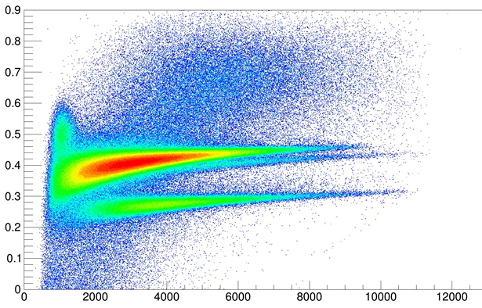
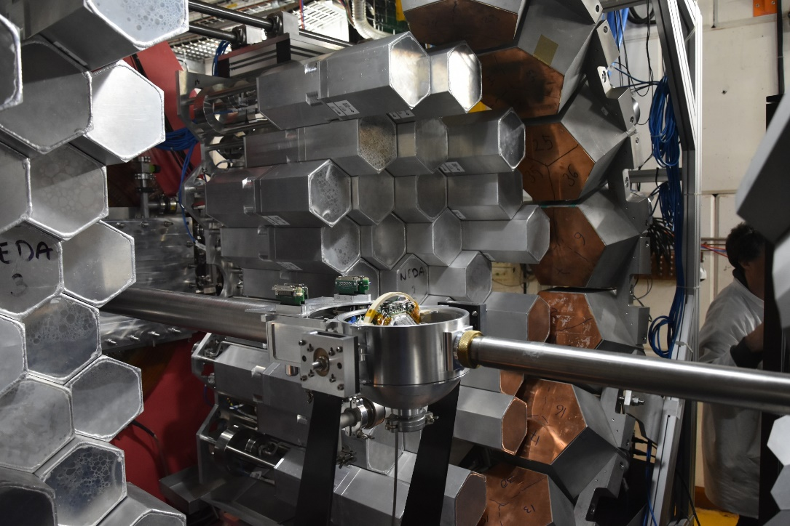
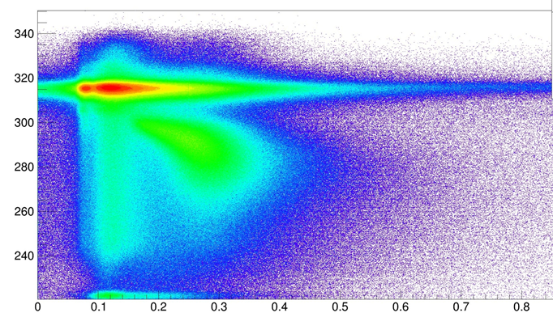
The GANIL Campaign [2015-2020]
2018 run NEDA campaign
DIAMANT and NEDA in full digital system making use of the NUMEXO2 boards and coupled to AGATA with the AGATA GTS system
×20 increase in (nγ²) event rate readout compared to the NWALL-DIAMANT-EXOGAM system in VME-VXI.
T. Huyuk et al, Eur. Phys. J. A (2016) 52: 55 Page 5
PSA
E. Clément et al., NIMA 855, 1-12 (2017)
J. J. Valiente-Dobon et al, to be submitted
p
α
Energy
Time of flight
γ
n
54 self produced NEDA detectors at forward angles and 14 NWALL detectors + plunger
~9% γ-efficiency at 1.4 MeV after tracking
>20% efficiency for 1 neutron
>35% efficiency for 1 proton
PSA – Neural network

Slide 7
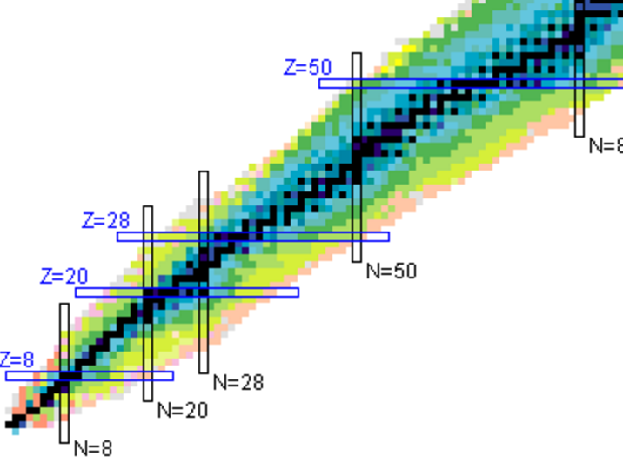
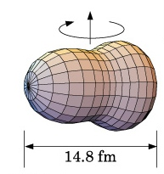
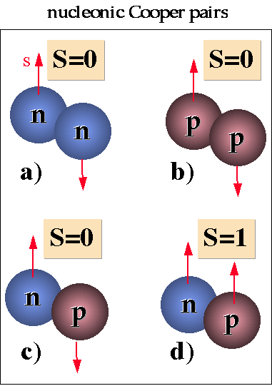
Physics of N~Z nuclei
N=Z
E. Clément/J.J. Valiente-Dobon
Octupoles in ¹¹²Xe
J.. Nyberg
^{102,103}Sn excited levels
B. Cederwall, R Wadsworth, G de France
T=0 pairing ⁸⁸Ru
S. Lenzi, F. Recchia
Iso. Symmetry Breaking A=63
Boso
⁷¹Kr-⁷¹Br – Isospin Symmetry Breaking
Does the Nuclear force identical for proton and neutron ?
New phenomena when proton and neutron occupy the same orbits ?
¹⁰⁰Sn magicity ?
Isospin Symmetry Breaking in the A=63,71 mirror nuclei
Studies of excited states in ^{102,103}Sn
Search for isoscalar pairing in the N=Z nucleus ⁸⁸Ru
Octupole – Quadrupole correlation in ¹¹²Xe

Slide 8
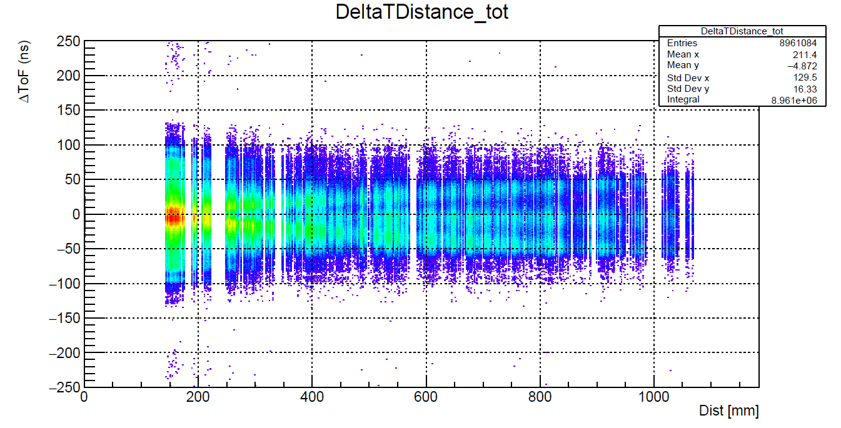
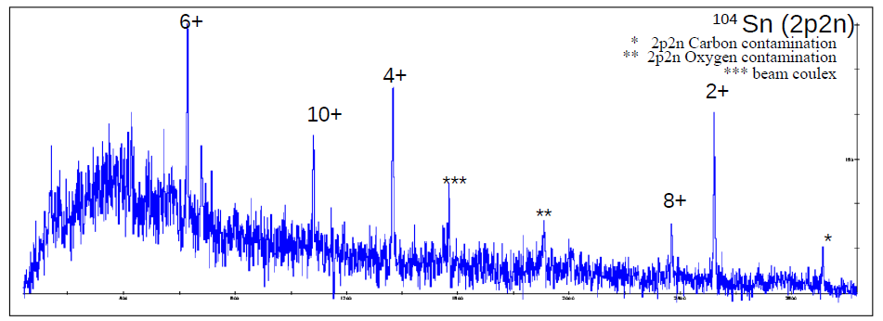
The NEDA setup : the 2n selectivity
Simulation
T. Huyuk and the NEDA collaboration,
Eur. Phys. J. A (2016) 52: 55 Page 5
ON-LINE
⁵⁸Ni(⁵⁰Cr,2p2n)¹⁰⁴Sn

Slide 9
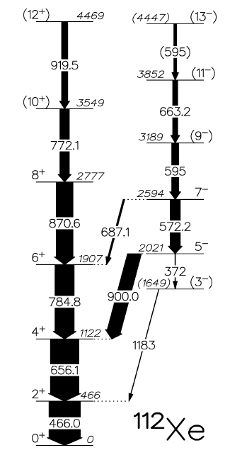
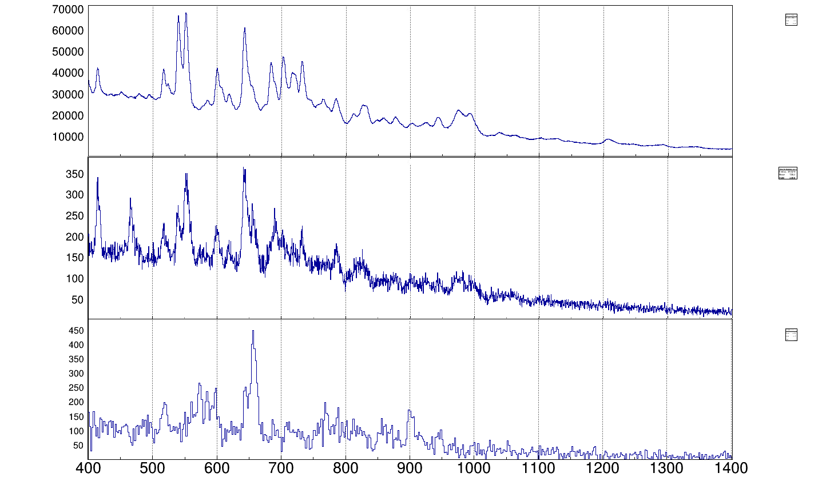
The NEDA setup : the 2n selectivity
Lifetime measurement ⁵⁸Ni+⁵⁸Ni at 250 MeV
1n2p
ON-LINE
2⁺
2n2p
7⁻
9⁻
4⁺
2n2p-2⁺ gated
6⁺
8⁺
5⁻
σ~100 μb
e⁺e⁻
3⁻ ?
D. Ralet, M. L. Jurado, EC et al,
OUPS Plunger, J. Ljungvall et al, NIM A 679 (2012) 61-66. Degrader mode

Slide 10
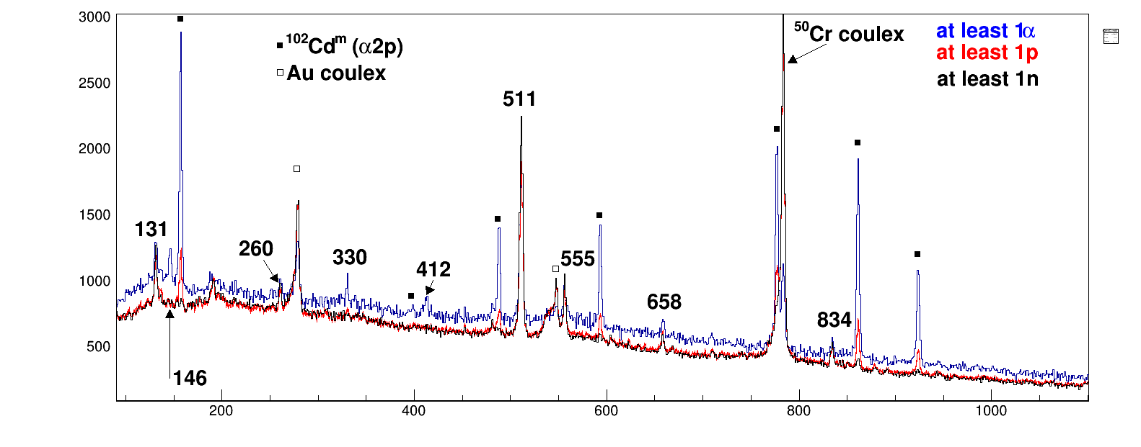
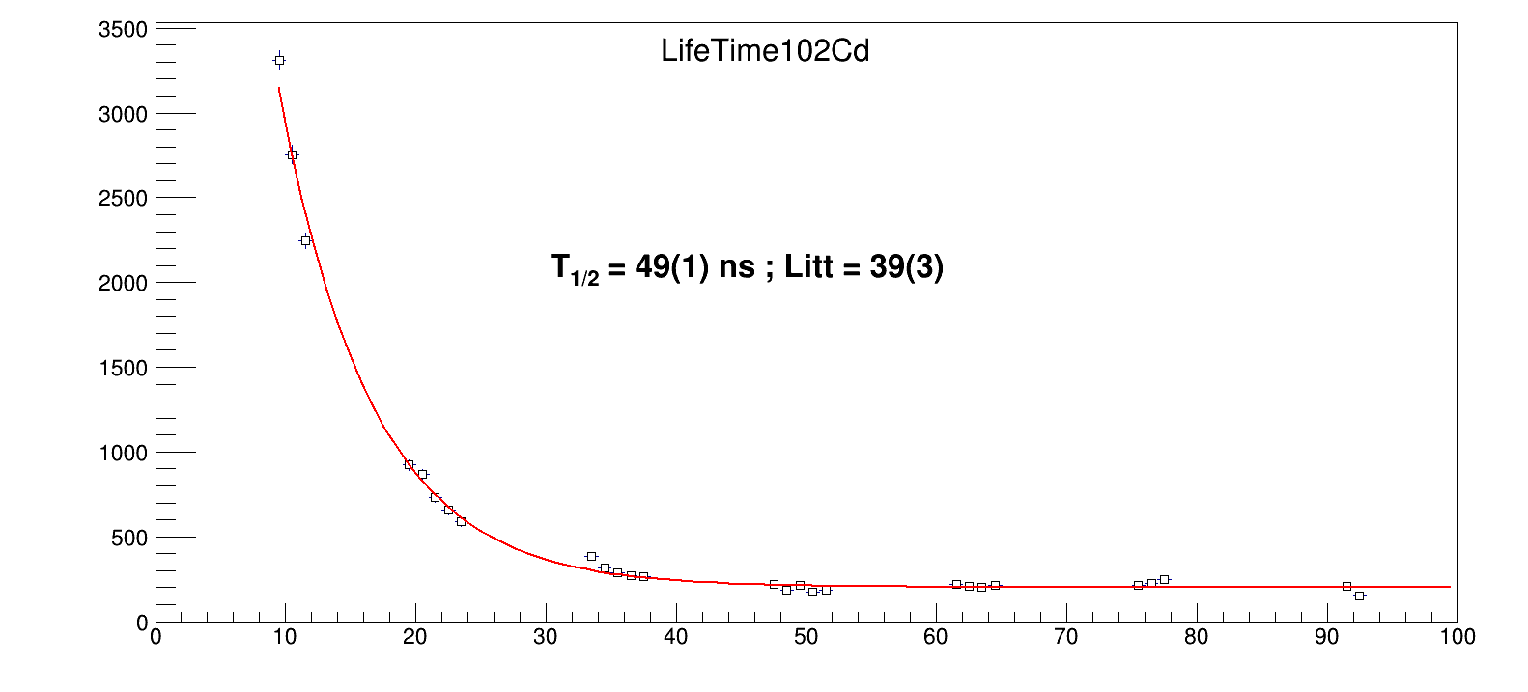
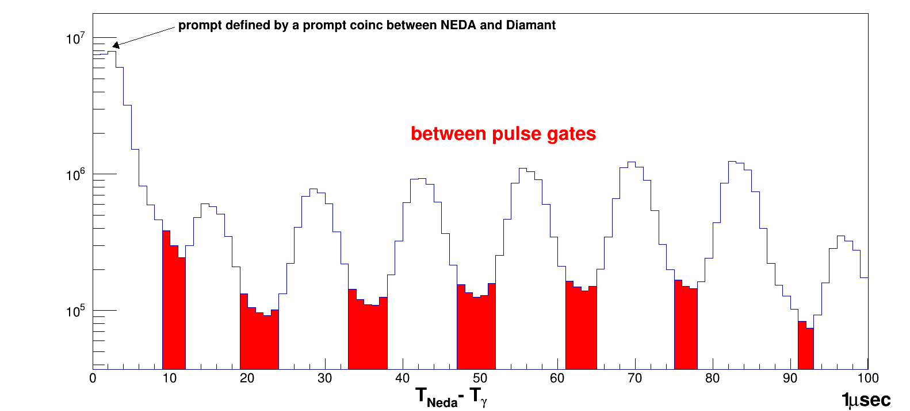
The NEDA setup : the isomer selectivity

Slide 11
MUGAST campaign 2019
Nucleons transfer spectroscopy using the SPIRAL1 ISOL beams
Nuclear Astrophysics: spectroscopic factors of relevant resonances for nucleosynthesis studies in radiative capture reactions: (⁶Li,d), (³He,d), (d,p)
Shell evolution:
spectroscopic factors, s.p. energies (d,p), (t,p), (³He,n)
n-p pairing, clusterization
Lifetime measurement after single nucleon transfer
2018 call for proposal
PAC meeting in November
Start of the campaign in April 2019

Slide 12
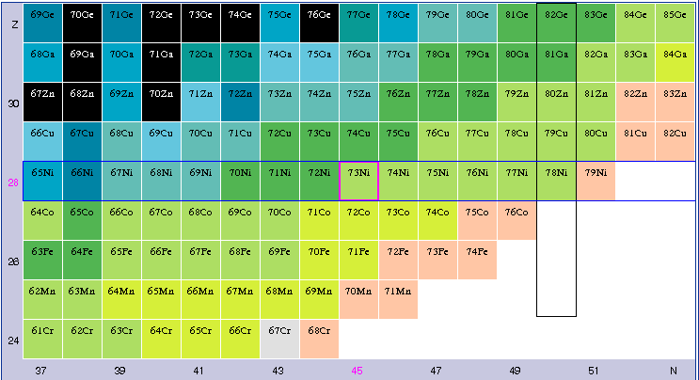
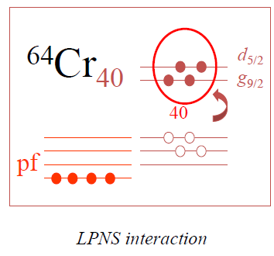
Shell evolution around Z=28
Interplay of the monopole terms of the interaction with multipole terms, like pairing and quadrupole, which determines the different phenomena we observe
Characterizing the islands of inversion, formed near the magic numbers.
These are new regions of deformation with configurations involving intruder orbitals from the above main shell.
While a signature of deformation is given by the energy of the first excited states, their lifetimes allow a better understanding of their properties by comparison with LSSM calculations

Slide 13
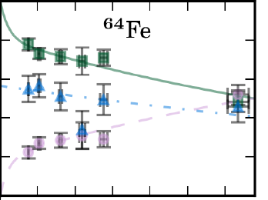
Shell evolution around Z=28
Interplay of the monopole terms of the interaction with multipole terms, like pairing and quadrupole, which determines the different phenomena we observe
Collecting spectroscopic data like transition probability constraining the theoretical description of the Island of inversion from N=28 to N=40 :
What is the influence of the νg9/2 and νd5/2 orbits ?
What is the influence of the proton excitations across Z=28 ?
How collectivity change when decreasing the number of proton in the f7/2 orbital
Lifetimes of the 4⁺ states in ^{62;64}Fe and the 11/2⁻ in ^{61;63}Co and ⁵⁹Mn
M. Klintefjord et al., PRC 95, 024312 (2017)

Slide 14
Shell evolution around Z=28
Interplay of the monopole terms of the interaction with multipole terms, like pairing and quadrupole, which determines the different phenomena we observe
Collecting spectroscopic data like transition probability constraining the theoretical description of the Island of inversion from N=28 to N=40 :
What is the influence of the νg9/2 and νd5/2 orbits ?
What is the influence of the proton excitations across Z=28 ?
How collectivity change when decreasing the number of proton in the f7/2 orbital
Lifetimes in ⁵⁴Ti and in neighboring isotopes have
been determined
4+
2+
A. Goldkuhle et al. to be submitted

Slide 15
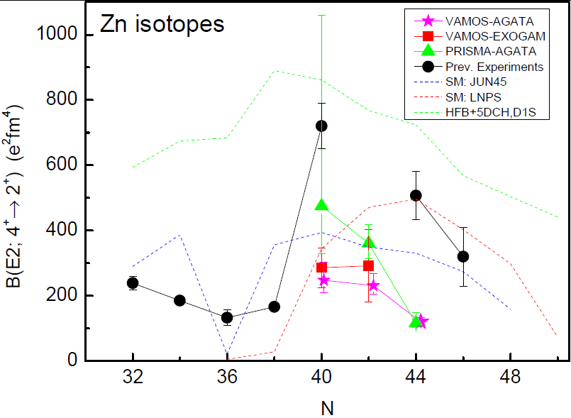
Shell evolution around Z=28
Interplay of the monopole terms of the interaction with multipole terms, like pairing and quadrupole, which determines the different phenomena we observe
Dirken et al., PRC 82 (2010) 064309
I. Čeliković, Ph.D. Thesis, GANIL 2013
C. Louchart et al., Phys. Rev. C, 87 054302 (2013)
⁷³Ga ground-state: 3/2⁻, 1/2⁻ doublet?
→ determine the M1 component of the first 5/2⁻
Obtained lifetime :
Fast M1 component in the decay of the first 5/2⁻ state.
Confirms 1/2⁻, 3/2⁻ g.s. doublet
I. Celikovic, C. Michelagnoli et al.

Slide 16
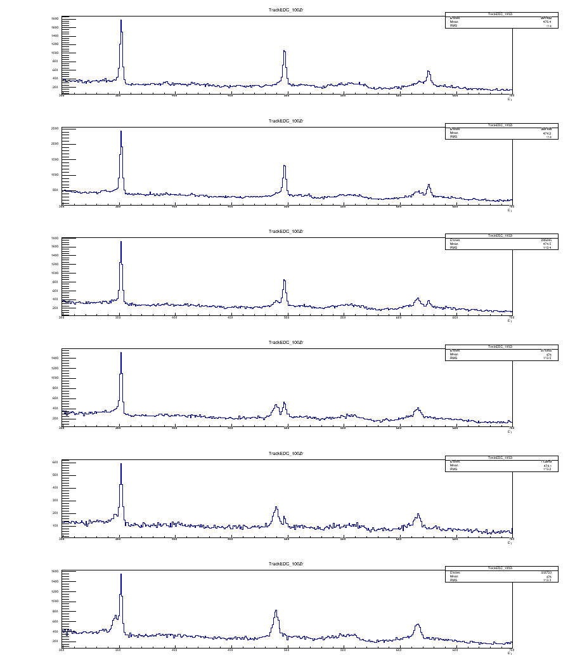
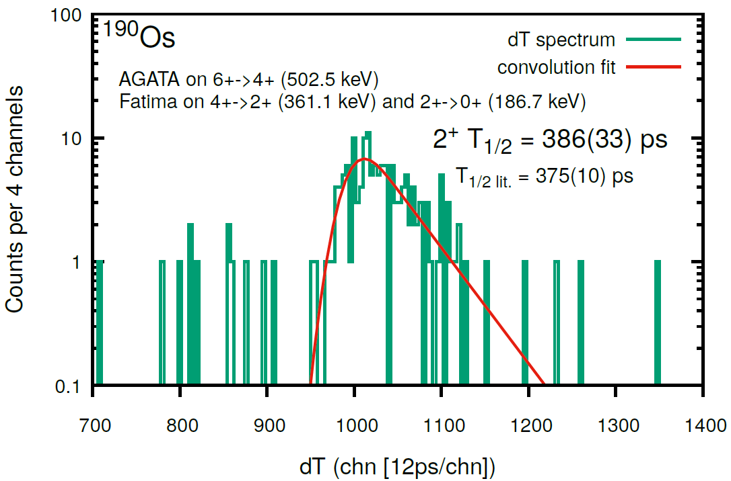
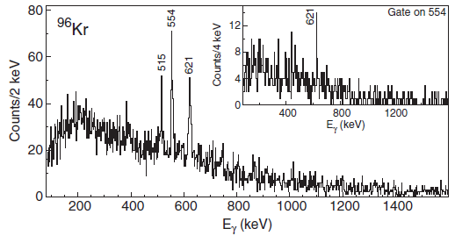
Shape evolution in fission fragments in the A~100 region
AGATA-VAMOS and a plunger + FATIMA for lifetime measurements using the ⁹Be(²³⁸U,FF) reaction
W. Korten, A. Görgen et al
Ph. John
¹⁰⁰Zr
On-line
On-line
High resolution spectroscopy of ⁹⁶Kr
J. Dudouet et al. Phys. Rev. Lett. 118, 162501 (2017)
+ Plunger (short lifetime I^{π} >4⁺)

Slide 17
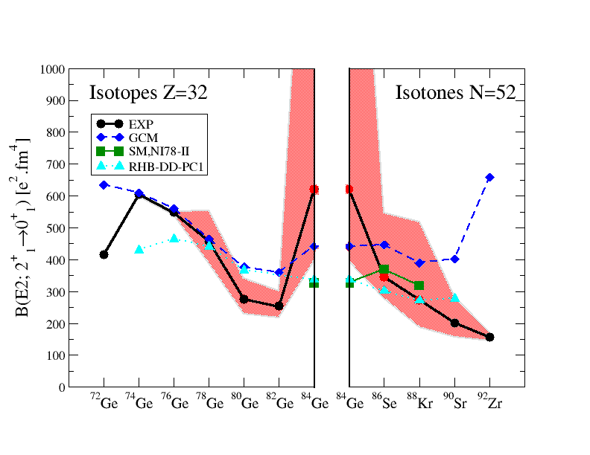
The quenching of the N=50 gap towards
⁷⁸Ni can be investigated looking at the
Spectroscopy of excited states involving particle-hole excitations across the N=50 gap
First lifetime of excited states measured in ⁸⁸Kr
Lifetime measured with better accuracy in ⁸⁶Se
First lifetime measured in the very exotic ⁸⁴Ge
Unexpected enhancement of collectivity in ⁸⁴Ge
Sudden rise of collectivity after the N=50 shell closure
… in contradiction with shell model calculation
⁸¹Ga spectroscopy
J. Dudouet et al, to be submitted
C. Delafosse et al., submitted to Phys. Rev. Lett.

Slide 18
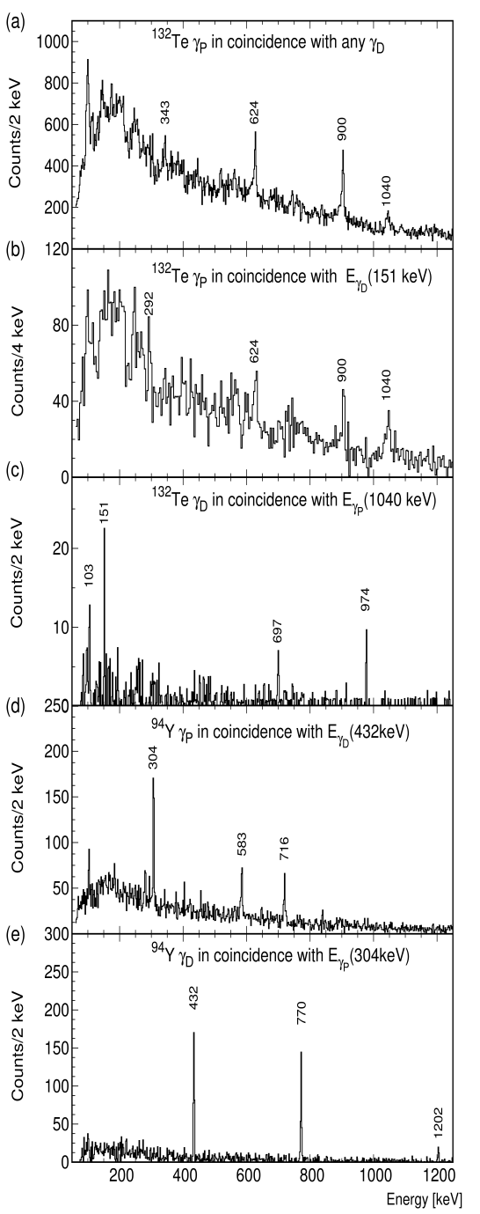
Prompt-Delayed Spectroscopy of Fission Fragments
Triple Coincidences (A,Z),γ_{p}, γ_{D}
New transitions above known isomer
t_{1/2} = 1.33 (0.01) µs
Work in progress :
Large data set to be explored
Y-H Kim et al, EPJ A 53, 162 (2017)
S. Biswas et al, in Preparation

Slide 19
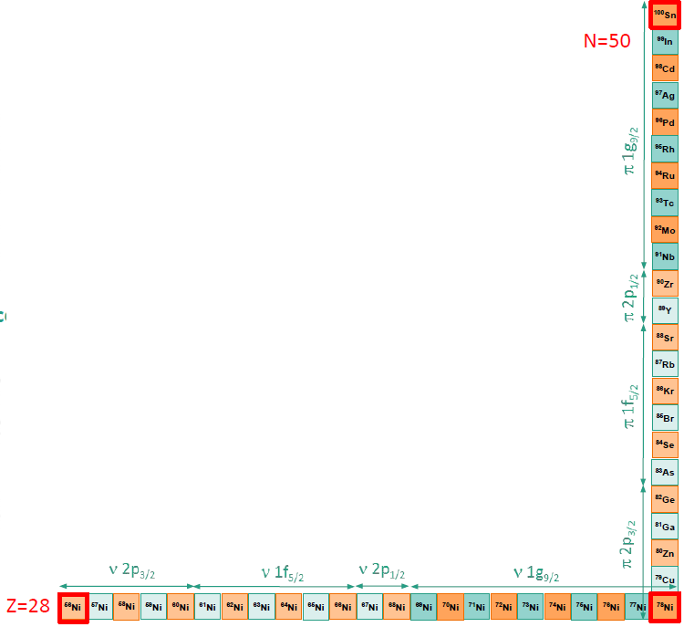
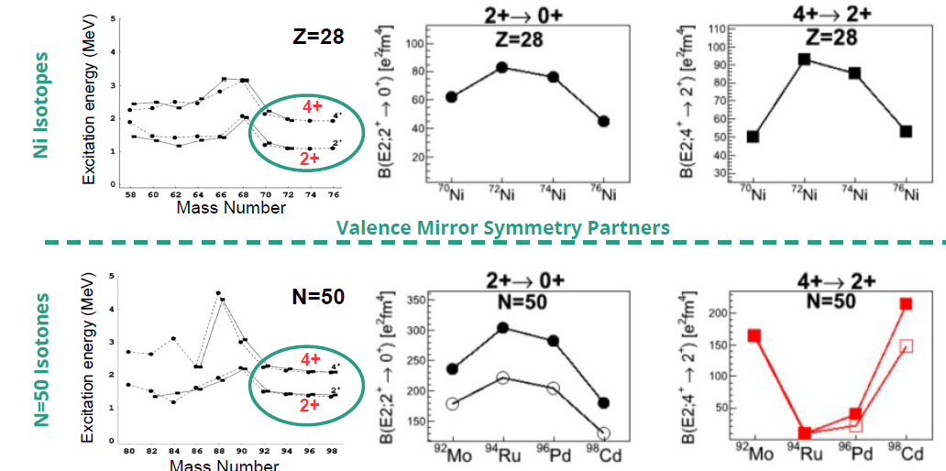
Shell evolution around ¹⁰⁰Sn
⁹²Mo and ⁹⁴Ru have similarities with Ni isotopes, filling the same orbitals than protons in N = 50 isotones.
Lisetskiy et al PRC (2004) :
courtesy of R. Perez Vidal
Notes:
Indeed, the energy of the lowest 2+ and 4+ states are quite similar for 70􀀀76Ni isotopes to those in 92Mo,94Ru,96Pd and 98Cd.

Slide 20
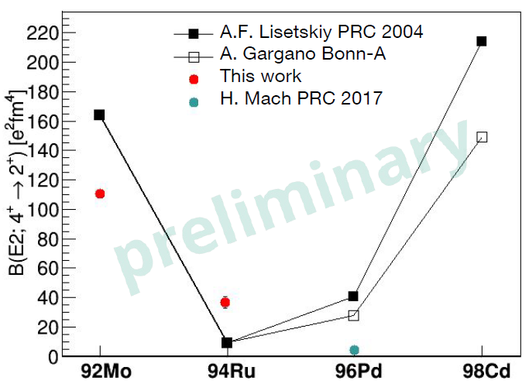
Shell evolution around ¹⁰⁰Sn
courtesy of R. Perez Vidal

Slide 21
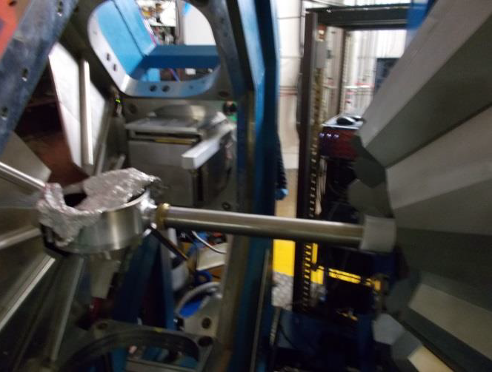
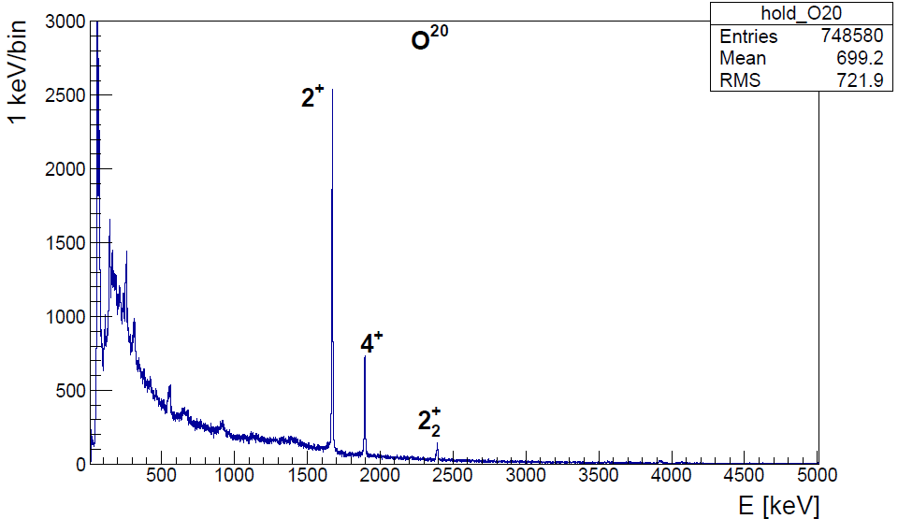
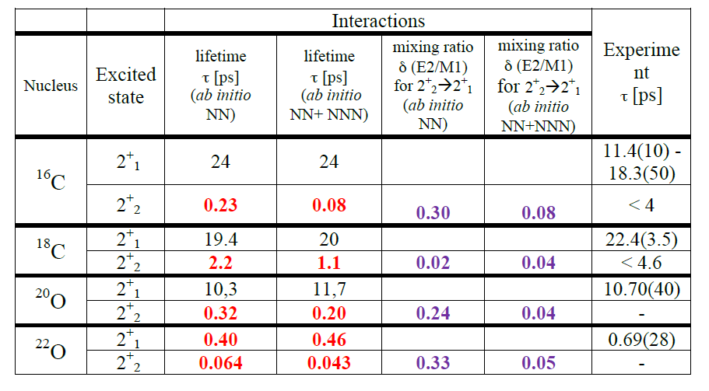
Lifetime in n-rich O and C
S. Leoni, B. Fornal, M. Ciemala et al.,
Lifetime measurement in the non-yrast excited states of neutron rich C and O isotopes. Branching ratio and E2/M1 using the PARIS LaBr3 array
The 2⁺₂ state corresponds to a neutron (d_{5/2})³(s_{1/2})¹ configuration
C. R. Hoffmanu et al .PRC 85, 054318 (2012)
T. Otsuka PRL 105, 032501 (2010)
⁹⁸Pt/Tl(¹⁸O, ^{16,18}C, ²⁰O)

Slide 22
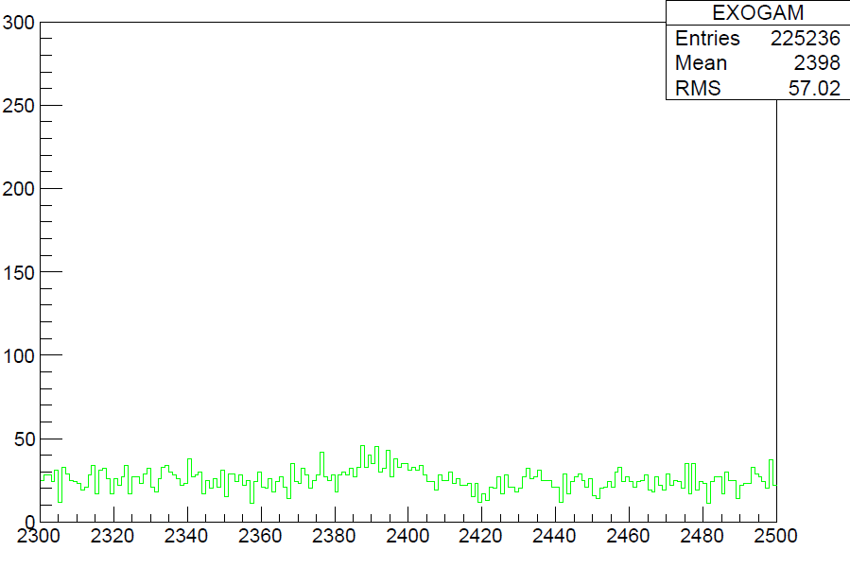
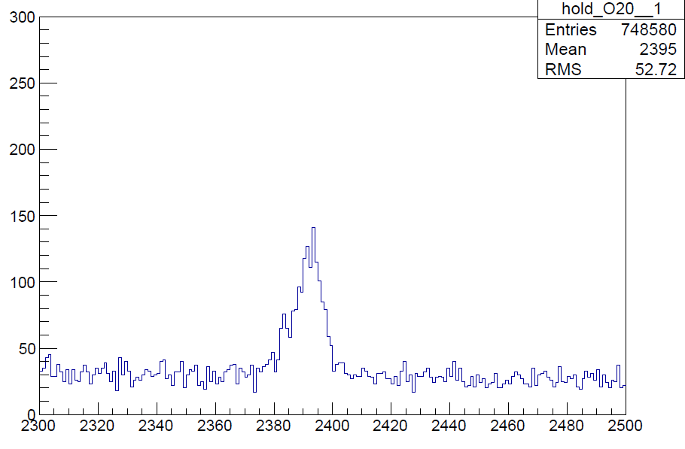
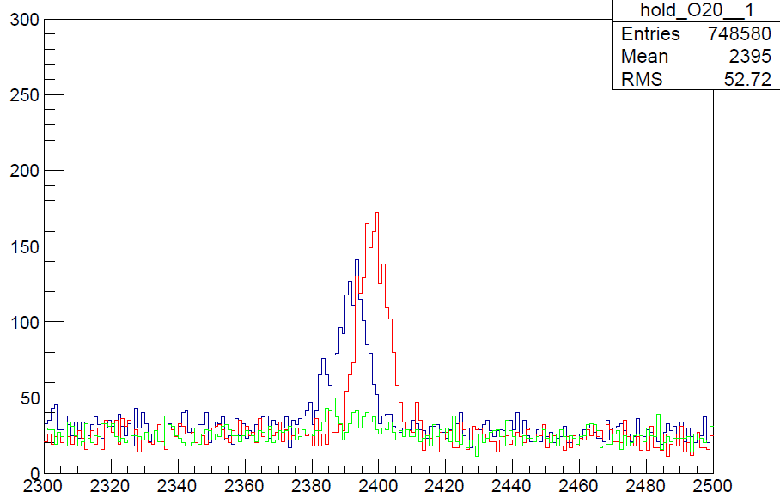
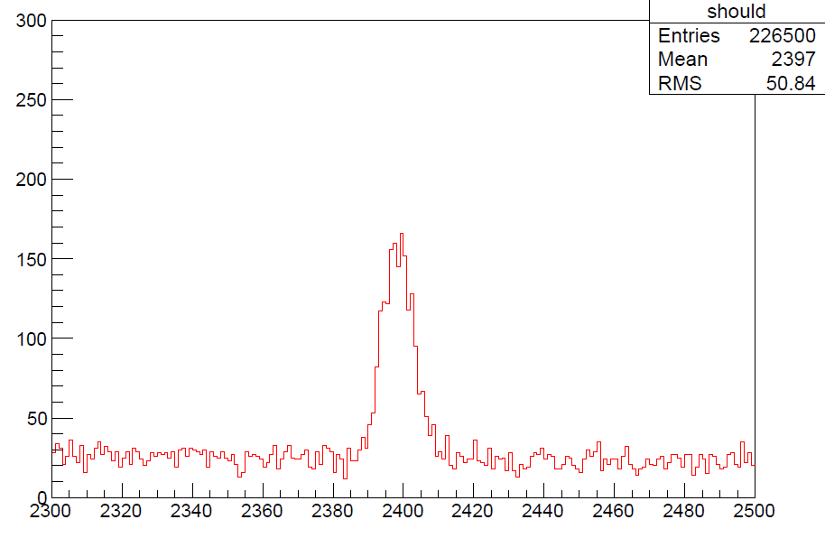
Performances of AGATA
AGATA-VAMOS++ (simulated if lifetime > 1 ps)
The lifetime is short; below ps
Ab-initio are in the good order of magnitude
EXOGAM-VAMOS (simulated)
AGATA-VAMOS++ (measured)
second 2⁺ → 2⁺ 2.4 MeV
2⁺ → G.S. 1.6 MeV
2⁺₂→2⁺₁
0.004
Preliminary
0.003
0.002
τ = 100 fs
CENTROID SHIFT
τ = 150 fs
0.001
τ = 200 fs
0.000
τ = 11 ps
130
140
150
160
170
Theta [degree]
S. Leoni, B. Fornal, M. Ciemala et al.,

Slide 23
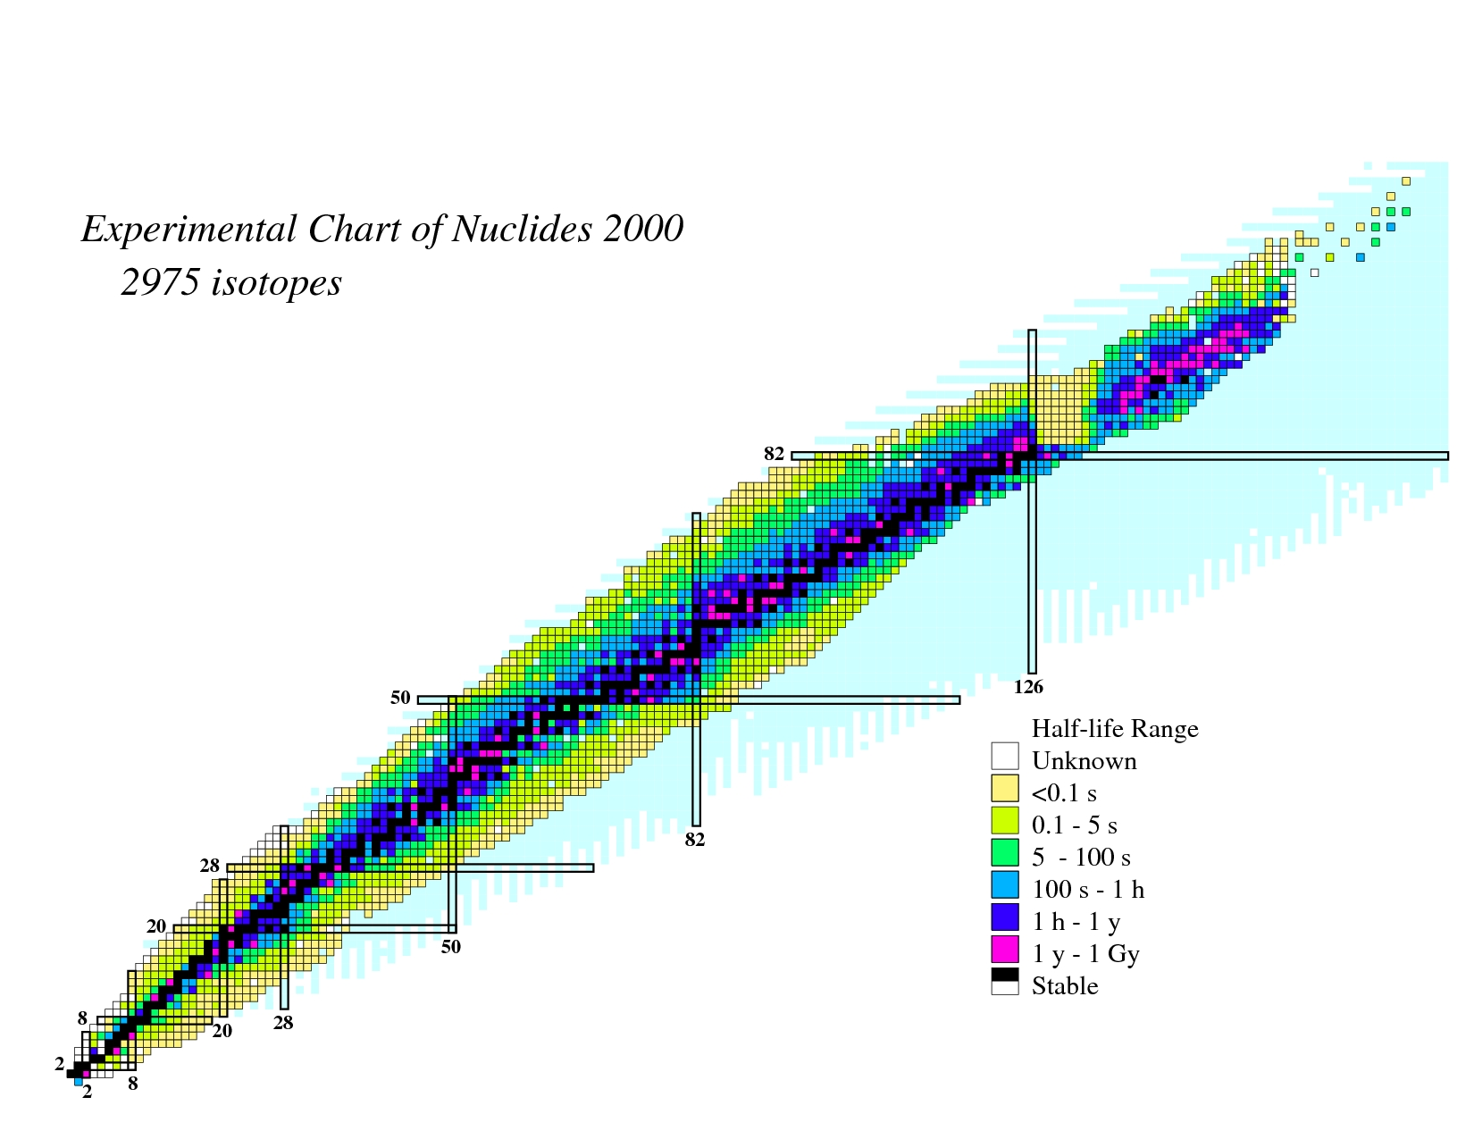
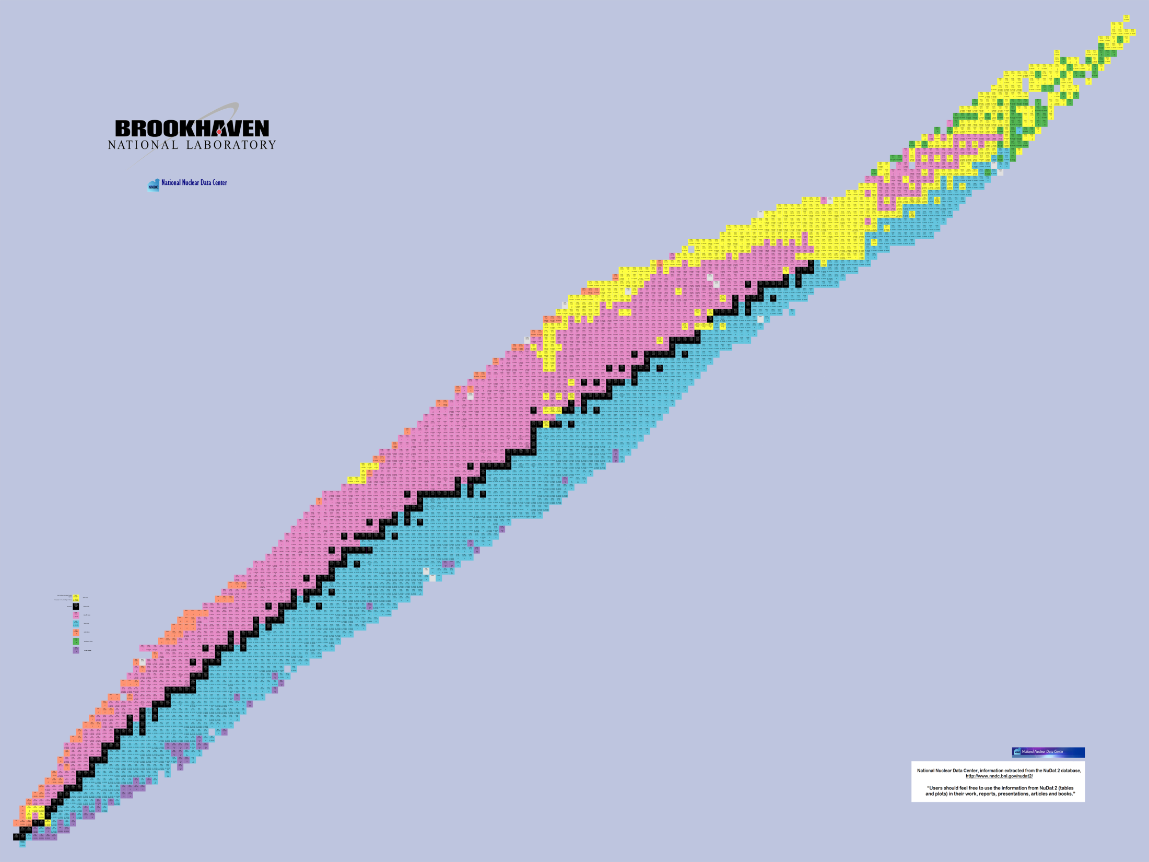
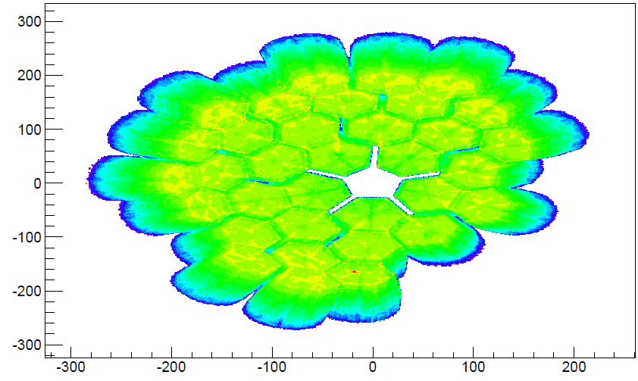
Experiments performed in 2015-2018 at GANIL with AGATA
Search for Double Gamma decay in ¹³⁷Cs source
Reaction mechanism : Fission of Light Hg
Octupole – Quadrupole correlation in ¹¹²Xe
²⁰⁸Pb
Studies of excited states in ^{102,103}Sn
Octupole correlation in ²⁰⁷Pb
Evolution of collectivity around N=50: lifetime measurements ^{104,106}Sn
Exploration of alpha-cluster : the unique case of ²¹²Po (²⁰⁸Pb + α)
Evolution of collectivity around N=50: lifetime measurements ⁹⁴Ru
Shape transition in the neutron-rich W isotopes
Search for isoscalar pairing in the N=Z nucleus ⁸⁸Ru
Transition Quadrupole Moments in ^{166,168}Dy.
¹⁰⁰Sn
i_{13/2} single particle state in ¹³³Sn and high spin in ¹⁰⁸Zr
Isospin Symmetry Breaking in the A=63,71 mirror nuclei
¹³²Sn
Shape evolution in neutron rich fission fragments in the mass A~100 region
⁶⁸Ni
⁷⁸Ni
Shell evolution around N=50: ⁸¹Ga spectroscopy
Evolution of collectivity around N=52: lifetime measurements in ^{83,84}Ge
Evolution of collectivity around N=40: lifetime measurements in ^{73,75}Ga
⁴⁸Ca
Evolution of collectivity around N=40: lifetime measurements in ⁶⁴Fe
Evolution of the shell structure in the region of neutron-rich Ti isotopes
Lifetime measurements of excited states in neutron-rich C and O isotopes
The lifetime of the 7.786 MeV state in ²³Mg as a probe for classical novae models

Slide 24
Conclusion
AGATA is operated since 2014 at GANIL and 22 experiments have been performed
In 2017 LaBr3 arrays have been coupled to the AGATA-VAMOS setup
In 2018, a successful campaign was performed using the unique combination of AGATA(γ), NEDA (n) and DIAMANT (p,α)
The next campaign starting in April 2019 will use the MUGAST-AGATA-VAMOS setup with the ISOL SPIRAL1 beams
Many results are coming all along the nuclear chart for many different physics topics
AGATA 1π at GANIL is very competitive for lifetime measurement from fs to ns in transfer, fission and fusion induced reaction
Notes:
4 Papers published (Kim, Dudouet, Klintefjord , Clément)
1 submitted (Delafosse)
4 in Preparation ( Damian, Siliciano, Duduouet2, Perez)
2 Technical in Preparation (Li, Michelagnoli)
(2016 - Alina, Celikovic, Navin, Michelagnoli)(2017 – Jungclauss,, John, Korten, Leoni, Camaano, Schmitt ) (2018 – Lenzi, Nyberg, Cederwall, Boso, Clement)
PhD (Klintefjord*, Delafosse, Siciliano*, Perez*, Alina, Celikovic’student, Alvaro, Dupont, Saba)

