Slide 1




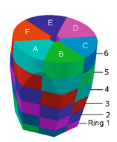



AGATA
What is AGATA?
Recent physics highlights from AGATA
AGATA technology in the UK
Precision Spectroscopy of Exotic Nuclei using AGATA
Mike Bentley & UK AGATA Collaboration

Slide 2

Gamma-ray spectroscopy
Precision spectroscopy of nuclear states
Gamma-ray (hence level) energies
Complex level schemes (γ^{n} coincidences)
(high resolution essential – i.e. Ge)
Precision probes of the nuclear wave function:
Lifetimes (transition matrix elements)
Electromagnetic moments
Cross-sections for direct reactions

Slide 3
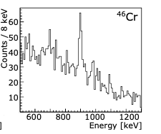
The need for AGATA
The challenge of the new generation of radioactive beam facilities
Low intensity
High background
Large Doppler broadening
High counting rates
High gamma-ray multiplicities
FAIR (Germany)
SPIRAL (France)
SPES (Italy)
HIE-ISOLDE (CERN)
Radioactive beam of ⁴⁶Cr
2⁺ -> 0⁺
v/c ~ 50%
High efficiency
Distinguish gammas from b/g
Highly position sensitive
High data throughput
Can distinguish multiple gammas
AGATA (GSI)
The ideal γ-ray spectrometer

Slide 4
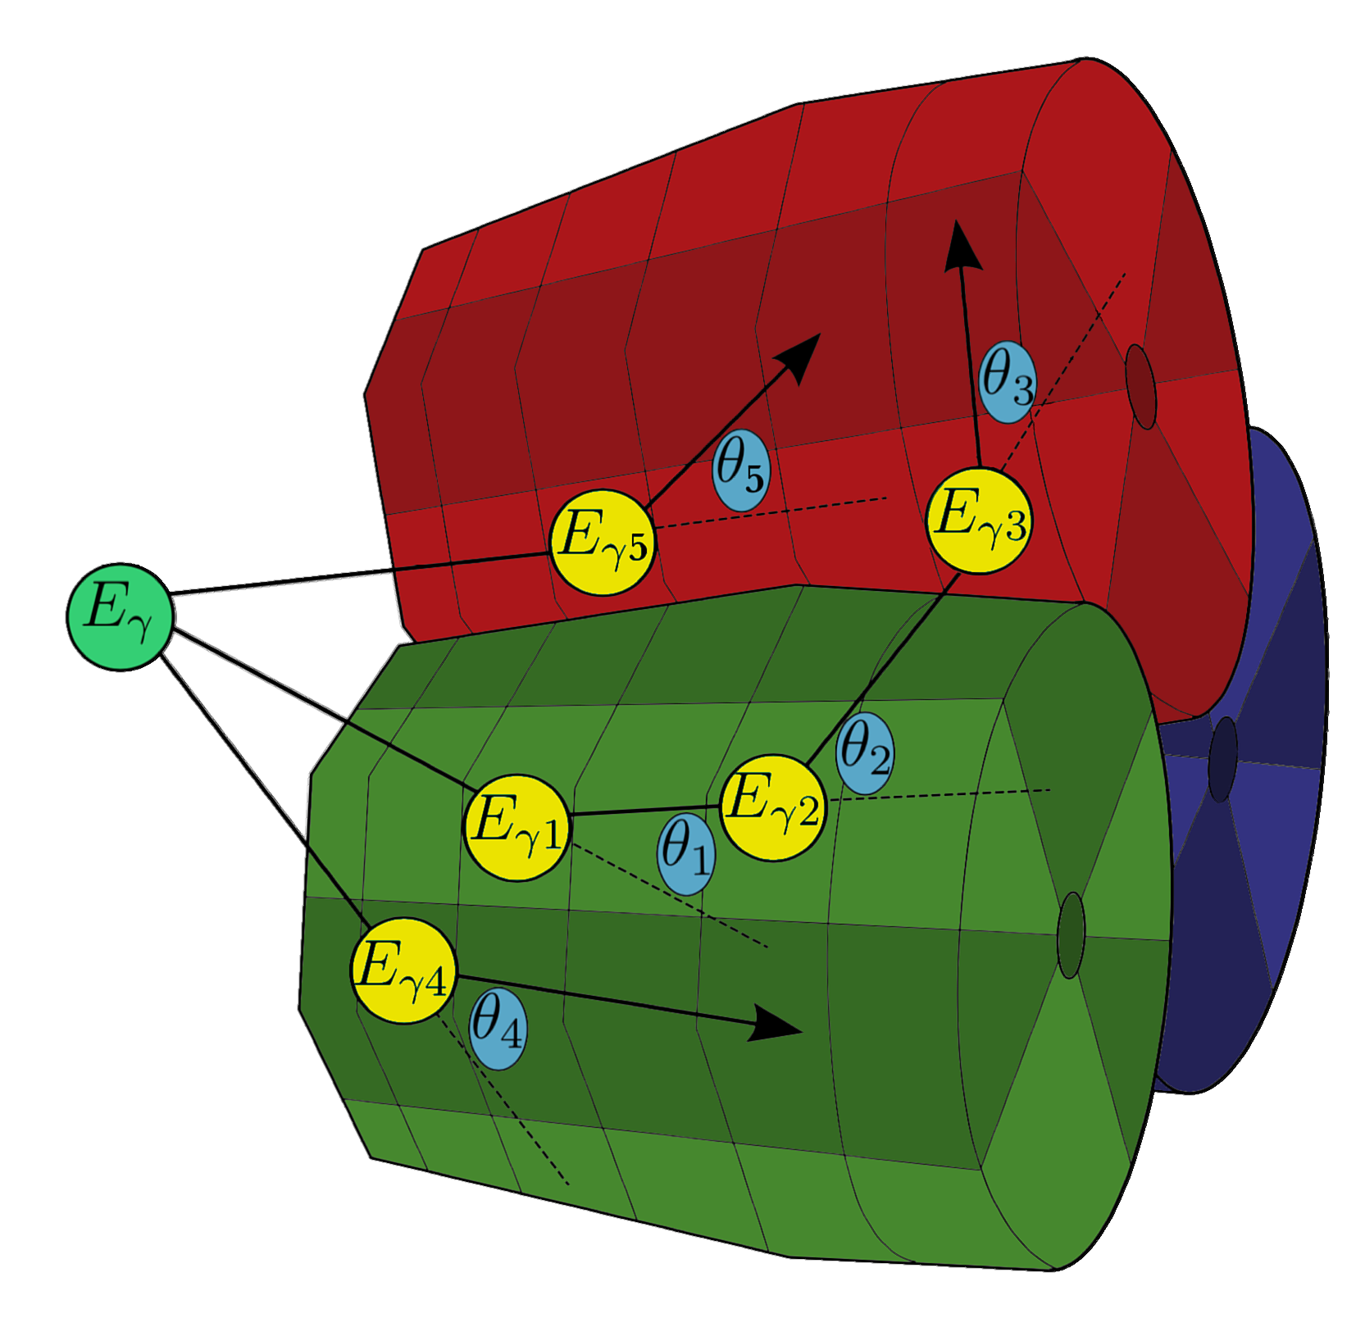













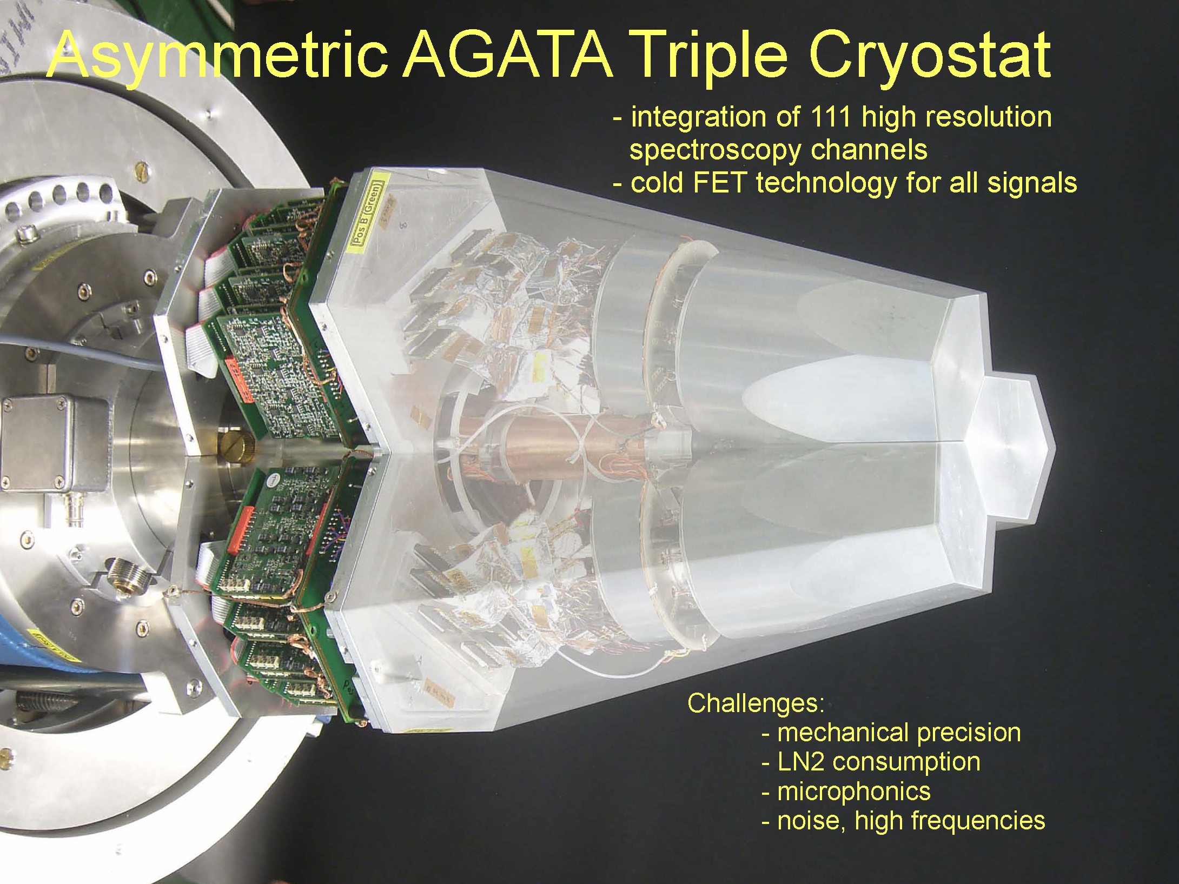
What is AGATA?
13 Countries, >40 Institutions
Solid Sphere of Ge material: Solid angle coverage ~ 82 %
36-fold segmentation of crystal
Track each gamma interaction through the crystal
Reconstruct and disentangle gammas
180 hexagonal crystals: 3 shapes
3 fold clusters (cold FET): 60 all equal
Inner radius (Ge): 23.5 cm
Amount of germanium: 362 kg
36-fold segmentation 6480 segments
AGATA Definition: NIM A 668 (2012) 26

Slide 5
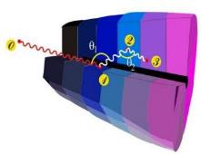
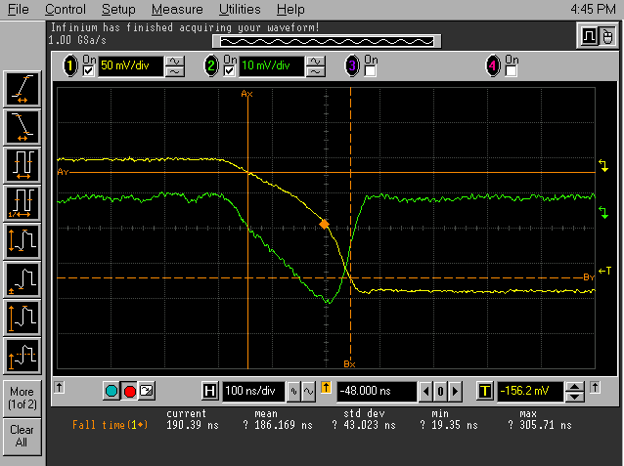
The concept of γ-ray tracking
4
1
Identified
interaction points
Highly segmented
HPGe detectors
Evaluation of permutations of interaction points
γ
(x,y,z,E,t)_{i}
Pulse Shape Analysis
to decompose
recorded waves
3
2
Digital electronics
to record and
process signals
Reconstructed γ rays

Slide 6
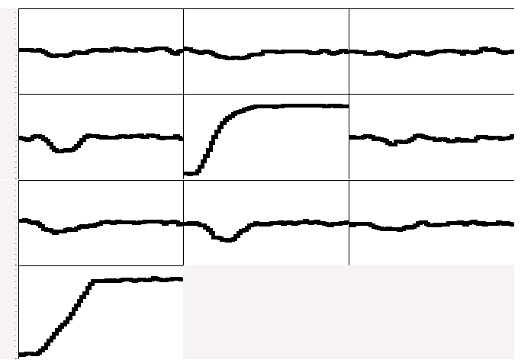
Pulse Shape Analysis concept
A3
A4
A5
(10,10,46)
B3
B4
B5
(10,30,46)
C3
C4
C5
y
CORE
C4
B4
measured
D4
A4
x
791 keV deposited in segment B4
E4
F4
z = 46 mm

Slide 7
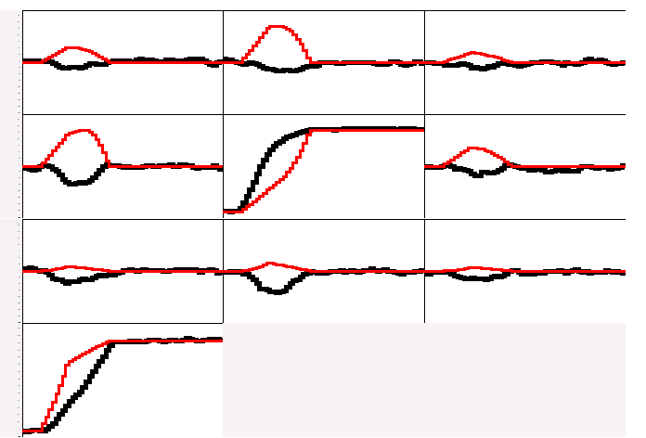
Pulse Shape Analysis concept
A3
A4
A5
B3
B4
B5
(10,10,46)
C3
C4
C5
y
CORE
C4
B4
measured
calculated
D4
A4
x
791 keV deposited in segment B4
E4
F4
z = 46 mm

Slide 8
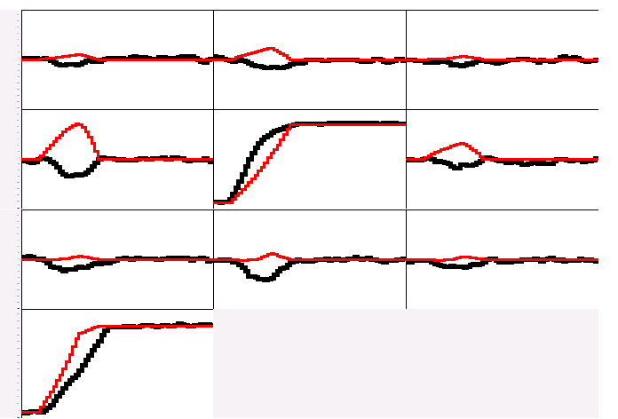
Pulse Shape Analysis concept
A3
A4
A5
B3
B4
B5
(10,15,46)
C3
C4
C5
y
CORE
C4
B4
measured
calculated
D4
A4
x
E4
F4
791 keV deposited in segment B4
z = 46 mm

Slide 9
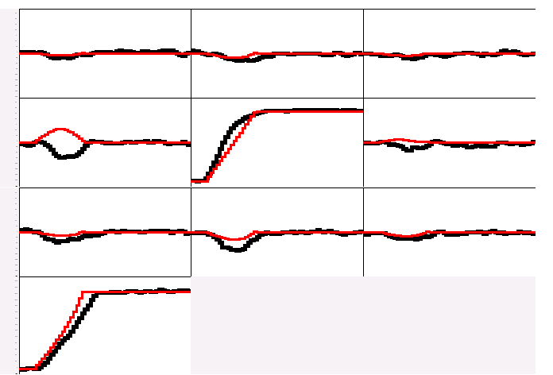
Pulse Shape Analysis concept
A3
A4
A5
B3
B4
B5
(10,20,46)
C3
C4
C5
y
CORE
C4
B4
measured
calculated
D4
A4
x
791 keV deposited in segment B4
E4
F4
z = 46 mm

Slide 10
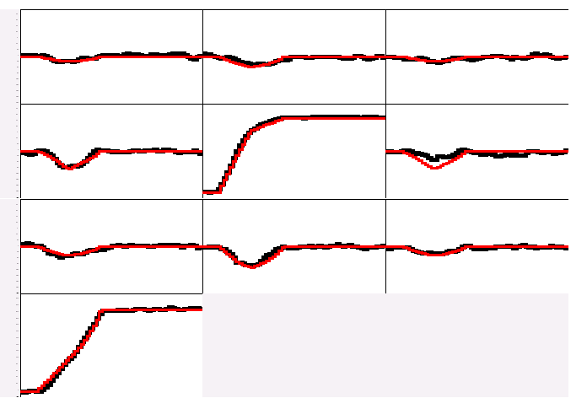
Pulse Shape Analysis concept
A3
A4
A5
B3
B4
B5
(10,25,46)
C3
C4
C5
y
CORE
C4
B4
measured
calculated
D4
A4
x
791 keV deposited in segment B4
E4
F4
z = 46 mm

Slide 11
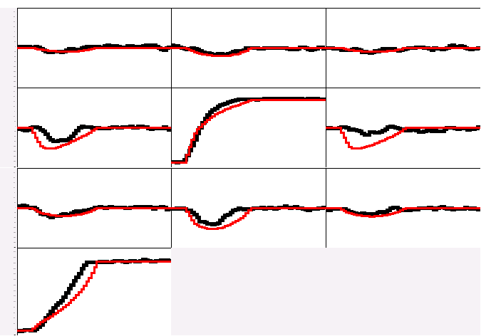
Pulse Shape Analysis concept
A3
A4
A5
B3
B4
B5
(10,30,46)
C3
C4
C5
y
CORE
C4
B4
measured
calculated
D4
A4
x
791 keV deposited in segment B4
E4
F4
z = 46 mm

Slide 12
Pulse Shape Analysis concept
A3
A4
A5
Result of
Grid Search
algorithm
B3
B4
B5
(10,25,46)
C3
C4
C5
y
CORE
C4
B4
measured
calculated
D4
A4
x
791 keV deposited in segment B4
E4
F4
z = 46 mm

Slide 13

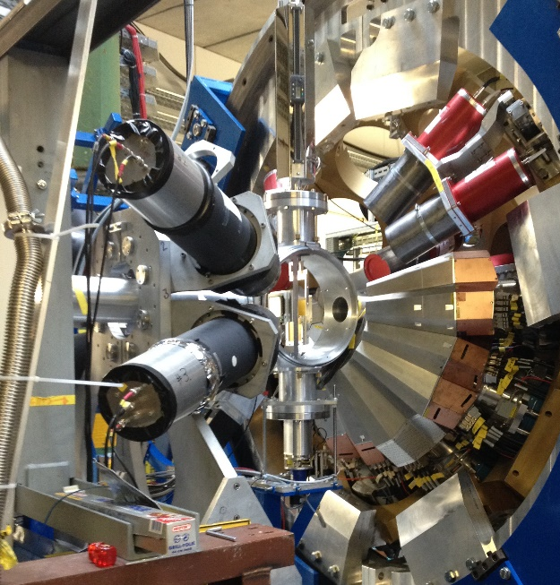
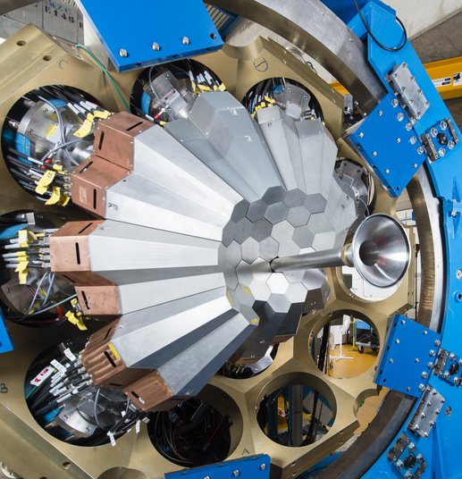
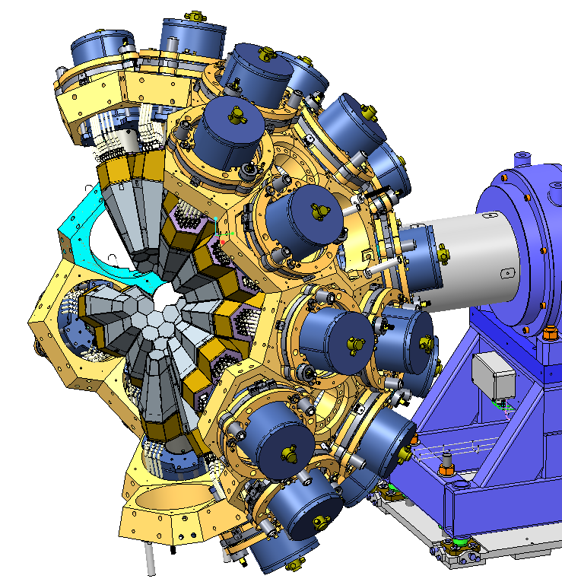
The AGATA journey…
2012-2014
GSI, Germany
~25 detectors
2014-2021
GANIL, France
45 -> detectors
2021-2024
Legnaro, Italy
60 -> detectors
2025 ->
FAIR, Germany
80-90 detectors
AGATA at GSI
AGATA at GANIL
AGATA at LNL
AGATA at NUSTAR
Reaccelerated RIBs:
Coulomb Excitation, Direct Reactions, MNT, Deep Inelastic, Fusion
Direct and inverse kinematics β ~ 10%
In-flight RIBs:
Relativistic Coulomb Excitation, Knockout, Fragmentation.
β ~ 50%

Slide 14
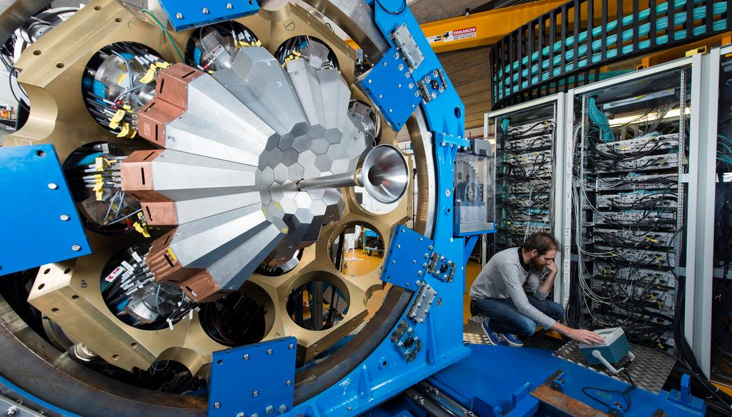
Recent Highlights at GANIL
2014-2021
GANIL, France
45 -> detectors
AGATA at GANIL

Slide 15

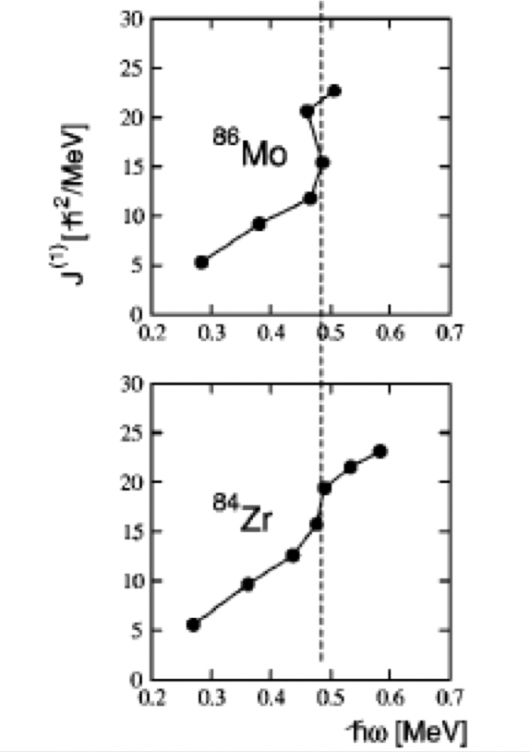
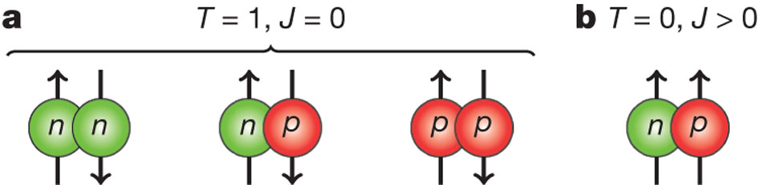
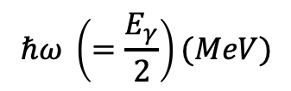

Neutron-proton pairing in N = Z nuclei
ISOVECTOR
ISOSCALAR
Moment of inertia = I / ω ($ℏ^{2}/MeV$)
Search for np T=0 pairing in N=Z nuclei, evidence is elusive
Is there a “fluid” of T=0 np pairs along with “normal” T=1 pairs?
T=0 pairing may respond differently to rotational motion
Look for delayed rotational alignments in heavy N=Z nuclei
S. Frauendorf, A.O. Macchiavelli, Prog. in Particle and Nuclear Physics 78, 24 (2014)
$$ℏω \left(=\frac{E_{γ}}{2}\right)(MeV)$$

Slide 16
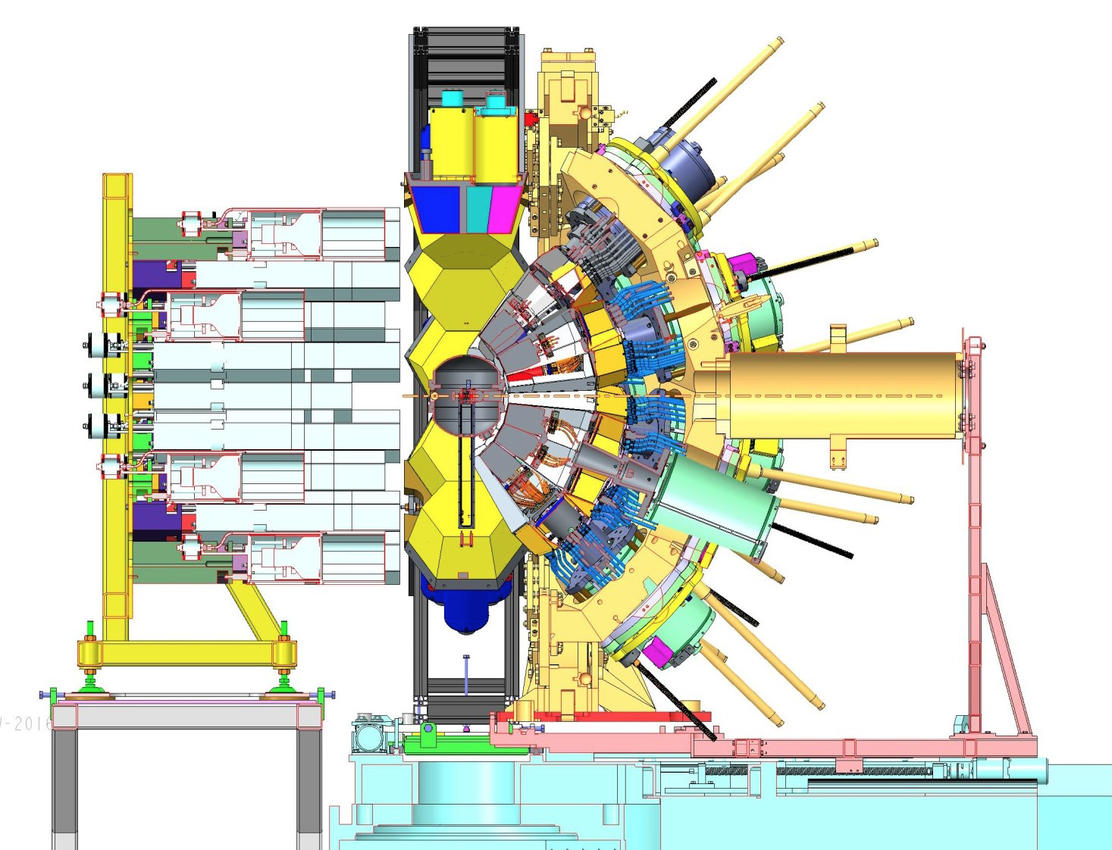
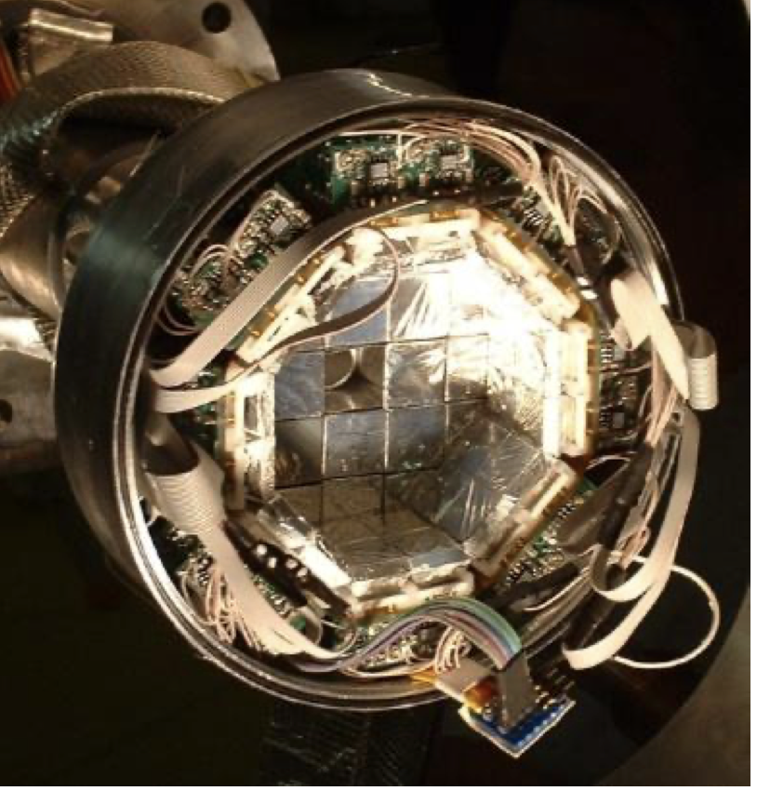
N=Z ⁸⁸Ru studied using AGATA
Bo Cederwall, KTH Stockholm
Bob Wadsworth, University of York
et al.
B. Cederwall et al., Phys. Rev. Lett. 124, 062501 (2020)
Fusion Reaction: ³⁶Ar + ⁵⁴Fe → ⁸⁸Ru + 2n + γ
Cross section σ ~ few μb
NEDA (neutron detectors)
Select two-neutron events
DIAMANT (CsI)
Reject charged-particle events
AGATA
Record multiple gamma rays
Power of AGATA:
High Efficiency
Multiple simultaneous γ rays

Slide 17

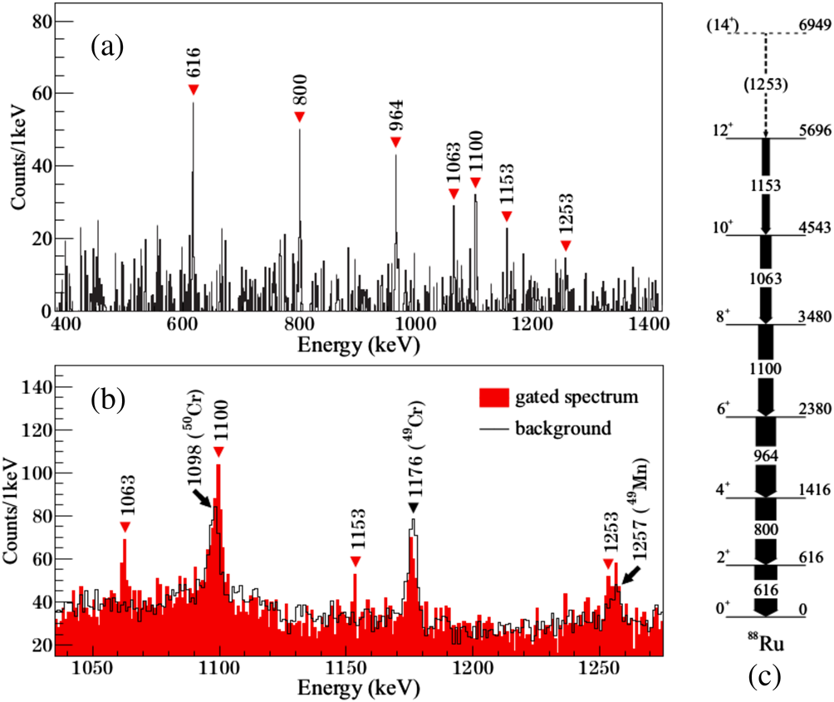
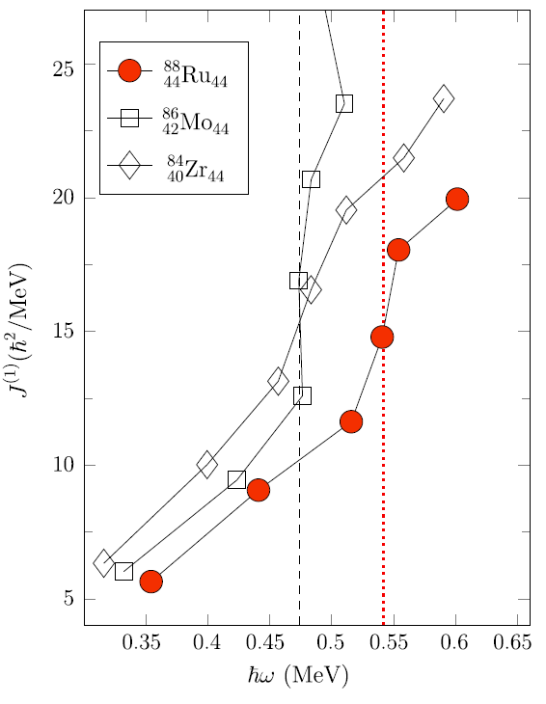
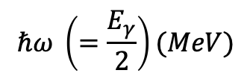

N=Z ⁸⁸Ru studied using AGATA
Bo Cederwall, KTH Stockholm
Summed two-neutron γ-γ spectrum
AGATA
Moment of inertia = I / ω ($ℏ^{2}/MeV$)
New
$$ℏω \left(=\frac{E_{γ}}{2}\right)(MeV)$$
Delayed alignment (πg_{9/2})²
…in N=Z system
B. Cederwall et al., Phys. Rev. Lett. 124, 062501 (2020)

Slide 18
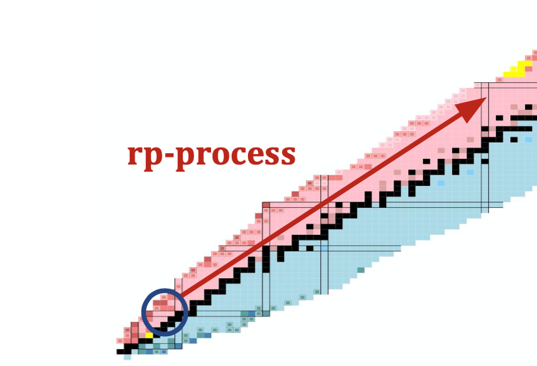
¹⁵O + α studied using AGATA: A crucial reaction in astrophysics
Jennifer Sanchez Rojo, Christian Diget, University of York
Thermonuclear runaway producing flashes: X-ray bursts
Site of the rp-process creating heavier elements up to A~100
Neutron stars in binary systems: accrete matter from companion
¹⁵O captures alpha particle ¹⁵O(α,γ)¹⁹Ne
Regulates flow between HCNO cycle and rp-process
¹⁹Ne 4.033 MeV state biggest contribution to reaction rate
Reaction rate through this state unknown (upper limit)
Hot CNO cycle(s)
= p-capture
= β decay

Slide 19
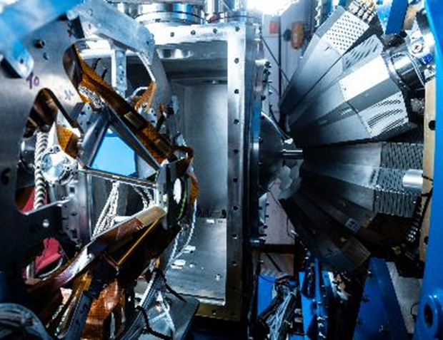
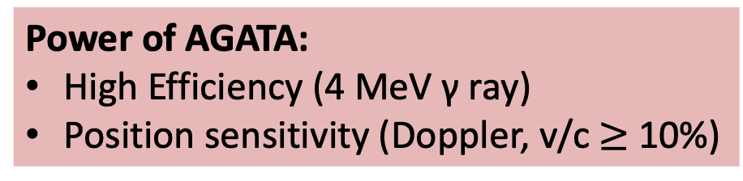
¹⁵O + α studied using AGATA at GANIL
¹⁵O radioactive beam
Cross section ~ few μb
Very challenging!
Power of AGATA:
High Efficiency (4 MeV γ ray)
Position sensitivity (Doppler, v/c $≥$ 10%)
Jennifer Sanchez Rojo, Christian Diget, University of York

Slide 20

¹⁵O + α studied using AGATA at GANIL
Jennifer Sanchez Rojo, Christian Diget, University of York
See Jenn’s talk Tomorrow (Tuesday)
J. Sanchez Rojo
3:45 PM - 4:00 PM Nuclear Astrophysics 1
4.033 MeV gamma-ray
Few (10?) counts expected
¹⁹Ne (VAMOS)-gated Doppler Corrected AGATA Spectrum
3500
4000

Slide 21


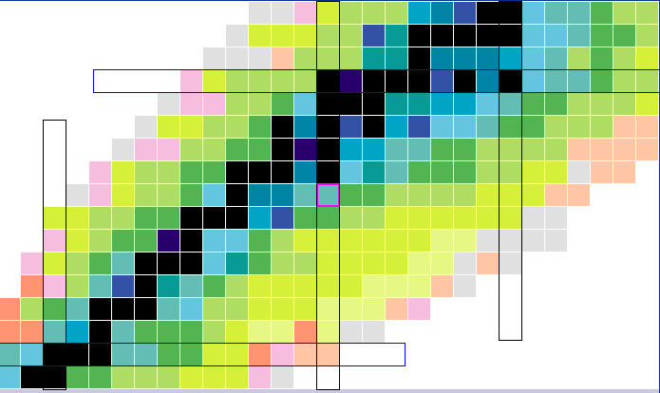
⁴⁸K as a window into shell structure near ⁴⁴P
Wilton Catford & Adrien Matta
Evolution of shell structure near N = 28
⁴⁰Ca
⁴⁸Ca
Z = 20
⁴⁸K
⁴⁴P
proton population inversion
The single-particle structure of ⁴⁸K
insights into the important valence interactions
π(s_{1/2}) - ν(f_{5/2}) etc
Z = 8
N = 28
LINE of N=Z
N = 20

Slide 22
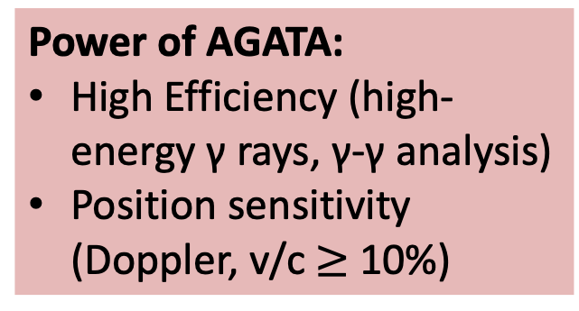
d(⁴⁷K,p)⁴⁸K at SPIRAL1+ A few weeks ago!
Wilton Catford & Adrien Matta
AGATA, MUGAST and VAMOS
10⁶ pps, >99.99% pure radioactive ⁴⁷K beam
Looking for new excited states in ⁴⁸K
π(0s_{1/2}) ⊗ ν(0f_{5/2}) interaction
ONLINE ANALYSIS: Experiment March 2021 (E793s)
Power of AGATA:
High Efficiency (high-energy γ rays, γ-γ analysis)
Position sensitivity (Doppler, v/c $≥$ 10%)
VAMOS-gated AGATA spectrum

Slide 23
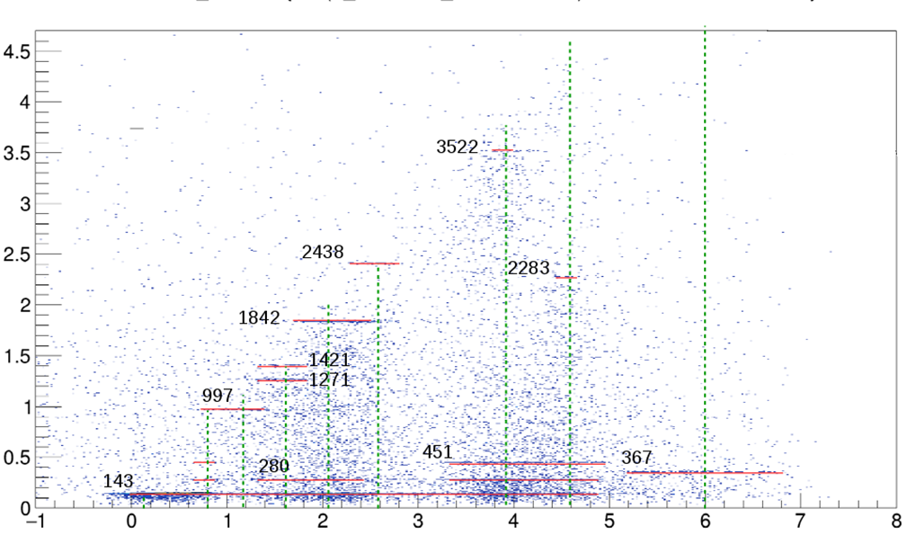
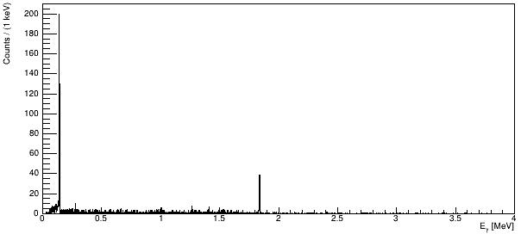
d(⁴⁷K,p)⁴⁸K at SPIRAL1+ A few weeks ago!
Wilton Catford & Adrien Matta
E_{γ}
Thanks to Wilton Catford (Surrey) for the analysis and spectra !
NEWLY IDENTIFIED
STATES &
DECAYS in ⁴⁸K
E_{x}
GATE E_{x}(⁴⁸K) =2.0 MeV
E_{γ}
PRELIMINARY ANALYSIS: Experiment March 2021 (E793s)

Slide 24
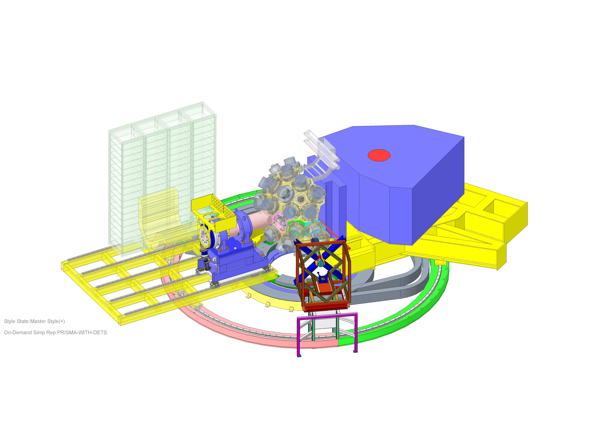



UK AGATA Project (STFC): 2020-24
Νext phases of AGATA (SPES and FAIR)
AGATA triple-cluster modules
Detector prototyping and characterisation
Mechanical support structure
Electronics and Firmware
Pulse-Shape Analysis
Simulation
GANIL
γ-interaction heat map
Support structure at LNL

Slide 25
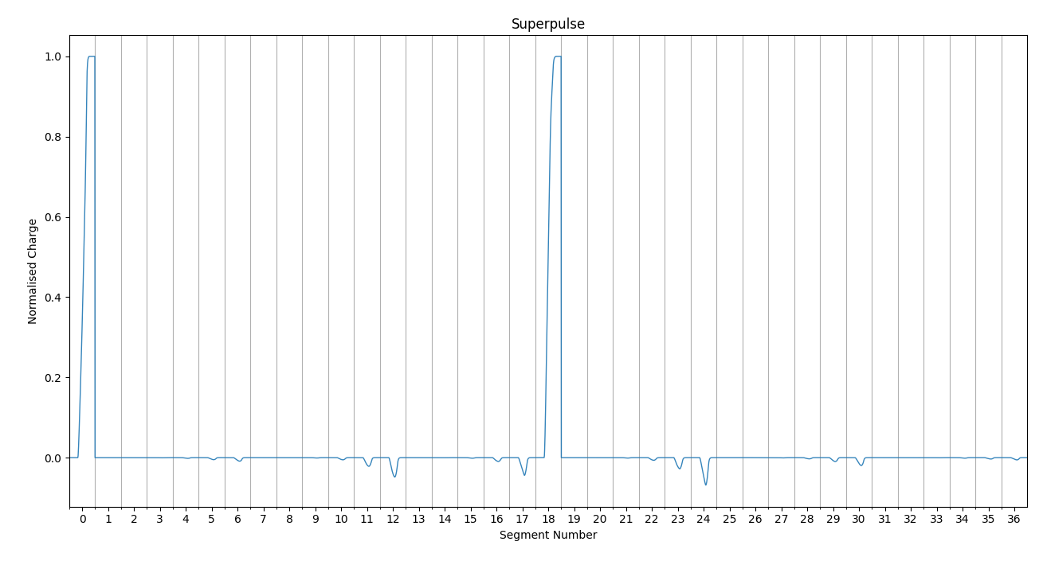
Challenges in pulse-shape analysis
signal basis generation
Experimental (scanning)
Analytical (calculated)
long acquisition times
experimental conditions change
Physics model, Complex Electric fields
Impurity/n-damage
electronics response
temperature etc
simulated detector response in ADL 3.0

Slide 26
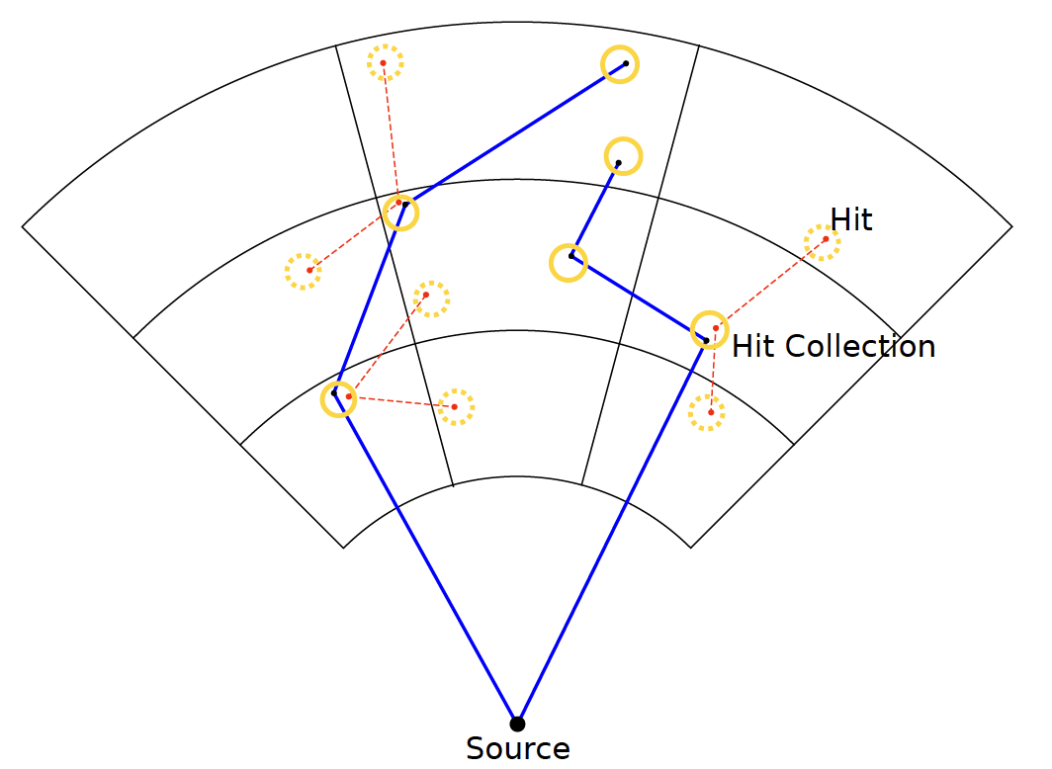
PSA Self-calibration (experimental basis set)
Generate an experimental set of position specific waveforms
High-statistics source data
Iterative process using Compton-tracking
Group interaction points from different gamma-rays into hit collections
Use Compton formula to order interaction points
Define tracks between interaction points that also link the hit collections with each other
Optimise coordinates of hit collection using the tracks that link their constituent points and Compton formula
Sebastien Heil
Stefanos Paschalis
Marina Petri
University of York
S.Heil, S.Paschalis and M.Petri.
Eur. Phys. J. A (2018) 54: 172

Slide 27
Challenges in pulse-shape analysis
signal basis generation
Experimental (scanning)
Analytical (calculated)
long acquisition times
experimental conditions change
Physics model, Complex Electric fields
Impurity/n-damage
electronics response
temperature etc
Signal matching (grid search)
Grid Search
University of Liverpool:
Require positions at resolution $≤$5mm
Require positions at resolution ≤ 5mm
Dataset is ~ 50,000 points (37x121)
PSA-grid search needs to be very fast (~ ms)
Experimental validation of Simulation.
Novel PSA techniques for accelerated Grid Search
Machine Learning for Advanced Signal Inference
High resolution simulations of new detectors.

Slide 28
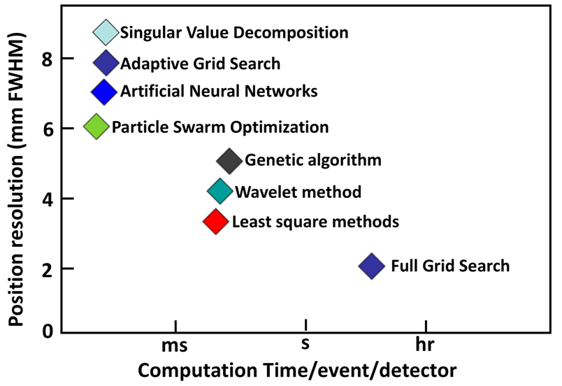
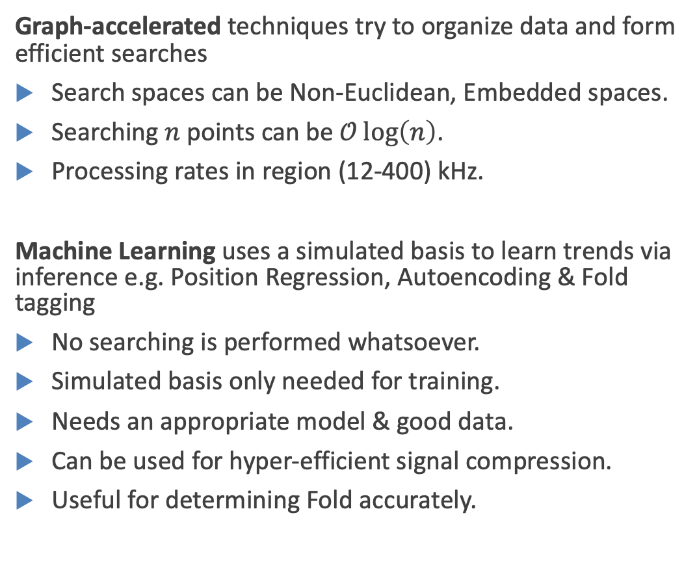
Novel Algorithm Development for PSA
Graph-accelerated techniques try to organize data and form efficient searches
Search spaces can be Non-Euclidean, Embedded spaces.
Searching $n$ points can be $𝒪\log\left(n\right)$.
Processing rates in region (12-400) kHz.
Machine Learning uses a simulated basis to learn trends via inference e.g. Position Regression, Autoencoding & Fold tagging
No searching is performed whatsoever.
Simulated basis only needed for training.
Needs an appropriate model & good data.
Can be used for hyper-efficient signal compression.
Useful for determining Fold accurately.
KD-Trees
CNNs
FAISS
HNSW
Courtesy of Fraser Holloway, University of Liverpool
F.Holloway@liverpool.ac.uk

Slide 29
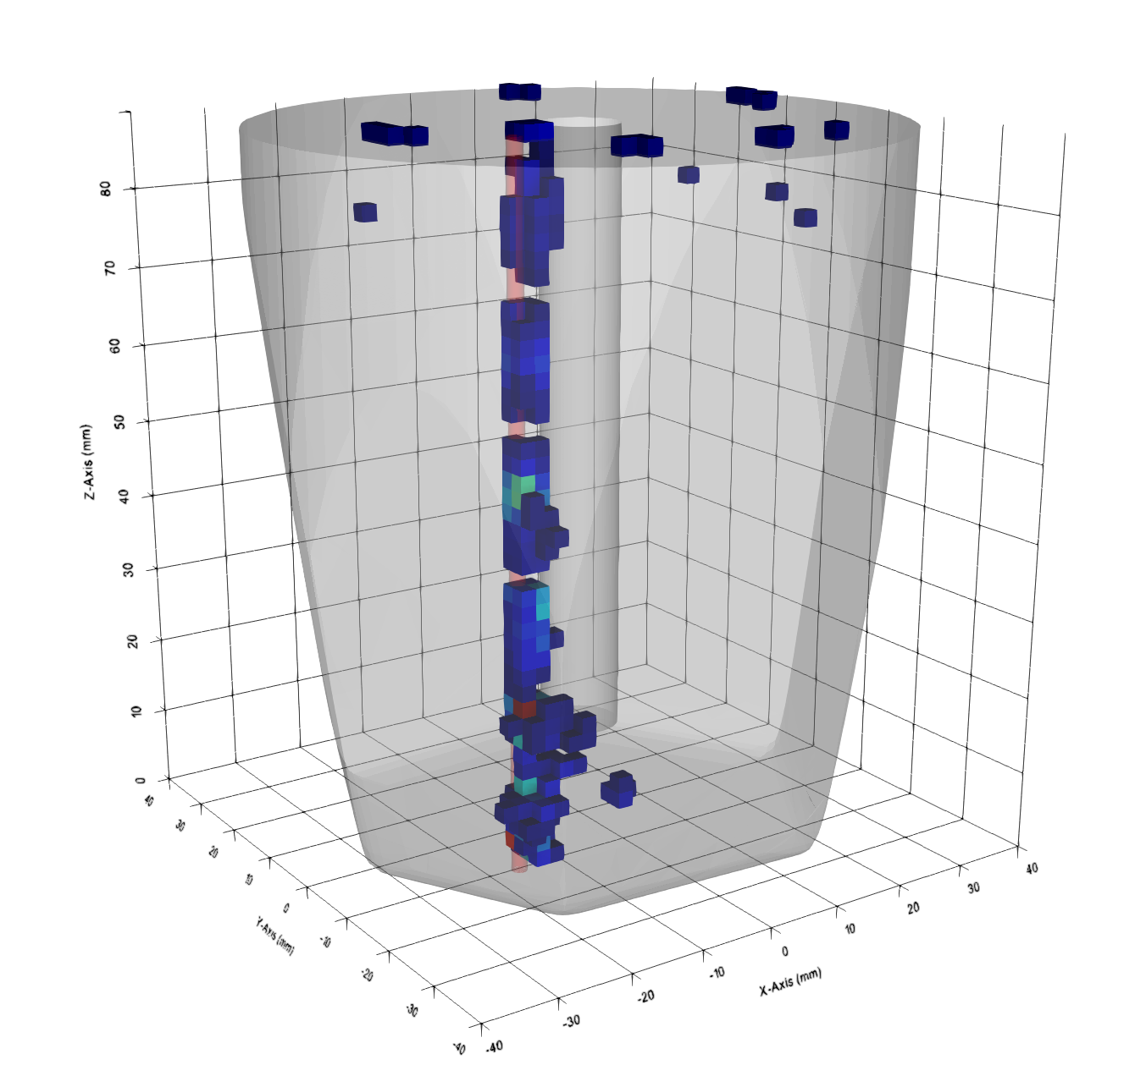
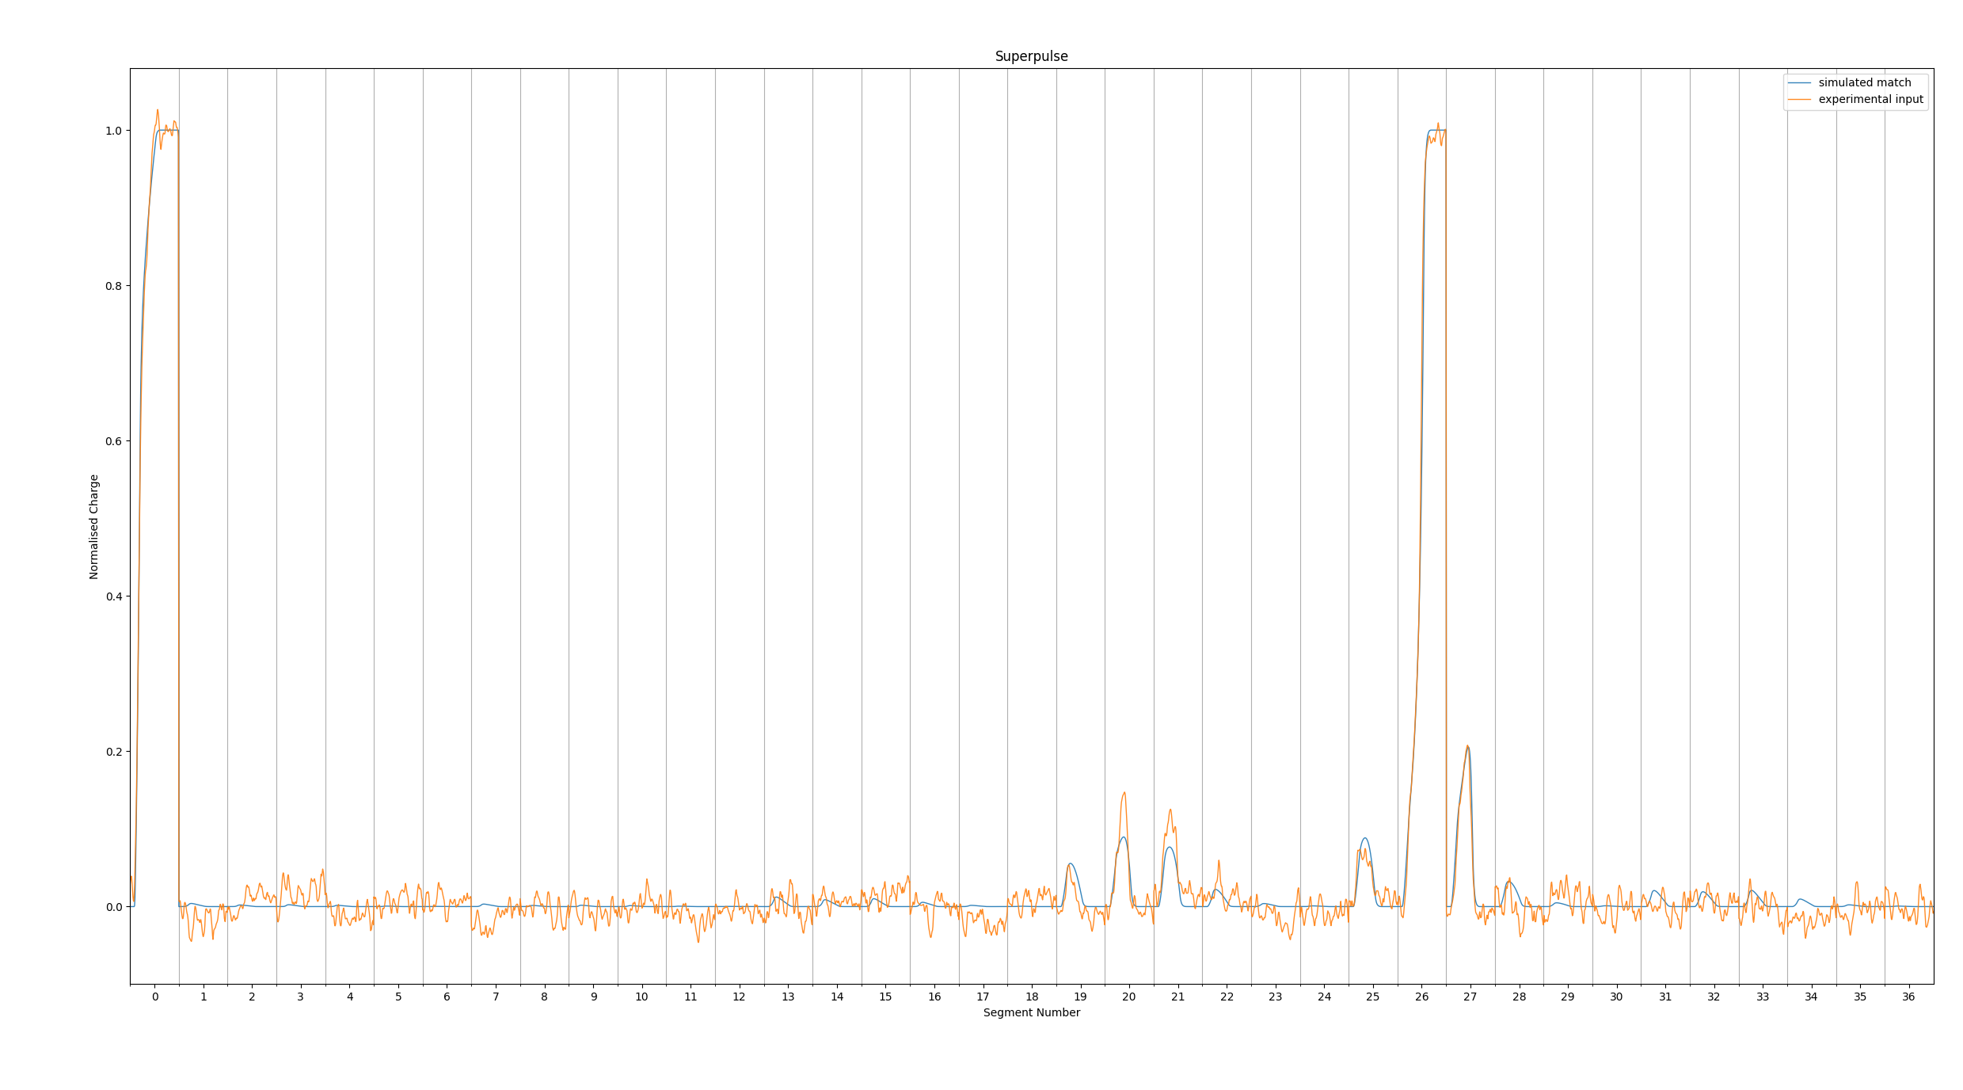
Novel Algorithm Development for PSA
Experimental Results:
Pencil Beam Reconstruction
Example Optimum Solution for k-NN Method
See Fraser’s talk Thursday
F. Holloway
12.15 PM Nuclear Structure 4
Courtesy of Fraser Holloway, University of Liverpool
F.Holloway@liverpool.ac.uk

Slide 30
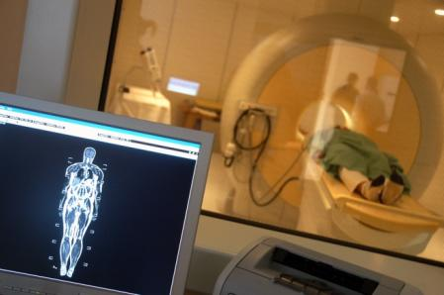


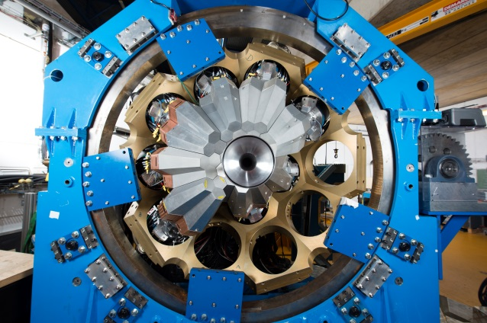

Societal Impact of AGATA technology
Scientific Research Curiosity
Applications
Medical
See Laura Harkness Brennan’s talk
Keynote talk
Thursday 10.00
Security
State of the art detectors
Environment

Slide 31
Conclusions and Thanks
AGATA:
Key device for nuclear physics in Europe
Capabilities enhance future RIB facilities
Huge European technical effort
Thanks:
UKRI-STFC support for AGATA
Staff at GANIL
Slides: Jenn, Wilton, Fraser
AGATA collaboration

Slide 32

Thank you

Slide 33
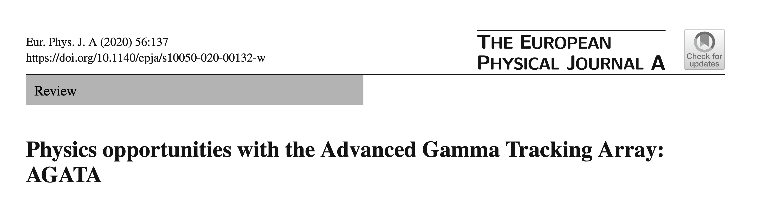
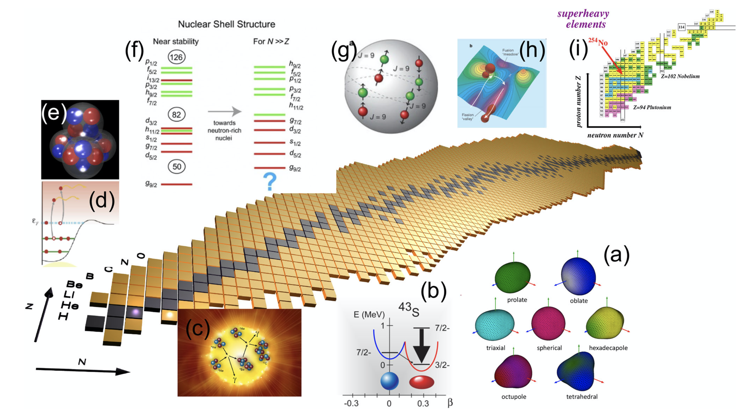
Physics of AGATA
W.Korten et al., Eur. Phys. J A56, 137 (2020)

Slide 35
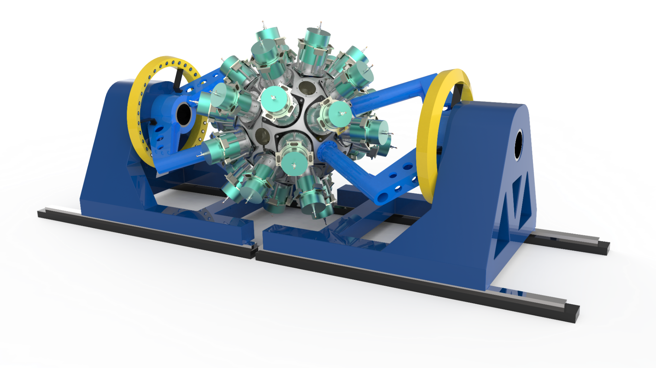
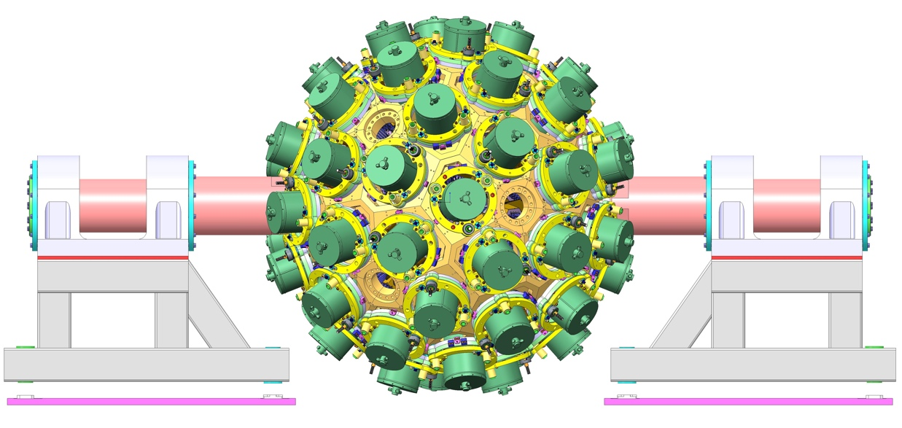
Gamma-Ray Energy Tracking Arrays Worldwide
GRETA (USA)
120 Ge crystals
30 Quad “modules”
~17 cm internal diameter
AGATA (Europe)
180 Ge crystals
60 Triple “clusters”
~23 cm internal diameter

Slide 36
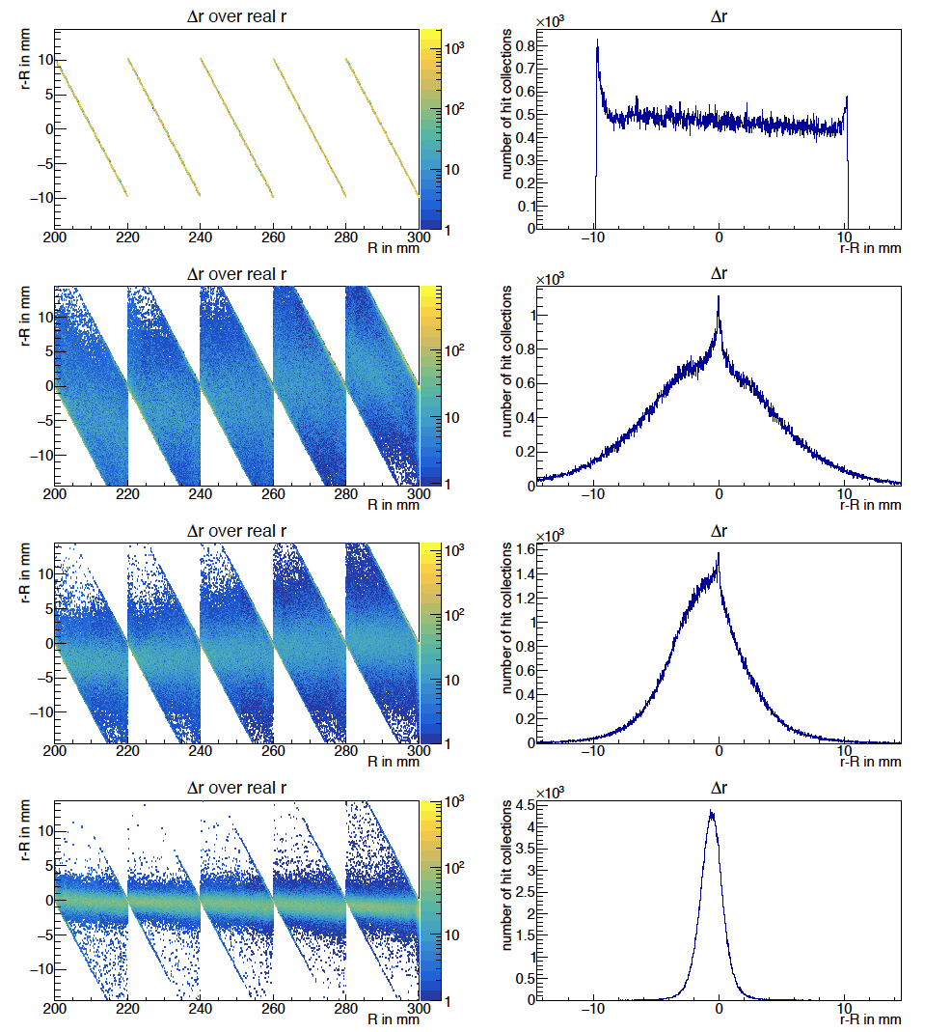
PSA Self-calibration (experimental basis set)
starting condition
University of York:
Demonstrated in simulation only
Needs experimental validation
Detailed analysis underway
Δr [mm]
after 1st iteration
Sebastien Heil
Stefanos Paschalis
Marina Petri
University of York
Δr [mm]
after 2nd iteration
RMS = 1.2 mm
Δr [mm]
after 10th iteration
S.Heil, S.Paschalis and M.Petri.
Eur. Phys. J. A (2018) 54: 172
R [mm]
Δr [mm]

