Slide 1
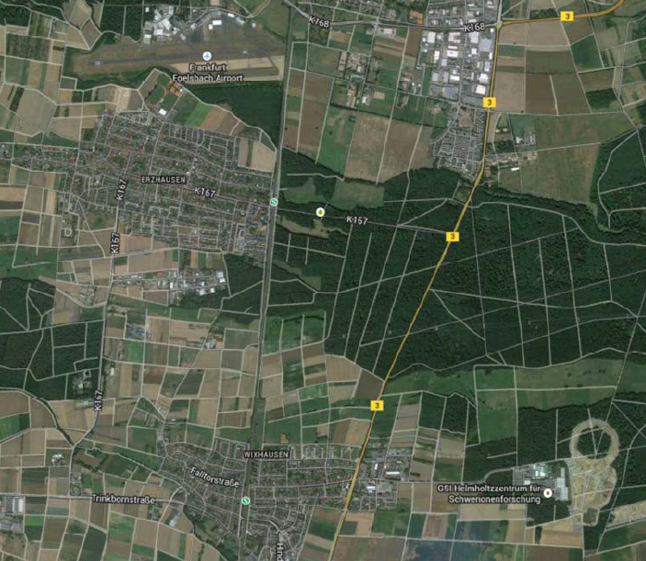
AGATA Collaboration Council Meeting
26th June 2014, GSI

Slide 2
Team | GP | W | D | L | GD | PTS
Deutschland | 2 | 1 | 1 | 0 | 4 | 4
USA | 2 | 1 | 1 | 0 | 1 | 4
Ghana | 2 | 0 | 1 | 1 | -1 | 1
Portugal | 2 | 0 | 1 | 1 | -4 | 1
Draw?

Slide 3
AGATA ACC Agenda 26th June 2014, GSI
Minutes of the last meeting from Liverpool 2013
Outstanding actions
Membership, ACC updates
Data policy
Publication procedure
Publications
Next chairperson
Report from ASC
Report from AMB
Next chairperson
AGATA 2017………
The open meeting and EGAN workshop
Next annual meeting
Any Other Business
Notes:
Huge collaboration
Over 40 laboratories in 10 countries
Others joining, Turkey, Hungary

Slide 4
AGATA ACC Agenda 26th June 2014, GSI
Apologies; Adam Mai (Piotr Bednarczyk) Adriana Nannini (Silvia Lenzi),
Jerome Rupert, Benedict Million (Angela Bracco)
Minutes of the last meeting from Liverpool 2013
Outstanding actions
Ongoing action on ALL: Keep the information on the ACC web page up to date. Supply information on such things as technical publications, student PhD thesis and AGATA presentations to JS.
Ongoing action on ALL: Content in the form of overview presentations has been made available on the web pages, please add your talks where appropriate. The aim is to provide generic talks for those who need slides for AGATA presentations.
Beyond Ganil, 2017….
There is a clear need to have a meeting to discuss this. The meeting could be at the next EGAN workshop in GSI.
ACTION BC + JS
Done GdeA, JS
Notes:
Huge collaboration
Over 40 laboratories in 10 countries
Others joining, Turkey, Hungary

Slide 5
AGATA ACC
Terms of Reference:
The ACC is the advisory body of the ASC on scientific matters concerning the AGATA project.
The tasks of the ACC are as follows:
elects the AGATA spokesperson who will serve for a period of two years.
advises the ASC on scientific matters concerning the AGATA project and the research programme through the AGATA Spokesperson.
nominates the Campaign Spokesperson for each experiment campaign to the ASC.
hold meetings, at least annually, to receive reports from the ASC and AMB on the progress of the project and from the Campaign Spokespersons on the progress of the research programme.
hold an annual open meeting of the AGATA Collaboration to present the status of the Project and to discuss future experiment campaigns.
Administer the data policy
Administer the scientific publications policy
Maintain web pages
Notes:
Huge collaboration
Over 40 laboratories in 10 countries
Others joining, Turkey, Hungary

Slide 6
AGATA ACC
Membership
Bulgaria:
Univ. Sofia Georgi Rainovski rig@phys.uni-sofia.bg
INRNE Sofia Pavel Petkov petkov@inrne.bas.bg
Finland:
Univ. Jyväskylä Rauno Julin rauno.julin@phys.jyu.fi
France:
GANIL Caen Emmanuel Clement clement@ganil.fr
LPSC –IN2P3 Grenoble Jerome Robert rubert@lpsc.in2p3.fr
IPN–IN2P3 Lyon Olivier Stezowski stezow@IPNL.IN2P3.FR
CSNSM–IN2P3 Orsay Joa Ljungvall verney@csnsm.in2p3.fr
IPN–IN2P3 Orsay David verney leblanc@ipno.in2p3.fr
CEA/DSM/IRFU Saclay Wolfram Korten wolfram.korten@cea.fr
IPHC –IN2P3 Strasbourg Dominique Curien curien@ires.in2p3.fr
Germany:
GSI Darmstadt Juergen Gerl j.gerl@gsi.de
TU Darmstadt Norbert Pietralla pietralla@ikp.tu-darmstadt.de,
Univ. zu Köln Peter Reiter preiter@ikp.Uni-Koeln.DE
TU München Roman Gernhaeuser roman.gernhaeuser@ph.tum.de
Hungary:
ATOMKI Barna Nyako nyako@atomki.hu
Italy:
INFN Firenze Adriana Nannini Adriana.Nannini@fi.infn.it
INFN Legnaro Daniel Napoli Daniel.R.Napoli@lnl.infn.it
INFN Milano Benedicte Million Benedicte.Million@mi.infn.it
INFN Padova Silvia Lenzi silvia.lenzi@pd.infn.it
Poland:
IFJ PAN Krakow Adam Maj Adam.Maj@ifj.edu.pl
University of Warsaw (HIL) Krzysztof Rusek Krzysztof.Rusek@fuw.edu.pl
Notes:
Huge collaboration
Over 40 laboratories in 10 countries
Others joining, Turkey, Hungary

Slide 7
AGATA ACC
Membership
Romania:
IFIN/HH Bucharest Victor Zamfir zamfir@tandem.nipne.ro
Spain:
IFIC, CSIC-University of Valencia Andres Gadea gadea@ific.uv.es
Electronic Engineering Department University of Valencia (UVEG) Vicente González vicente.gonzalez@uv.es
IEM, CSIC, Madrid Andrea Jungclaus andrea.jungclaus@csic.es
Department of Fundamental Physics, University of Salamanca Begoña Quintana quintana@usal.es
Sweden:
Chalmers Univ. of Technology Göteborg Andreas Heinz andreas.heinz@chalmers.se
Lund Univ. Dirk Rudolph Dirk.Rudolph@nuclear.lu.se
Royal Institute of Technology Stockholm Bo Cederwall cederwall@nuclear.kth.se
Uppsala Univ. Johan Nyberg johan.nyberg@physics.uu.se
Turkey:
Univ. Ankara Ayse Kaskas aysekaskas@yahoo.com
Univ. Istanbul Ela Ganioglu ganioglu@istanbul.edu.tr
Technical Univ. Istanbul Cenap Ozben ozben@itu.edu.tr
UK:
Univ. Brighton Alison Bruce Alison.Bruce@brighton.ac.uk
Daresbury Laboratory John Simpson john.simpson@stfc.ac.uk
Univ. Edinburgh Phil Woods pjw@ph.ed.ac.uk
Univ. Liverpool Helen Boston A.J.Boston@liverpool.ac.uk
Univ. Manchester Dave Cullen Dave.cullen@manchester.ac.uk
Univ. Surrey Phil Walker P.Walker@surrey.ac.uk
Univ. West of Scotland John Smith John.F.Smith@uws.ac.uk
Univ. York Mike Bentley michael.bentley@york.ac.uk
Notes:
Huge collaboration
Over 40 laboratories in 10 countries
Others joining, Turkey, Hungary

Slide 8
AGATA ACC Data Policy
Definition – Output of the AGATA system
Primary contact for each experiment has to be defined
Ownership AGATA
Spokesperson of AGATA delegates ownership and access to primary contact
Done for Legnaro so far period of two years, needs updating done
All extended to end 2015
GSI to do.
http://npg.dl.ac.uk/agata_acc/AGATA_Data_Policy.html
Exploitation
Annual report to ACC of status of experiment (report at annual meeting)
Publication information to the ACC
Brief report on experiments, send in or keep up to date.
http://npg.dl.ac.uk/agata_acc/AGATA_Data_Policy.html
Notes:
Huge collaboration
Over 40 laboratories in 10 countries
Others joining, Turkey, Hungary

Slide 9
AGATA ACC
AGATA Publication and Publications Policy
Policy defined for Physics and technical publications
Maintain list on AGAA ACC web pages
What else, thesis, reports, talks …..
Technical publications, AMB approval
Publications Policy:
ASC
Core authors for physics papers from Legnaro (156)
List defined
Sign up required
Administration ASC asked ACC
Web based system.
GSI to do. List being defined, co-ordinated through ASC members
Notes:
Huge collaboration
Over 40 laboratories in 10 countries
Others joining, Turkey, Hungary

Slide 10
AGATA ACC
AGATA Publication and Publications Policy Web based system
Created and maintained by Johan Nyberg
https://www.agata.org/physics_publications/
Instructions
Submit paper to Johan Nyberg (copy John Simpson)
Set a deadline for core authors to reply (2 weeks)
List of core authors available after deadline
System works, not totally automatic yet
Notes:
Huge collaboration
Over 40 laboratories in 10 countries
Others joining, Turkey, Hungary

Slide 11
AGATA ACC
AGATA Publications status
Technical Publications, 66 on web pages
Scientific publications, 11 papers on the web page
Recent publication: Track it to the limit, Philip Walker
NATURE PHYSICS Vol. 10 May 2014 (news and views)
Latest activity:
Philipp John et al., Shape evolution in the neutron-rich Osmium isotopes: prompt γ-ray spectroscopy of 196Os
Submitted to PLB
F.C.L. Crespi et al., Isospin character of low-lying pygmy states in 208Pb via inelastic scattering of 17O ions
PRL in press
Notes:
Huge collaboration
Over 40 laboratories in 10 countries
Others joining, Turkey, Hungary

Slide 12
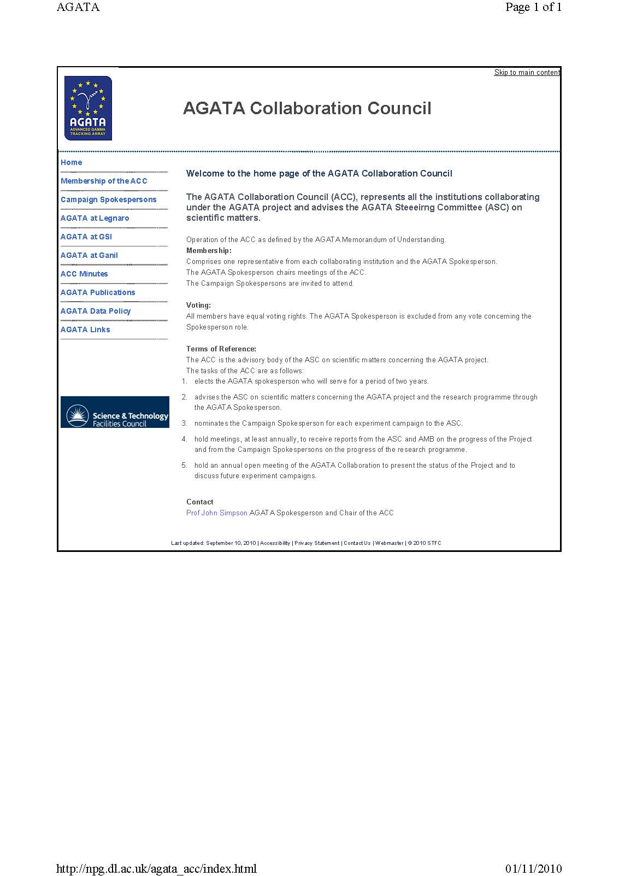
AGATA ACC
Web pages
http://npg.dl.ac.uk/agata_acc/index.html
Comments
Additions
Input
Notes:
Huge collaboration
Over 40 laboratories in 10 countries
Others joining, Turkey, Hungary

Slide 13
AGATA ACC
Report from ASC
Giacomo deAngelis
Notes:
Huge collaboration
Over 40 laboratories in 10 countries
Others joining, Turkey, Hungary

Slide 14
AGATA ACC
Report from the AMB
Andres Gadea
Notes:
Huge collaboration
Over 40 laboratories in 10 countries
Others joining, Turkey, Hungary

Slide 15
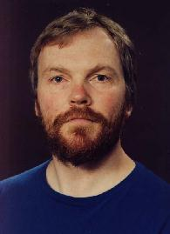
AGATA ACC
Chair of the AGATA ACC and AGATA Spokesperson
Vote took place (Johan Nyberg and Wolfram korten)
37 out of 41 voted
Winner is
Notes:
Huge collaboration
Over 40 laboratories in 10 countries
Others joining, Turkey, Hungary

Slide 16
AGATA 2017…..
Where and When?
Open Call for Laboratory Expressions of Interest for the next campaigns
Ganil, Isolde, Legnaro, Riken
Discussion
Next steps

Slide 17
AGATA ACC
Annual collaboration meetings
EGAN workshop
Format
Comments
Notes:
Huge collaboration
Over 40 laboratories in 10 countries
Others joining, Turkey, Hungary

Slide 18
AGATA ACC
Annual collaboration meeting
2010 Legnaro Discussion at the inauguration
2010 Istanbul LNL Status LoI
GSI LoI
2010 Lyon LNL LoI
SPIRAL LoI
GSI Status
2011 Padova with EGAN
Results
Status and Plans
2012 Orsay with EGAN
Results
Status and plans
2013 Liverpool with EGAN, 24-27 June
2014 GSI with EGAN, 23-26 June
2015 where and when??
Notes:
Huge collaboration
Over 40 laboratories in 10 countries
Others joining, Turkey, Hungary

Slide 19
AGATA ACC
Any other business
Notes:
Huge collaboration
Over 40 laboratories in 10 countries
Others joining, Turkey, Hungary

